Slide 1


Safety During
The Holidays
Notes:
Thank you for including me…
My background – over 25 years of commercial Property and Casualty insurance experience, specializing in marketing, product development, and the utilization of client-facing technologies.
Began career with Willis, then was with Sedgwick which became Marsh, then spent the last 15 years with WGA and came into Gallagher as a merger partner in 2015.
Beyond all my marketing years, I was a producer while at Marsh and when I started at WGA, making me uniquely qualified to know what it takes for all of you to get the kind of opportunities I want to work on with you.

Slide 2

At Home

Slide 3
At Home
Lock your doors and windows, even if you’re only leaving for a few minutes.
When leaving for an extended period of time, have a neighbor or a family member pick up your mail and newspapers.
Indoor and outdoor lights should be on an automatic timer.
Leave a radio or television on so that the house looks and sounds occupied.

Slide 4
At Home
Large displays of holiday gifts should not be visible through the windows and doors.
When setting up Christmas or other holiday displays, make sure doors and passageways are clear inside your home.
Be sure your Christmas tree is mounted on a sturdy base so children, elderly persons, or pets cannot pull it over on themselves.

Slide 5

Driving

Slide 6
Driving
Keep all car doors locked and windows closed while in and out of the car.
Remember to set your alarm.
If you must shop at night, park in a well-lit area.
Avoid parking next to vans, trucks with camper shells, or cars with tinted windows.
Park as close as you can to your destination and take notice of where you parked.

Slide 7
Driving
Never leave your car unoccupied with the motor running or with children inside. NOT EVEN FOR A SECOND!
Do not leave packages or valuables on the seat of your car.
  This creates a temptation for thieves.
  If you must leave something in the car, lock it in the trunk or put it out of sight.
Locate your keys prior to going to your car.

Slide 8
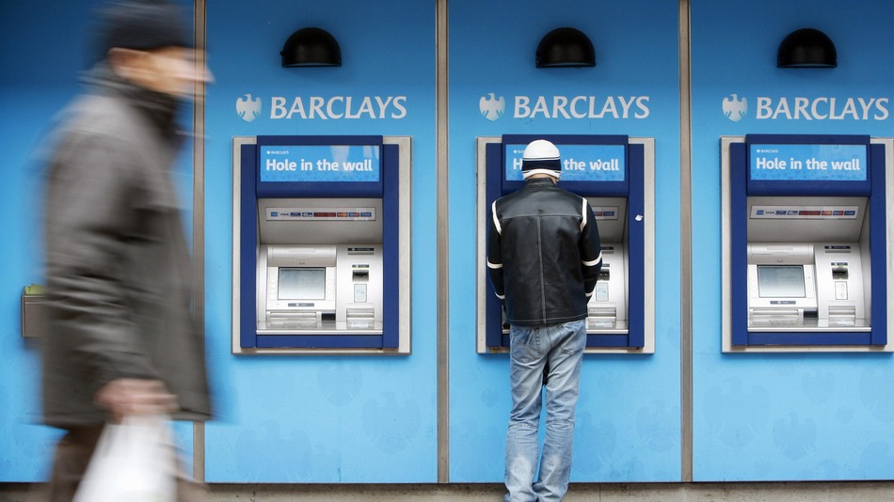
ATM

Slide 9
ATM
If you use an ATM, choose one that is located inside a mall or well-lit location.
  Be aware of bushes and blind spots.
  Withdraw only the amount of cash you need.
Protect your pin number by shielding the ATM keypad from anyone who is standing near you.
Do not throw your ATM receipt away at the ATM location.

Slide 10

Shopping

Slide 11
Shopping
Shop during daylight hours whenever possible.
  If you must shop at night, go with a friend or family member.
Dress casually and comfortably.
Avoid wearing expensive jewelry.
Do not carry a purse or wallet, if possible.
Keep cash in your front pocket.

Slide 12
Shopping
Always carry your drivers license or ID card along with necessary cash, checks, and/or a credit card you expect to use.
Stay alert to your surroundings.
Avoid carrying large amounts of cash.
Pay for purchases with a check or credit card when possible.

Slide 13

Strangers At Your Door

Slide 14
Strangers At Your Door
Be aware that criminals sometimes pose as couriers delivering gifts.
It is not uncommon for criminals to take advantage of the generosity of people during the holiday season by soliciting donations door-to-door for charitable causes although no charity is involved.
Donate to a recognized charitable organization.

Slide 15

Online Shopping

Slide 16
Online Shopping
Online Shopping Dangers
  Identity Theft
  Credit Card Fraud
  Theft
  Counterfeit Goods
These crimes are still more prevalent in the “real” world, but trends are shifting.
Think before you click.

Slide 17
Online Shopping Tips
Choose Credit Over Debit
  Credit cards have much better fraud protection.
  Disposable credit cards are even better.
Verify Website Security
  Some online web sites don’t offer secure shopping.
  Limit yourself to secure sites.
    Look for Https:// instead of Http://
    Secure sites will also have a small lock in the lower right corner of the screen.

Slide 18
Online Shopping Tips
Don’t Shop Publicly
  Don’t use a shared or public computer to shop online.
  Don’t use open or shared networks when shopping online.
Don’t Store Information Elsewhere
  One click shopping is faster, but the risk is greater.
  Data breaches are becoming more and more common.
Shop At Trusted Websites
  If it appears to be too good to be true, it usually is!

Slide 19
S.C.A.M.
(S)tingy: Be stingy about giving out your personal information to others unless you have a reason to trust them, regardless of where you are.
(C)heck: Check your financial information regularly, and look for what should be there and what shouldn’t.
(A)sk: Ask periodically for a copy of your credit report.
(M)aintain: Maintain careful records of your banking and financial accounts.

