Slide 1


Summertime
Safety
Notes:
Thank you for including me…
My background – over 25 years of commercial Property and Casualty insurance experience, specializing in marketing, product development, and the utilization of client-facing technologies.
Began career with Willis, then was with Sedgwick which became Marsh, then spent the last 15 years with WGA and came into Gallagher as a merger partner in 2015.
Beyond all my marketing years, I was a producer while at Marsh and when I started at WGA, making me uniquely qualified to know what it takes for all of you to get the kind of opportunities I want to work on with you.

Slide 2

Summer Safety

Slide 3
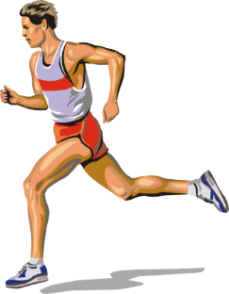
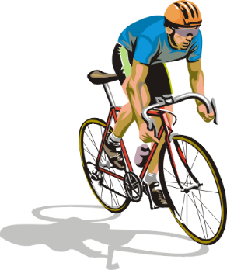
SUMMER SAFETY ISSUES
Heat Injuries
Personal Vehicle Safety
Recreation Safety
Sports Safety
Water Safety
Outdoor Safety

Slide 4
HEAT INJURY
The summer season can be an enjoyable time of the year. It is also a time when the potential for heat injuries increases. Heat injuries are preventable. By following these simple recommendations, it will decrease your susceptibility to them.

Slide 5
HEAT INJURY PREVENTION
Prevention tips include:
Drink plenty of water
Avoid heavy meals at lunch time
Maintain a well balanced diet
Wear appropriate clothing
Use sunscreen
Follow recommended work/rest cycles

Slide 6
HEAT INJURY PREVENTION
Prevention tips include:
Keep areas well ventilated
Schedule outdoor activities during the cooler part of the day
Use the buddy system
Monitor those at risk
Use common sense

Slide 7
SUNBURN PREVENTION
To prevent sunburn:
Use sunscreen - reapply frequently
Moderation - avoid extended exposure during peak hours (1000-1600)
Avoid repeated exposure
Seek medical care if severely burned

Slide 8
HEAT RASH
CAUSE
Skin irritation caused by excessive sweating in a hot, humid environment
SYMPTOMS
Appears as a cluster of pimples or small blisters: neck, groin area; under breasts & arms; and skin creases
TREATMENT
Baby powder with corn starch
Cool shower - avoid lotions – change
clothes frequently

Slide 9
HEAT CRAMPS
CAUSE
Excessive loss of salt from the body
SYMPTOMS
Painful cramps of the major muscle groups
(arms, legs, or stomach)
TREATMENT
Provide cool water - shade - monitor

Slide 10
HEAT EXHAUSTION
CAUSE
Excessive loss of salt and water in the body
SYMPTOMS
Profuse sweating Headache
Weakness Paleness
Cool moist skin
Tingling sensation in extremities
TREATMENT
Provide water, shade, elevate feet, monitor condition, and seek medical attention immediately

Slide 11
HEAT STROKE
CAUSE
The body’s heat regulatory mechanism stops
SYMPTOMS
Headache Dizziness
Delirium Weakness
Nausea Red, hot skin
Unconsciousness
SEEK MEDICAL TREATMENT IMMEDIATELY
Put in cool shaded area
Soak clothing
Fan, and elevate feet
Massage extremities

Slide 12
PERSONAL VEHICLE SAFETY (PVS)
Factors that influence our risk:
Age
Seatbelts
Alcohol / Drugs
Fatigue
Location
Speed

Slide 13
PVS
Age is a contributing factor:
Ages 18 – 24:
People who are at the highest risk. Risk of involvement in a fatal crash of those who are 18-24 is nearly 4 times greater than any other age group.

Slide 14
PVS – Cont’d
Seatbelts
Seatbelts prevent deaths in 42% of all potentially fatal crashes.
Add an air bag to the buckled seatbelt and you increase your odds of surviving the crash to 47%.

Slide 15
PVS – Cont’d
Alcohol
The intoxicated driver is 15x more likely to be involved in a crash and to be fatally injured than a sober driver.
About 48% of all traffic fatalities involve an intoxicated or alcohol impaired person.

Slide 16

PVS – Cont’d
Fatigue
Drivers between the ages of 18-24 are at special risk with over 56% of fatal crashes involving fatigue or falling asleep at the wheel.

Slide 17

PVS – Cont’d
Location
Statistics show that travel on interstates is safer than two lane roads.
The fatality rate for travel on roads where high speed is possible increases the fatality rate by 30%.

Slide 18
PVS – Cont’d
Speed Kills
The faster a car is going, the more distance and time it takes the driver to stop.
Speeding also reduces the amount of time a driver has to react, and reduces the ability to safely negotiate the road.

Slide 19
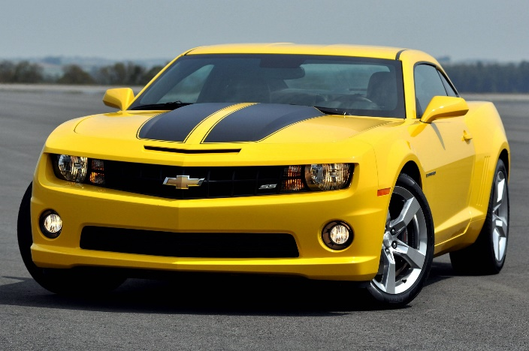
PVS TIPS
Don’t drink and drive
Use a designated driver
Wear seatbelts
Obey the speed limit
Don’t drive when you’re tired
Take rest breaks

Slide 20

PVS TIPS – Cont’d
Adjust speed for conditions
Don’t follow too close
Maintain your vehicle
Drive defensively
Avoid using cellular phone while driving.

Slide 21
RECREATIONAL SAFETY
Get in shape, start slowly
Choose exercise appropriate for your
age and conditioning
Start with warm-up
Finish with cool down
Know your exercise limits
Dress appropriately

Slide 22
SPORT INJURIES
Before taking the field, consider the following:
Warm up
Stay physically fit
Players who are fit are less prone to accidents
Wear appropriate shoes and socks
Wear knee pads to protect knees
Participate only in games at your skill level
Ensure playing surface is safe and bases are secure

Slide 23
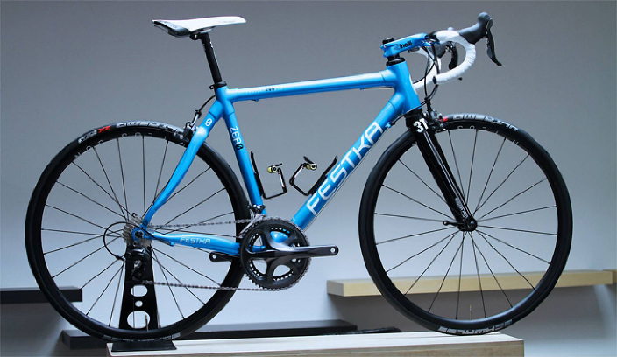
BICYCLE SAFETY
Bicycle crashes result in 800-900 deaths per year
90% of bicycle-related deaths involve collisions with motor vehicles
Before you ride……..
  Inspect your bicycle for serviceability
  Wear a helmet
  Inflate tires properly
  Check your brakes

Slide 24
BICYCLE SAFETY - cont.
When you ride:
See and be seen – (light colored clothing)
Carry a backpack with essential repair tools
Avoid riding at night
Ride single file with traffic and obey traffic signs
Use hand signals
Stay alert for road hazards
Watch for motorists
Stay out of driver’s blind spots

Slide 25
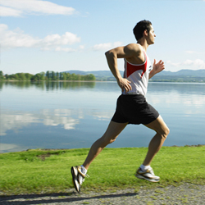
JOGGING SAFETY
Pace yourself
Good running shoes are essential
Always jog against traffic
Be seen while running, wear reflective material
Finish with cool down
Headphones are hazardous where vehicle traffic occurs

Slide 26

WATER SAFETY
Drownings:
Are a leading cause of death
Most often occur during recreational swimming in unauthorized swimming areas after dark
Frequently related to alcohol use
Be safe around water

Slide 27
WATER SAFETY TIPS
Learn to swim and know “your limits”
Use the buddy system
Swim in supervised areas
Obey “NO DIVING” signs
Don’t drink and swim
Wear life preservers when boating and fishing
Know the weather conditions
Use common sense - don’t swim after eating, while chewing gum or after drinking

Slide 28
Watch out for the “Dangerous Too’s”
      Too tired
      Too cold
      Too far from safety
      Too much sun
      Too much strenuous activity

Slide 29

BOATING
Most boating mishaps involve capsizing, falls overboard, and collisions.
About 90% of all fatalities are caused by drowning.
In nearly all cases, life preservers were NOT used.

Slide 30
BOATING LIMITS
Limit loading your boat to recommended
weight
Limit movement inside the boat
Limit boating to safe weather and water conditions

Slide 31
BOATING SAFETY TIPS
Yield right of way
Be aware of others
Avoid alcohol
Maintain a safe speed
Don’t overload
Don’t loan to inexperienced operators
Wear proper clothing
Ensure proper maintenance

Slide 32
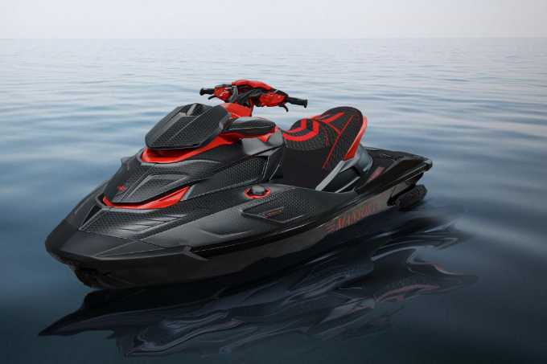
JET SKIS
“Jet Skis” or “personal watercraft” are classified as Class A inboard boats.
What does that mean?
It means that they are subject to the same rules and regulations as any other power boat.

Slide 33
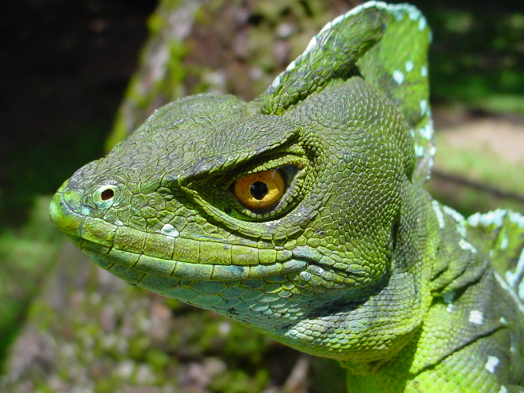
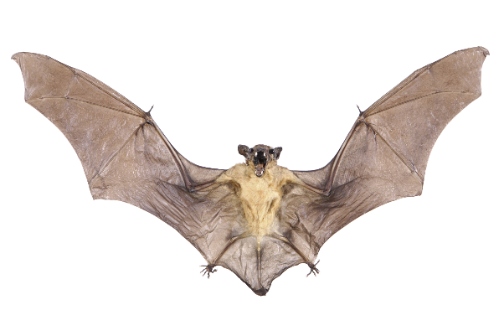
ANIMALS AND REPTILES
To prevent potential rabies exposure, avoid wild animals, bats, and domestic animals that are unknown to you or that display strange behavior.

Slide 34
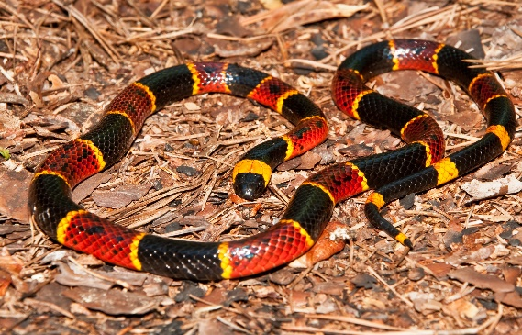
ANIMALS AND REPTILES
Poisonous snakes
Several types of dangerous snakes and spiders are indigenous to this area to include rattlesnakes, black widow, and brown recluse.
Treat all snakes and spiders as if they are poisonous. Most bites result from handling or aggravating snakes.

Slide 35
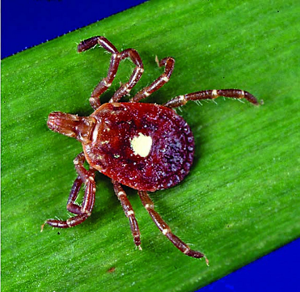
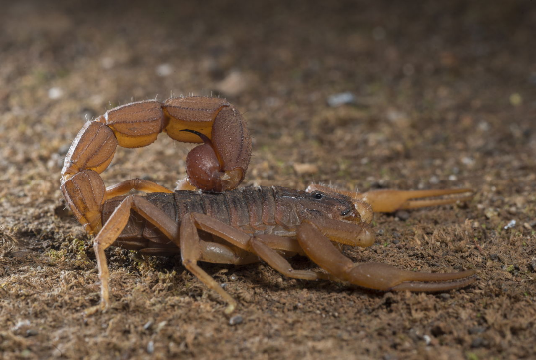
INSECTS
Identify individuals who are allergic to insect bites or stings and ensure that they have an emergency first-aid kit on hand.
When camping, inspect bedding before use, and avoid sleeping or leaving clothes in damp places.
Food and crumbs attract insects.
Use insect repellent (follow directions).

