Slide 1
CDBG-CV HVAC Improvements 2021 Grantee Workshop
Office of Community Development
Local Government Assistance
August 4, 2021

Slide 2
Introduction of Staff
Traci Watts –Director
Heather Paul – Assistant Director
Kimberly Rogers – Policy and Program Coordinator
Kristie Galy – Program Manager
Jefferson Tessier – Engineer
William Hall – Financial Analyst/ Program Specialist

Slide 3
Staff
Janelle Dickey – Financial Analyst
Victoria Cavalier – Financial Analyst
Fenishia Favorite – Community Development Specialist
James Martin - Community Development Specialist
Layla Argrave – Community Development Specialist
Denease McGee – Community Development Specialist

Slide 4
Questions & Answers/ Technical Assistance
Answered by:
OCD STAFF
PLEASE TYPE ALL QUESTIONS IN THE CHAT BOX

Slide 5
Grant Agreement Conditions
Presented by:
Jimmy Martin

Slide 6
Grant Agreement Conditions
You will receive via mail and email:
  Authorization to Incur Costs letter:
    Authorizes planning and administration costs
    Permits Environmental Review Record (ERR) to begin
    Permits Plans & Specifications to be prepared
    Describes penalties for not meeting deadlines
    If there will be a problem with the time frame, contact your grant representative early to request an extension of time
    DO NOT ADVERTISE FOR BIDS OR BEGIN CONSTRUCTION AT THIS TIME.

Slide 7
Grant Agreement Conditions (continued)
  *Transmittal of Blank Grant Agreement – instructions for each item below are in the cover letter
  *Sign the Grant Agreement and return within 30 days.
  DO NOT DATE THE GRANT AGREEMENT.
  *Additional forms needed to complete the grant agreement:
    One (1) Authorized Signature Form – list at least 2 people who will sign the Request for Payment Form. The certifying officer signs & dates the form. Make sure the typed signatures exactly match the written signatures including initials. Send a council resolution if the certifying officer is not the mayor or parish president.
    Electronic Funds Transfer (EFT) - Contact the Office of Statewide Reporting and Accounting Policy (OSRAP) at DOA-OSRAP-EFT@la.gov or 225-342-1097 for the enrollment form. Do not use an existing form.
    Voided Check - Send with the EFT Form to OSRAP
    Request for Vendor Information – Include bank information
    Form W-9

Slide 8
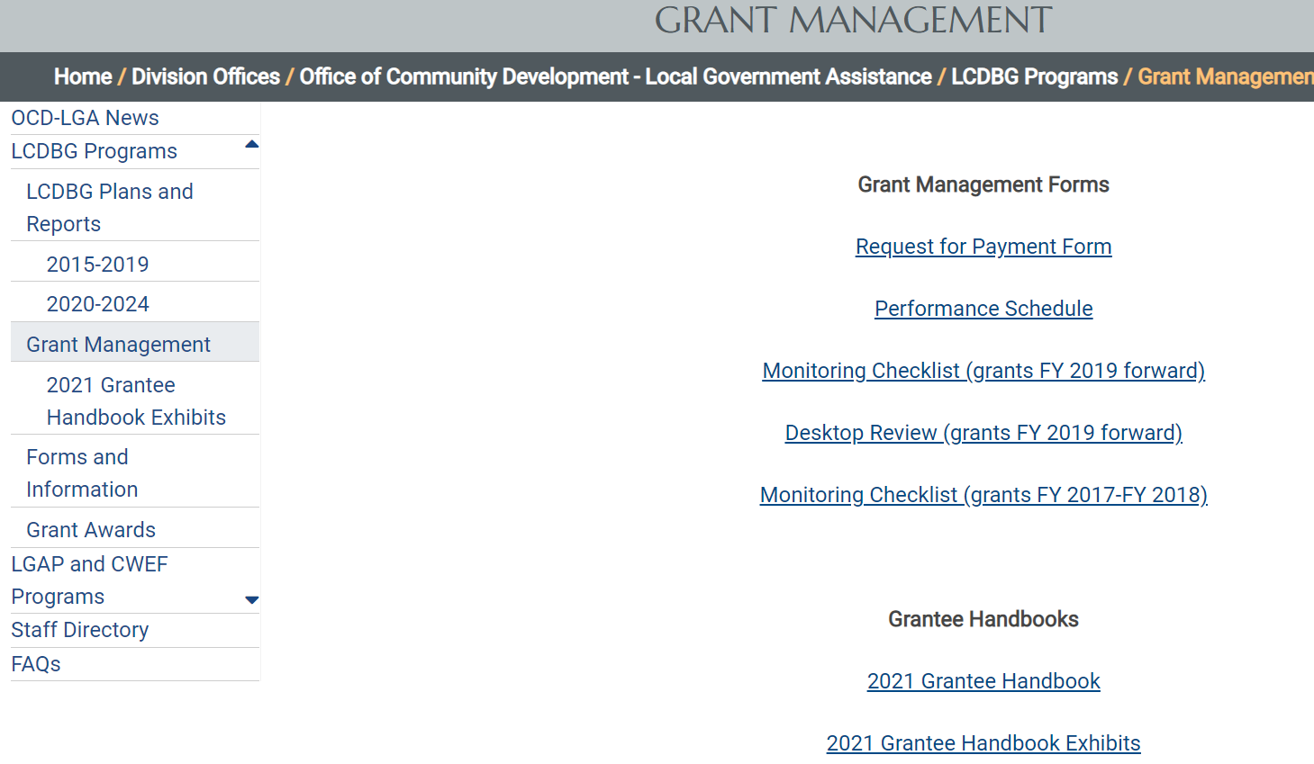
Where are the forms?
https://www.doa.la.gov/doa/ocd-lga/lcdbg-programs/grant-management/

Slide 9
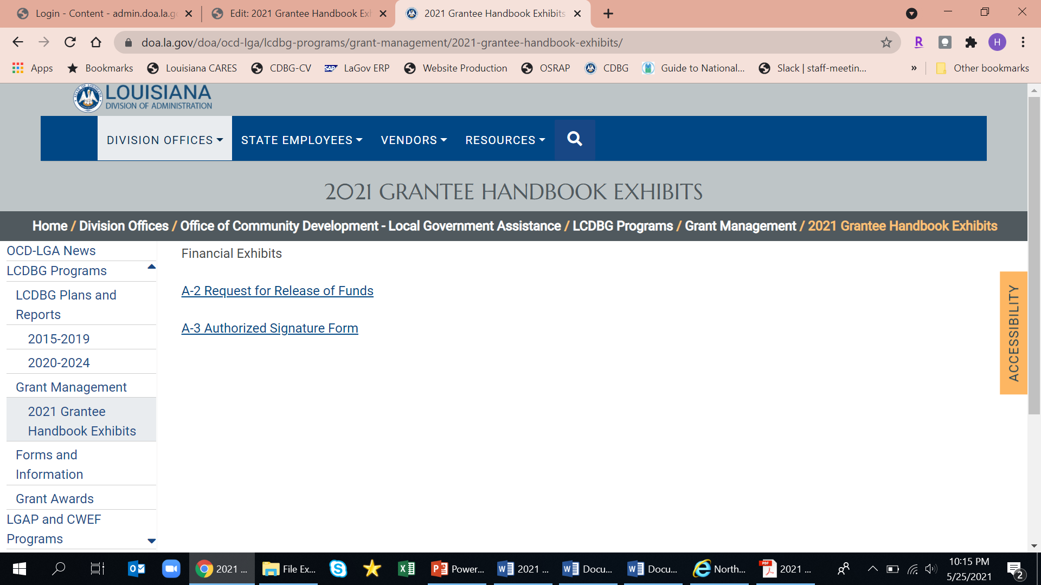
Where are the forms (Cont’d)

Slide 10
Next Steps
  Application Revisions Letter – Clear Grant Agreement Conditions
  FOUR MONTH DEADLINE (from the date on your AIC letter) – November 15, 2021
    Annual Audits, Financial Mgt. Questionnaire (FMQ), Surety Bonds
    Environmental Review Record – must receive authority from OCD to publish final notice(s) and request release of funds by deadline
    Performance Schedule
    Fair Housing Assurance
    Section 504 Assurance
    Residential Antidisplacement and Relocation Plan and Certification
    Revisions to Application
    Plans & Specs and Final Cost Estimate – must only be submitted to OCD by deadline
    Any other documentation, if requested by OCD

Slide 11
Risk Analysis
Based on various factors, the grantee has been identified as a high risk grantee. Therefore, the OCD will make an on-site technical assistance visit prior to conducting the monitoring of this grant. During this visit, the OCD staff will work with the grantee to ensure that all compliance areas are adhered to as required.
Based on various factors, the grantee has been identified as a medium risk grantee. Therefore, the grantee can request an on-site technical assistance visit prior to the date that OCD schedules to monitor this grant. During this visit, the OCD staff will work with the grantee to ensure that all compliance areas are adhered to as required.
Based on various factors, the grantee has been identified as a low risk grantee. Technical assistance will be provided on an as needed basis.

Slide 12
Contacts
  Jimmy Martin
  (225) 342-7412

Slide 13
Financial Management
Presented by:
Janelle Dickey

Slide 14
Financial Management Section of Grantee Handbook
  Complete Requirements and forms are in the Grantee Handbook beginning on page 7.

Slide 15
Accounting
  Source Documentation – maintain evidence of expenditures of LCDBG funds paid to contractors and other parties.
  Surety bonding or fidelity insurance is required on those employees authorized to sign checks.
  The best way for LCDBG funds to be recorded by the grantee is in a separate Capital Projects fund or a separate Special Revenue fund.
    CDBG regulations specifically require that financial reporting establish that funds were used for an eligible activity and clearly establish that funds were not used for ineligible purposes (ex. General Government or Operating and Maintenance expenses are not eligible expenses).

Slide 16
Cash Management and Payments
2 CFR 200.305

Slide 17
Bank Account
Maintain a separate bank account for each grant – for all transactions including deposits & payments to vendors.
Must be a non-interest bearing account.
Use pre-numbered checks, not counter checks. (Unused checks may be used for future grants. Void about 3-4 checks to create a clean sequence break.)
Two signatures are required on all checks – DO NOT PRE-SIGN.
Write the LCDBG Grant Agreement (contract) number on the check.

Slide 18
Clearing Account
Prior written approval must be obtained for use of a “general” or “central” bank account.
All invoices must be paid in advance.
Checks must clear prior to reimbursement.
Separate financial statements for LCDBG funds must still be produced.

Slide 19
Internal Controls and Bonding
2 CFR 200.303
2 CFR 200.304

Slide 20
Financial Management Questionnaire
List the people who actually perform various financial duties on the Financial Management Questionnaire (FMQ).
Make sure that at least two people are listed as authorized to sign Requests for Payments (RFPs).
Make sure that at least two people are listed as authorized to sign checks, that they are the only ones signing them, and that they are either insured or bonded.
Person responsible for preparing fiscal year-end financial statements should have the skills and knowledge to apply Generally Accepted Accounting Principles (GAAP).
If there are changes in personnel, a new FMQ must be submitted for approval.

Slide 21
Surety Bond/Insurance Policy
Generally, the people who handle financial transactions should be insured or covered by a surety bond.
Typically, the Elected Official, (Mayor or Parish President), the Financial Officer and/or the Clerk are covered by the Surety Bond or Insurance Policy.
Specifically, those authorized to sign checks must be covered.
Include a current copy of the Surety Bond/Insurance Policy that specifically identifies the persons and/or positions insured with the Financial Management Questionnaire.
If the FMQ is updated, documentation of current bonding is also needed.

Slide 22
Audit Requirements
2 CFR Part 200 Subpart F
“…standards …for the audit of non-Federal entities expending Federal awards.”
Yes, LCDBG funds are Federal Funds

Slide 23
Audit Requirements
2 CFR 200.501
“Single audit. A non-Federal entity that expends $750,000 or more during the non-Federal entity's fiscal year in Federal awards must have a single audit conducted…”
$750,000 in total Federal expenditures, not just LCDBG

Slide 24
Audit Requirements
2 CFR 200.508
It is the grantee’s responsibility to:
Procure or otherwise arrange for the audit.
Prepare appropriate financial statements, including the schedule of expenditures of Federal awards.
Provide the auditor with access to personnel, accounts, books, records, supporting documentation, and other information.
Promptly follow up and take corrective action on audit findings.
Note: If extension has been granted by the LLA, send a copy of LLA’s approval to the LGR.

Slide 25
Audit Requirements
LCDBG funds should be reported in a separate Capital Projects fund or a separate Special Revenue fund.
LCDBG revenue and program expenditures must be clearly identified.
LCDBG funds utilized for each project should be separately identified.
If LCDBG funds are reported in or transferred to the enterprise/proprietary fund, or are otherwise not reported separately from other sources of funds, a supplemental schedule, containing agreed upon procedures, a balance sheet, and income statement, should be included in the back of the audit report.

Slide 26
Audit Requirements
Grantee will be placed on the Louisiana Legislative Auditor’s (LLA) Non-Compliance List if the audit is not received by the LLA within 6 months of the fiscal year end date.
Note: If grantee is on LLA’s Non-Compliance List, they cannot receive LCDBG funds.

Slide 27
Requests for Payments (RFP)
Requesting Program Funds From the State Office of Community Development-Local Government Assistance (OCD-LGA)

Slide 28
Request for Payment Form
Request for Payment Form – Available on-line at:
    https://www.doa.la.gov/doa/ocd-lga/lcdbg-programs/grant-management/
Signatures must match the Authorized Signature Form exactly as typed and signed, including middle initials and titles, (examples: Dr., Sr., or Jr.)
If there is a personnel change, please send us a new Authorized Signature Form and Financial Management Questionnaire.

Slide 30
RFP Form Procedures
  Fill out the spreadsheet
  Print 2 copies
  Sign both in blue ink
  Attach approved invoices
  Mail to the OCD-LGA

Slide 31
Invoices
Must be submitted with all Requests for Payment.
Must identify the date the goods and/or services were received.
If goods are provided, the vendor must identify the item(s) quantities and unit costs.
For services rendered, the vendor must state the time period covered by the invoice.
For professional services (2 CFR 200.459), the vendor must identify the task, the effort (in hours), and the hourly rate.
Beginning and ending dates should be on all invoices.

Slide 32
Invoices
If “other” money is covering part of the invoice, identify the LCDBG portion and the “other” portion.
Example: City funds $5,000
LCDBG funds $8,000
Total $13,000
Invoices must be signed, indicating approval, by the person listed with that responsibility on the Financial Management Questionnaire.

Slide 33
  You can monitor deposits online at DOA-OSRAP website.
HERE’S HOW….

Slide 34
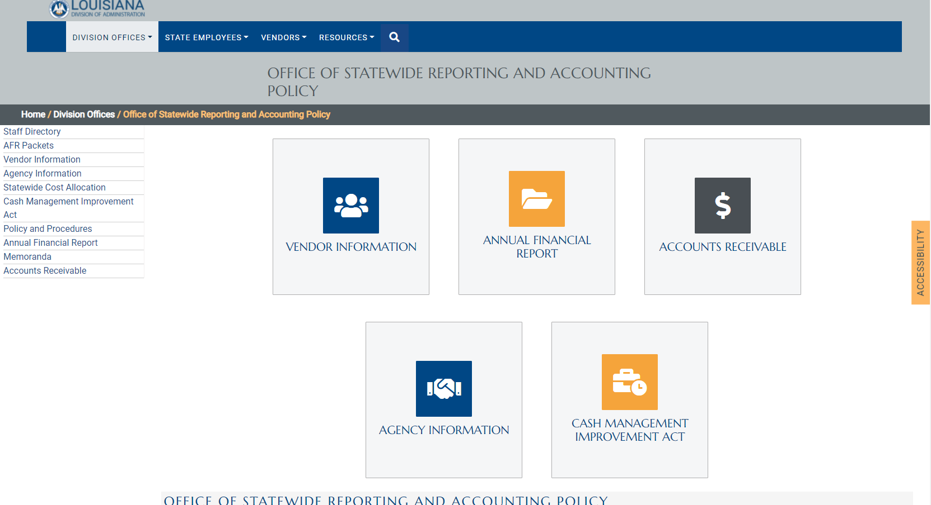
Office of Statewide Reporting and Accounting Policy (OSRAP) – Click “Vendor Information” https://www.doa.la.gov/doa/osrap/
Notes:
Click “Find Payments”.

Slide 35
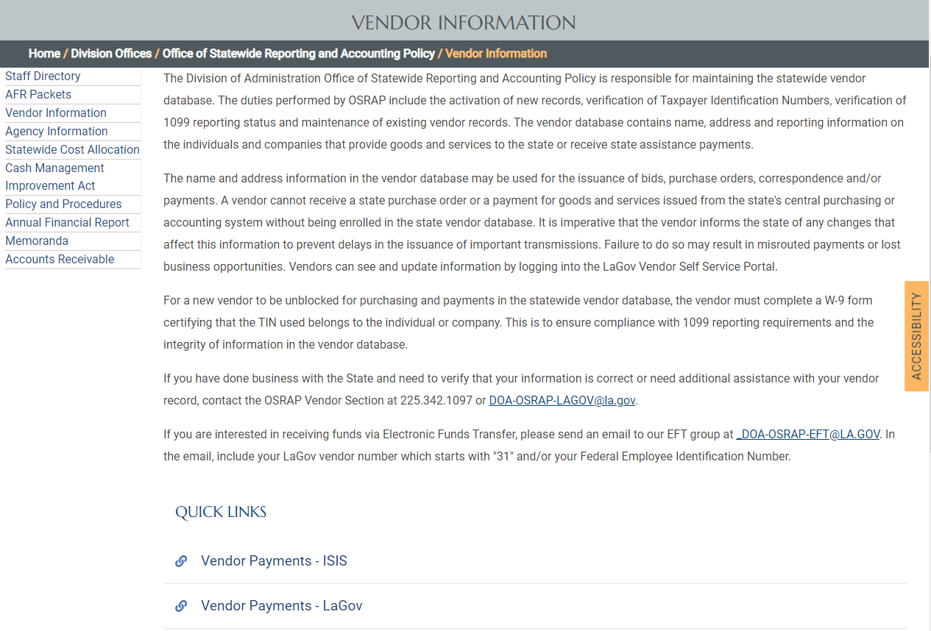
Then “Vendor Payments – ISIS”

Slide 36
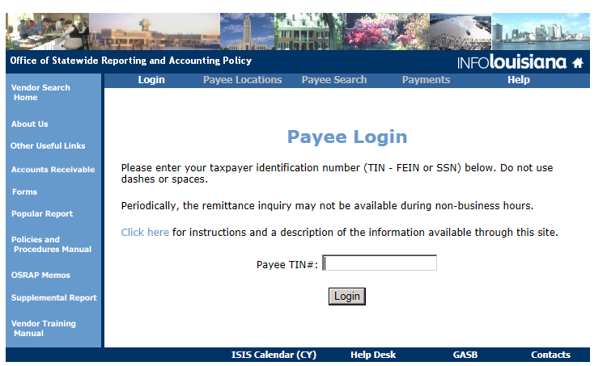
Enter Taxpayer Identification Number (TIN).
Notes:
…then click “Login” or hit “Enter” button on keyboard.

Slide 37
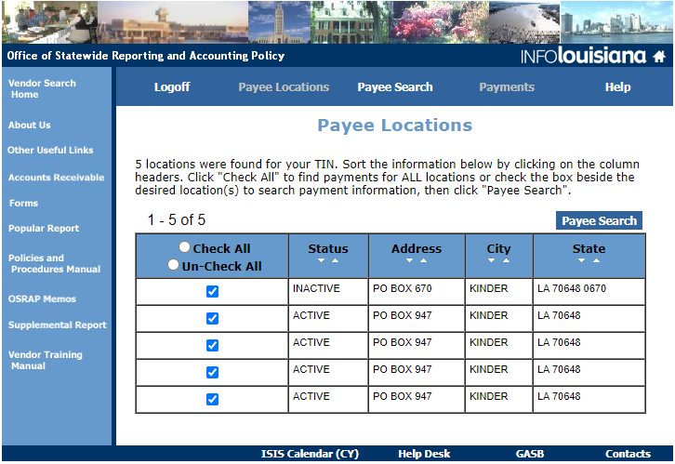
Click the “Check All” box, then “Payee Search.”
Notes:
…then click “Payee Search”.

Slide 38
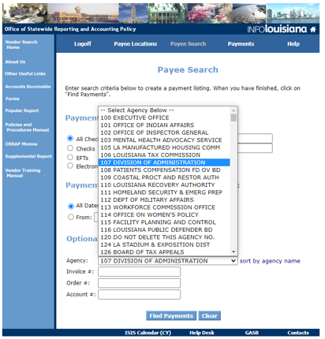
Under Optional Selection Criteria/Agency choose:
107 DIVISION OF ADMINISTRATION (DOA), then “Find Payments.”
Notes:
…then click “Find Payments”.

Slide 39
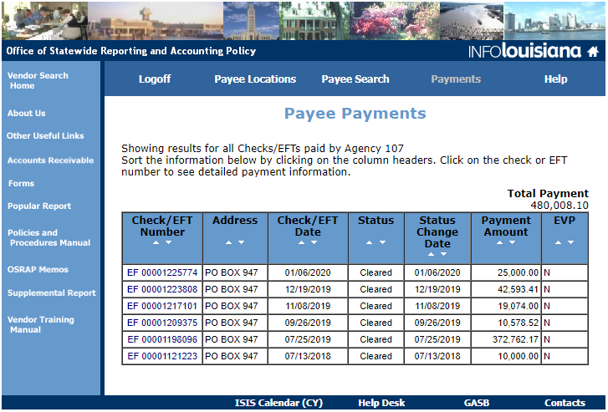
You get a listing of all DOA payments. More detail can be found by clicking the Check/EFT Number.

Slide 40
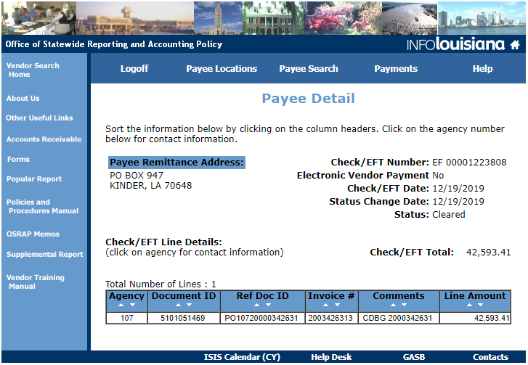
This shows CDBG Grant Agreement (contract) #2000342631 paid on 12/19/19 in the amount of $42,593.41.

Slide 41
Receipt of Requested Funds
If the RFP is processed by Thursday afternoon, the money should be in the LCDBG account the following Friday.
When expecting LCDBG funds, monitor the LCDBG account closely to see if funds were deposited.
3-Day Rule: Vendors must be paid within 3 business days of funds being deposited.

Slide 42
Program Income
24 CFR 570.489(e) & 24CFR 570.504
Gross Income that is generated by the use of LCDBG funds.
  For example: Sale of firetrucks purchased by a previously funded grant or interest earned on LCDBG funds incorrectly deposited into an interest bearing account.
  Any program income earned as a result of the LCDBG Program must be submitted to the State.
  Contact the OCD for instructions if program income is received or if there is a possibility that it will be received.

Slide 43
Monitoring
For monitoring purposes – we need current & accurate financial records including:
  Chart of Accounts for either a Special Revenue Fund or Capital Projects Fund
  General Ledger (Including All Transactional Detail by Account)
  Statement of Revenues, Expenditures and Changes in Fund Balances
  Balance Sheet
  All Bank Statements within timeframe of LCDBG Account Activity – from award through closeout – and all checks.
  Documentation of current bonding or other insurance for individuals signing checks.

Slide 44
Frequent Findings or Concerns
Unauthorized individuals performing financial functions.
Not providing documentation of current bonding or insurance for persons signing checks.
Using a clearing account without written permission.
Using a separate LCDBG bank account for deposits, but not for disbursements.
Depositing “other” funds in LCDBG account, not related to the same project.
Using an interest bearing account.
Violating the 3-day rule.
Not reporting LCDBG revenue and expenditures separately and clearly in year-end audited financial statements.
Not ensuring timely submission of audits to the Louisiana Legislative Auditor.

Slide 45
Call In or Email Questions To:
  Email: Janelle Dickey at Janelle.dickey@la.gov
  Victoria Cavalier at Victoria.cavalier@la.gov
  Phone: (225) 342-7412

Slide 46
Civil Rights
Presented by:
Jimmy Martin

Slide 47
Section 3 (HUD Act of 1968)
Purpose to ensure economic opportunities for lower income residents and businesses in the area.
Notify Section 3 residents of employment and training opportunities.
Notify contractors of Section 3 requirements at the pre-construction conference (discussing both employees and subs).

Slide 48
Section 3 (Part 75) Changes
Section 3 applies when amount of HUD assistance >$200,000.00.
Section 3 does not apply to administrative/professional entities.
Section 3 reporting is based on hours worked on the project, not new hires.
New forms included in the construction contract/bid documents.
New text for the “Section 3 Compliance in the Provision of Training, Employment and Business Opportunities.”
Section 3 Utilization Report from all primes and subs required to pay retainage.

Slide 49
Goals of Section 3
Section 3 worker means:
(1) Any worker who currently fits or when hired within the past five years fit at least one of the following categories, as documented:
(i) The worker's income for the previous or annualized calendar year is below the income limit established by HUD.
(ii) The worker is employed by a Section 3 business concern.
(iii) The worker is a YouthBuild participant.
Targeted Section 3 worker means any worker who currently fits or when hired in the past 5 years were living within the service area or neighborhood of the project or YouthBuild participants.
25% of total hours to Section 3 workers.
5% of total hours to Targeted Section 3 workers.

Slide 50
Goals of Section 3 (cont’d)
Section 3 business concern means:
(1) A business concern meeting at least one of the following criteria, documented within the last six-month period:
(i) It is at least 51 percent owned and controlled by low- or very low-income persons;
(ii) Over 75 percent of the labor hours performed for the business over the prior three-month period are performed by Section 3 workers; or
(iii) It is a business at least 51 percent owned and controlled by current public housing residents or residents who currently live in Section 8-assisted housing.
10 % of total $ amount of all section 3 covered construction should be section 3 businesses.

Slide 51
Goals of Section 3 (cont’d)
Service area or the neighborhood of the project means an area within one mile of the Section 3 project or, if fewer than 5,000 people live within one mile of a Section 3 project, within a circle centered on the Section 3 project that is sufficient to encompass a population of 5,000 people according to the most recent U.S. Census.
https://portalapps.hud.gov/Sec3BusReg/BRegistry/SearchBusiness
Website will be updated July 1, 2021 to include service area.

Slide 52
Goals of Section 3 (cont’d)
“New Hires” no longer tracked.
Total Hours by Section 3 workers will be tracked.
Monitoring and Compliance moved from HUD’s Fair Housing and Equal Opportunity (FHEO) office to the local field office.

Slide 53
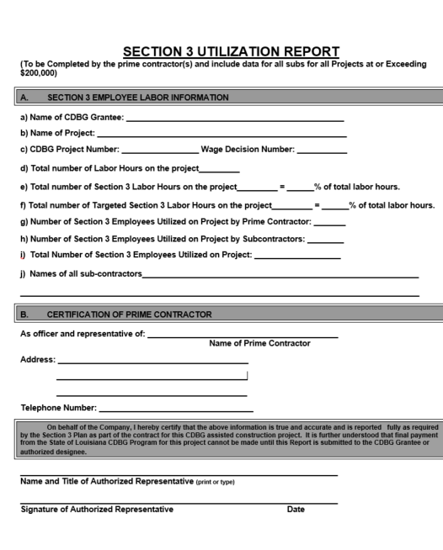
Section 3 Utilization Report (due with clear lien to pay retainage and included with closeout documents)

Slide 54
Certification
Normal advertising is no longer enough.
Good Faith Effort (Section A)
Keep a file showing attempts as to why goals were not met.
Grantees must certify residents and businesses and keep on file. Checked at monitoring.
“Resident Employee Opportunity Data” and “Certification For Business Concerns Seeking Section 3 Preference (Exhibits A)
Utilization Report due when retainage is paid and at closeout.
Complaints made directly to local HUD Field Office. These offices can be found @ www.hud.gov.

Slide 55

If it’s not in writing, it didn’t happen.

Slide 56
Limited English Proficiency (LEP)
Required to complete and adopt a Language Access Plan (LAP) for LEP persons within 1 year of the AIC.
Must be reviewed and updated annually.
Four Factor Analysis
FAQ’s can be found at:
  https://portal.hud.gov/hudportal/HUD?src=/program_offices/fair_housing_equal_opp/promotingfh/lep-faq
  http://www.lep.gov

Slide 57
LEP (Continued)
Use Census.gov for statistics (S-1601), not American FactFinder. (Do a web search for “census.gov S-1601 language spoken at home”). The Handbook has a link to the table. You will have to change the parameters for your Parish/Village/Town/City.
Translation Requirements (Vital Documents):
  1,000 or more LEP persons (translate)
  More than 5% & more than 50 in number (translate)
  More than 5% & 50 or less (translated written notice of right to receive free oral interpretation of documents).
  5% or less & less than 1,000 (no written translation required)

Slide 58
LEP (Continued)
Google Translate can be a helpful tool.
An example of OCD’s LAP is available in the “Exhibits A” Section of the Handbook.

Slide 59
Section 504
Section 504 of the Rehabilitation Act of 1973
  Requires grantee to comply with non-discrimination based on handicap status in federally assisted programs and activities of the Dept of Housing and Urban Development
  Objective: No qualified individual with handicaps shall, solely on the basis of handicap, be excluded for participation in, be denied the benefits of, or otherwise be subjected to discrimination under any program or activity.

Slide 60
Minimum 504 Requirements
504 Assurance to OCD (Exhibits A)—part of requirement to clear contact conditions. Both Sections should be completed if 15 or more employees.
Self Evaluation of current policies and practices in the areas of communication, employment and program/physical accessibility.
Maintain Data showing individuals that are beneficiaries of a program
Have a functioning TDD or LA Relay System (Section A). Number must be advertised in paper within 6 months of the AIC letter and operate 24 hours if you have emergency service.

Slide 61
Minimum 504 Requirements (cont)
Grantees with 15 or more employees
  Designate 504 coordinator
  Prepare and adopt grievance procedure of any complaints and keep records on file of grievance and resolution.
  Place notice in Town Hall or publish in the newspaper that the grantee does not discriminate on basis of handicap within 90 days of the receipt of the executed grant agreement (check Section A, for current language).
  Identify the 504 coordinator in the posting.
  Maintain in file for monitoring.

Slide 62
Self-Evaluation
Evaluate current policies
Modify policies that don’t meet requirements
Take steps to remedy discrimination revealed in the evaluation
  Areas covered: Building or facilities for physical access, program and services accessibility, communications and employment (includes pre-employment)
IF YOU ACQUIRED A BUILDING BUILT PRIOR 1988, YOU MUST COMPLETE AN EVALUATION OF THAT BUILDING.

Slide 63
Summary of Previous Actions Taken
For prior grantees who have completed self-evaluations and whose transition plans have expired should complete Summary of Previous Actions Taken (Exhibits A).
Summary of past plans, deficiencies found and corrected
Must do a complete self-evaluation if you don’t have a complete summary.

Slide 64
Fair Housing
Fair Housing Law (Title VIII of Civil Rights Act)
  “No person shall be subjected to discrimination because of race, color, religion, sex, handicap, familial status, or national origin in the sale, rental or advertising of dwellings, in the provision of brokerage services, or in the availability of residential real estate related transactions.” (24 CFR 100.5)
  Action does not have to be intentional to be a violation
  Some examples of what is prohibited and examples of discrimination

Slide 65
Requirements of Grantee
Affirmatively Affirming Fair Housing
  At least one additional Fair Housing Activity during the grant period (Exhibits A). Ex. fair housing notices by grantee (at town hall or where utility bills are paid), seminars for public (have in evenings when people can attend) and landlords, rental agents, real estate brokers, lenders, etc. Posting the Flyer in City Hall/Courthouse is no longer enough.
  Maintain documentation of that activity for file and monitoring.
  Submit housing complaints to HUD or LDOJ (Exhibits A). Make sure your citizens are aware of this information.

Slide 66
Requirements of Grantee (cont.)
  Fair Housing Assessment (Exhibits A)
    Consider Impediments
    Fair Housing Choice (everyone must have available to them the same housing choices.)
    Grantee should be involved in preparing even if consultant prepares the form. You know your area best. Both preparer and chief elected official must sign the document.

Slide 67
Fair Housing Assessment
Part 1
  Housing Profile
  Rental Units
  Public Housing
  Mortgage Lending
  Real Estate Brokers
  Zoning Ordinances
  Building Codes

Slide 68
Fair Housing Assessment (cont.)
Part II
  Review of Fair Housing Practices should be researched by using available resources
  Look at loan applications
  Loan approval procedures
  Advertising
  Appraisals
  Degree of segregation

Slide 69
Part III
Should only be marked “N/A” if the same category is marked “N/A” in Part II.
Assessment should be signed by both the preparer and the Chief Elected Official.

Slide 70
Fair Housing Assurance (Exhibits A)
Grantee assures OCD that there have been no findings made by, or open complaints with the HUD Fair Housing and Equal Opportunity (FHEO) Office or the Louisiana Attorney General.
Grantee will notify OCD at any time during the grant if a complaint is filed.

Slide 71
MBE/WBE
Place in your advertisement.
http://dsbs.sba.gov/dsbs/search/dsp_dsbs.cfm
Minority report is due in October (email forthcoming to grantees and consultants in September).
Report only new contracts that were awarded between 10/1—9/30 each year and paid for with CDBG Funds.

Slide 72
Equal Employment Opportunity
Must follow EEO guidelines, post posters and include language in advertisement for bids.
Local government should develop employment policies which include nondiscrimination clauses.
ADDITIONALLY EEO GUIDELINES MUST BE FOLLOWED. DISPLAY IN GRANTEE’S OFFICE AND PRINT ON LETTERHEAD.
Grantees must maintain employment data. Workforce Analysis (Exhibits A) or HUD Form EEO-4

Slide 73
Procurement
Presented by:
William Hall

Slide 74
Procurement Policy
All grantees must have an adopted Procurement policy that is equivalent to requirements in 2 CFR 200.318-200.326.

Slide 75
Procurement Policy
LCDBG Procurement Procedures
(https://www.doa.la.gov/media/ffmp3xi5/lcdbg-procurement-procedures.pdf)
Procurement Policy Outline
Persons or firms that “… develop or draft specifications, requirements, statements of work, or invitations for bids or requests for proposals must be excluded from competing for such procurements.” 2 CFR 200.319(a)

Slide 76
Procurement Requirements
Records sufficient to detail the history of procurement 2 CFR 200.318(i):
Procurement Method Chosen
Contract Type Selected
Type of Price(s) Utilized

Slide 77
Procurement Requirements
Records sufficient to detail the history of procurement 2 CFR 200.318(i):
Procurement Method Chosen
4 Choices

Slide 78
Procurement Requirements
Records sufficient to detail the history of procurement 2 CFR 200.318(i):
Rationale for the method of procurement.
  Micro-purchases,
  Small purchase,
  Sealed bids,
  and Competitive Proposals

Slide 79
Procurement Requirements
Records sufficient to detail the history of procurement 2 CFR 200.318(i):
Rationale for the method of procurement
  Micro-purchases,
  Small purchase,
  Sealed bids,
  and Competitive Proposals
Selection based principally on Price

Slide 80
Procurement Requirements
Records sufficient to detail the history of procurement 2 CFR 200.318(i):
Rationale for the method of procurement
  Micro-purchases,
  Small purchase,
  Sealed bids,
  and Competitive Proposals
Selection based on qualitative/technical factors and Price/Cost

Slide 81
Procurement Requirements
Records sufficient to detail the history of procurement 2 CFR 200.318(i):
Contract Type Selected
3 Choices

Slide 82
Procurement Requirements
Records sufficient to detail the history of procurement 2 CFR 200.318(i) continued:
Selection of contract type
  Firm Fixed Price
  Cost Reimbursement
  Time and materials

Slide 83
Procurement Requirements
Records sufficient to detail the history of procurement 2 CFR 200.318(i):
Type of Price(s) Utilized
4 Choices

Slide 84
Procurement Requirements
Records sufficient to detail the history of procurement 2 CFR 200.318(i) continued:
Basis for the contract price(s)
  Lump sum Price
  Unit price
  Billable hours
  Reimbursable costs

Slide 85
Other LCDBG Procurement Procedures
Procurement of professional services (administrative consulting and engineering services) is required prior to submittal of application.
Grantees are not allowed to terminate these services without permission from OCD if using grant funds to pay for these services.
If there is a need to procure additional professional services during the grant.
Contract requirements

Slide 86
Contractor Clearances
Administrative consulting, architectural, and engineering firms that have not provided services to grantees under the LCDBG Program within the previous five program years, regardless of the source of funding, must be cleared. (Exhibit A-34)
Should be obtained following grant award and before any costs are incurred other than pre-agreement costs.

Slide 87
Recordkeeping for Procurement
OCD must review and approve all solicitations for professional services before they can be publicized and before contracts can be executed

Slide 88
Recordkeeping for Procurement
Copy of Advertisements
Copy of package requesting RFPs or qualification statements
Description of method for conducting technical evaluations used to select consultants
Copies of proposals and qualification statements received
Written evaluations and statement explaining basis of selection
Basis for cost reasonableness
Clearance of firms, if necessary

Slide 89
Procurement of materials, supplies and construction services
Micro-Purchase – Up to $10,000
Small Purchase – Materials and supplies less than $30,000 and construction services not m
Competitive Sealed Bids – Materials and supplies $30,000 and up as well as construction services. Must receive two bids. If not, contact OCD.

Slide 90
Procurement of materials, supplies and construction services
Noncompetitive Negotiation – inadequate competition, only used with written approval from OCD

Slide 91
Advertisement for Sealed Bids
Must be published once a week for three different weeks in a newspaper in the locality.
First advertisement must appear at least 25 days before opening of bids and must not occur on a Saturday, Sunday or legal holiday.

Slide 92
Advertisement for Sealed Bids
RS 38: §2212
“E.(1) Public entities shall provide, as an additional bidding option, a uniform and secure electronic interactive system for the submittal of bids for public works”
Parish governments with populations >20,000
Municipalities with population >10,000

Slide 93
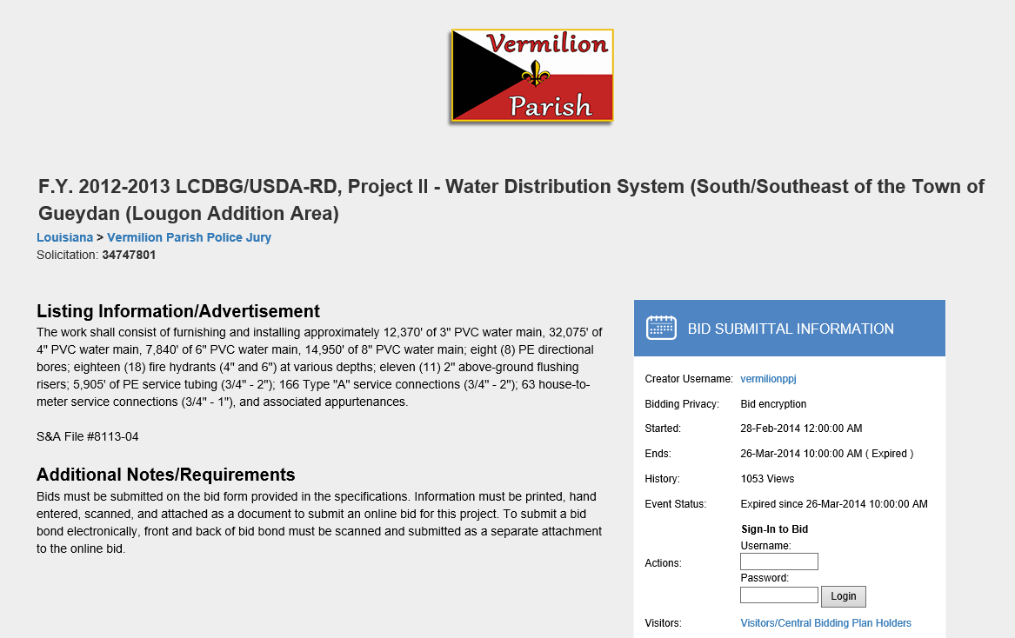
Advertisement for Sealed Bids

Slide 94
Bid/Contract Documents and Bid Opening
OCD must receive a copy of all addenda.
Contract Documents Guide Exhibit A-39.
Suggested that bid package is reviewed in its entirety by legal counsel.
Must maintain copy of minutes of bid opening, roster of attendees, and tabulation of bids.
Award or Rejection must be taken within 45 days.
May extend deadline to take action by written mutual consent in 30 calendar day increments.

Slide 95
Important Bid Law Dates
 |  |  |  | Max Days
Start | Day | 1 | First Advertisement appears
between | Days | 8-14 | Second Advertisement appears
between | Days | 15-21 | Third Advertisement appears
Latest | Day | 22 | Latest date to issue addenda
Earliest | Day | 25 | Bid Opening
Earliest | Day | 32 | Bid Opening if addenda after day 22
Latest | Day | 46 | Bid opening if addenda after day 22
Latest | Day | 70 | Award or Reject Bids | 45
Latest | Day | 85-130 | Execute Contract for bid award | 60
Latest | Day | 115-160 | Issue Notice to Proceed | 30

Slide 96
Important Bid Law Dates addenda
 |  |  |  | Max Days
Start | Day | 1 | First Advertisement appears
between | Days | 8-14 | Second Advertisement appears
between | Days | 15-21 | Third Advertisement appears
Latest | Day | 22 | Latest date to issue addenda
Earliest | Day | 25 | Bid Opening
Earliest | Day | 32 | Bid Opening if addenda after day 22 | 7
Latest | Day | 46 | Bid opening if addenda after day 22 | 21
Latest | Day | 70 | Award or Reject Bids | 45
Latest | Day | 85-130 | Execute Contract for bid award | 60
Latest | Day | 115-160 | Issue Notice to Proceed | 30

Slide 97
Procedures for when bids exceed cost estimates
Contact OCD engineer Jeff Tessier to discuss options.
Reject all bids
Reallocate funds
Inject local funds
Award to low bidder and execute change order to bring cost down.
Must get approval from OCD to make changes to the plans, execute change orders, or reallocate funds.

Slide 98
Next Steps…
Award Contract
Execute contract and all required documents
Hold pre-construction conference
Issue notice to proceed
Process any needed change orders correctly

Slide 99
Engineering
Presented by:
Jeff Tessier

Slide 100
Grant – 3 Parts
Application
ERR
P&S

Slide 101
Communication!
Engineer
Grant Consultant
Grantee
CDBG

Slide 102
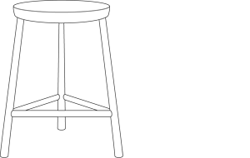
Grant
ERR
Application
Application
P&S

Slide 103
Plans
Specifications
Cost Estimate
(=Bid Form)
Fire Marshall,
LDH & Permitting
Transmittals
Addendums

Slide 104
Math
Signatures
Reasons
The engineer & the contractor sign and date the C.O.
Submit the C.O. to me by email or mail.
I approve it and email it back to you, this is for your records.
Get the Mayor or Parish President to approve and date the Change Order. You keep and distribute as many copies as you need.
Submit to LCDBG one copy with all signatures.
Change
Order

Slide 105


Change Orders
Addendums
RPR Certifications
*Anything Time Sensitive
Plans and Specs and Revisions
* Large Attachments

Slide 106


Slide 107
To streamline and lessen paperwork and findings, we are establishing a qualified Resident Project Representative (RPR) database.
Qualification process is the same. Submit RPR form and RPR resume.
After a Resident Project Representative is qualified, there is no need to resubmit the certification or resume.
When the grant is monitored, the monitoring team will check to see that the RPR signing the inspection reports is RPR database.

Slide 108
Environmental Review
Presented by:
Fenishia Favorite

Slide 109
Federal Requirements
24 CFR Part 58
Each LCDBG (Louisiana Community Development Block Grant) Program participant must implement their program in compliance with the National Environmental Policy Act of 1969 (NEPA) and other applicable federal environmental laws.
For all projects, especially economic development projects, particular attention must be given to 24 CFR Part 58.32 – Project Aggregation.

Slide 110
Program Requirements
All contract conditions must be cleared within four months of the date of the Authorization to Incur Costs letter.
The Environmental Review Record (ERR) should be received by the State within four months of this date to ensure sufficient time for review.
The grantee’s Chief Elected Official (CEO) will assume overall responsibility for the environmental review process.
The CEO must sign all certifications and findings.

Slide 111
Environmental Review Clearance Levels
Exempt
  Environmental studies, project planning, and administrative costs
Categorically Excluded Not Subject to 58.5 – 58.35 (b)
  Operating costs and equipment
Categorically Excluded Activities Subject to 58.5 – 58.35 (a)
  Acquisition, repair, and improvements (less than 20%)
Activities Requiring an Environmental Assessment 58.36
  New construction and substantial improvements (more than 20%)
Environmental Impact Statement – 58.37
  Significant impact on environment

Slide 112
Activities Requiring an Environmental Assessment – 58.36
 | Publication | Posted
“Combined Notice” Date | 06/04/xx (15 days) | 06/04/xx (18 days)
Date of “Request for Release of Funds and Certification” | 06/20/xx | 06/23/xx
Date ERR and request for funds mailed to State | 06/20/xx | 06/23/xx
ERR received by State | 06/22/xx | 06/25/xx
State’s 15-day Public Comment Period | 06/23/xx to 07/07/xx | 06/26/xx to 07/10/xx
Comment Periods - Combined Notice

Slide 113
Categorical Exclusions Subject To 58.5 – 58.35 (a)
Comment Periods - Notice of Intent to Request Release of Funds
 | Publication | Posted
Notice of Intent Date | 06/04/XX (7 days) | 06/04/xx (10 days)
Date of “Request for Release of Funds and Certification” | 06/12/xx | 06/15/xx
Date ERR and request for funds mailed to State | 06/12/xx | 06/15/xx
ERR received by State | 06/14/xx | 06/17/xx
State’s 15-day Public Comment Period | 06/15/xx to 06/29/xx | 06/18/xx to 07/02/xx

Slide 114
ASTM Phase I Environmental Site Assessment – Required for all HVAC projects
…all property being proposed for use in HUD programs be free of hazardous materials, contamination, toxic chemicals and gases, and radioactive substances, where a hazard could affect the health and safety of occupants or conflict with the intended utilization of the property. 24 CFR Part 58.5(i)(2) & 50.3(i)
Site Assessment must follow the ASTM Standard E 1527-05

Slide 115
ASTM Phase I ESA
Systematic research of current and past on-site and surrounding property uses that could have adverse effect on the environment;
Conducted or supervised by a qualified environmental professional; • Includes interviews, and review of historical and regulatory records
Includes a site inspection (site inspection must include radon testing, and lead based paint/asbestos testing if applicable)
Interpretation of ESA data and conclusions
Presented in a written report that follows a standardized format
Mold must be addressed in the assessment.
For more information visit https://www.hud.gov/sites/documents/CPD_ENV_SLIDES8-22.PDF

Slide 116
ERR Clearance
All required permits, site assessments, remediation efforts, mitigation measures, and the Eight-Step Process must be included in the notices.
The Request for Release of Funds must be signed by the CEO after the end of the local public comment period.
All activities must be environmentally cleared including those funded by private funds.
Until the State has approved the recipient’s Request for Release of Funds, neither a grantee nor any participant, including public or private non-profit or for-profit entities or any of their contractors, may commit LCDBG/HUD funds or private funds or undertake an activity or project. (24 CFR Part 58.22)
This regulation is triggered when the grantee’s application is submitted to the State.

Slide 117
Revised Environmental Review Records
If the project site/location or scope of work changes after clearance, then the ERR must be amended.
All compliance areas must be reconsidered and all relevant agencies contacted.
OCD will review all changes once submitted and issue a new clearance.
For Environmental Assessment projects:
  No change in determinations - only have to submit revised ERR.
  Change in determinations or new activity or location added – post/publish new FONSI notice.

Slide 118
Common Errors
  Not including all of the required maps or not including enough information on the maps.
  Not including whether or not the project is site specific or not listing all proposed activities in the Project Description.
  Not following requests from tribes.
  Not signing and dating forms that require signatures.
  Not discussing alternatives in the Eight-Step Process.
  Request for Release of Funds not one page.
  Missing documentation to support determinations.
  Not making sure that the Statutory Worksheet and Checklist match (e.g., dates, names, etc.) and that all relevant information is included in the Statutory Checklist.
  Make sure you review the entire ERR before turning it in! This will minimize errors.

Slide 119
Questions??
Please contact Fenishia Favorite
  Fenishia.favorite@la.gov
225-342-5884
Staff that Review Environmental Review Records:
  Fenishia Favorite & Layla Argrave

Slide 120
Labor Standards
Presented by:
Jimmy Martin

Slide 121
Five Regulation/Requirements
Davis Bacon
  DBA and DBRA – prevailing wages
Copeland
  payrolls, Statements of Compliance, deductions
CWHSSA
  overtime (time-and-a-half)
Louisiana law (as opposed to federal law)
  if state law is more stringent, state law governs
LCDBG program requirements

Slide 122
What is Davis Bacon?
Davis-Bacon Act vs. Davis-Bacon Related Acts
  federal law
covering minimum payments to laborers and mechanics for work done on most LCDBG projects.
designed to prevent out of area contractors from underbidding local contractors.
covers federally-funded contracts
  over $2000
“prevailing wages”
  contractors must meet, at minimum, wage requirements set forth in the wage decision.

Slide 123
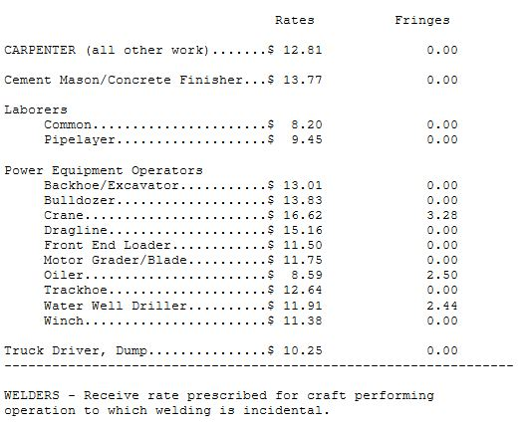
Wage Decision

Slide 124
What is Copeland?
Copeland Anti-kickback Act
  federal law
outlaws paying the employer kickbacks
requires weekly payrolls
  with Statements of Compliance
requires permission for pay deductions not required by law
  authorization form (section B)

Slide 125
What Is CWHSSA?
Contract Work Hours and Safety Standards Act
federal law that requires time and a half pay for any hours worked in excess of 40 during a work-week
  has liquidated damages of $27 per person per day for any hours in excess of 40 in a given workweek (no longer $10/$25/$26)
  In addition to restitution paid to worker
two methods to address the liquidated damages penalties:
  contractor requests a waiver from HUD → ☺
  contractor pays HUD by wire transfer → ☹

Slide 126
Examine Labor Exhibits (Section B)
Wage Decision
Verification of Wage Decision and Contractor Eligibility
Notice of Contract Award
Report of Additional Classification and Rate
Record of Employee Interview Form
Payroll Form & Statement of Compliance (HUD WH-347)
Payroll Review Flow Chart
Payroll Deduction Authorization
Notice of Restitution Due

Slide 127
Verification Of Wage Decision & Contractor Eligibility Form
DUNS #’s for all known subs.
must receive proof of active DUNS #’s prior to subcontractor beginning work.
if a subcontractor is later added, that subcontractor’s DUNS # must be active prior to that sub beginning work.
OCD must be notified of the “new” sub.

Slide 128
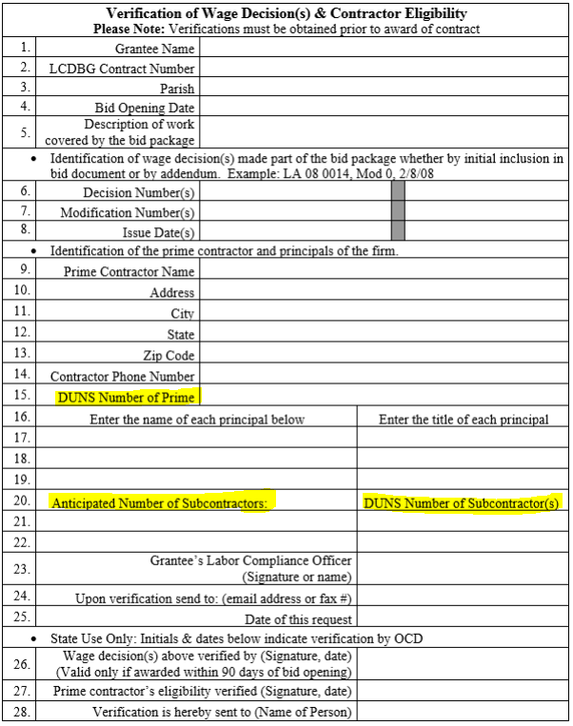
Verification Of Wage Decision & Contractor Eligibility form

Slide 129
Chronological Steps
Obtain a wage decision
Prepare bid documents
Advertise for bids
Ten day responsibility (10dc no longer required)
Bid opening
Verification of contractor eligibility (Revised to Include Subs)
Award contract
Notice of contract award
Preconstruction conference (Required)
Additional classifications

Slide 130
17 Chronological Steps (cont’d)
Employee interviews
Examinations of payrolls (must stay current to ensure compliance of contractors before they leave the site)
Corrective actions (if applicable) such as restitution and liquidated damages
Labor Standards Enforcement Report
Monitoring by OCD staff
Corrective action to address findings of deficiency
Final Wage Compliance Report

Slide 131
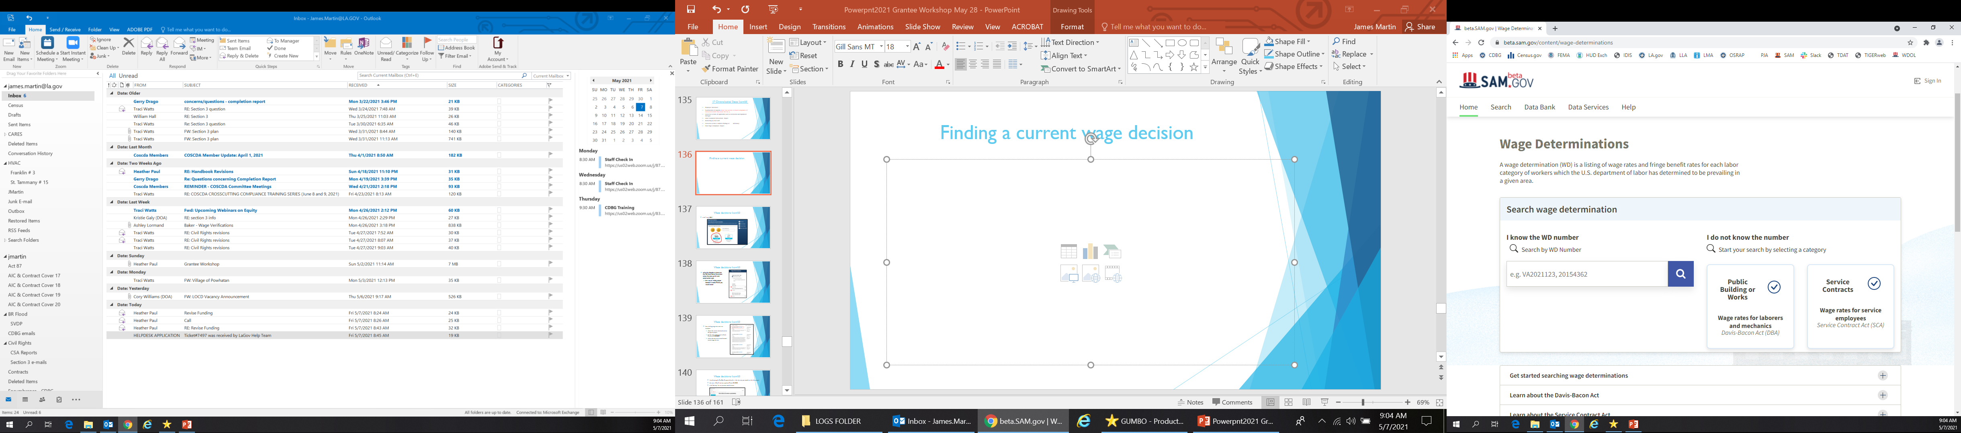
Finding a current wage decision

Slide 132
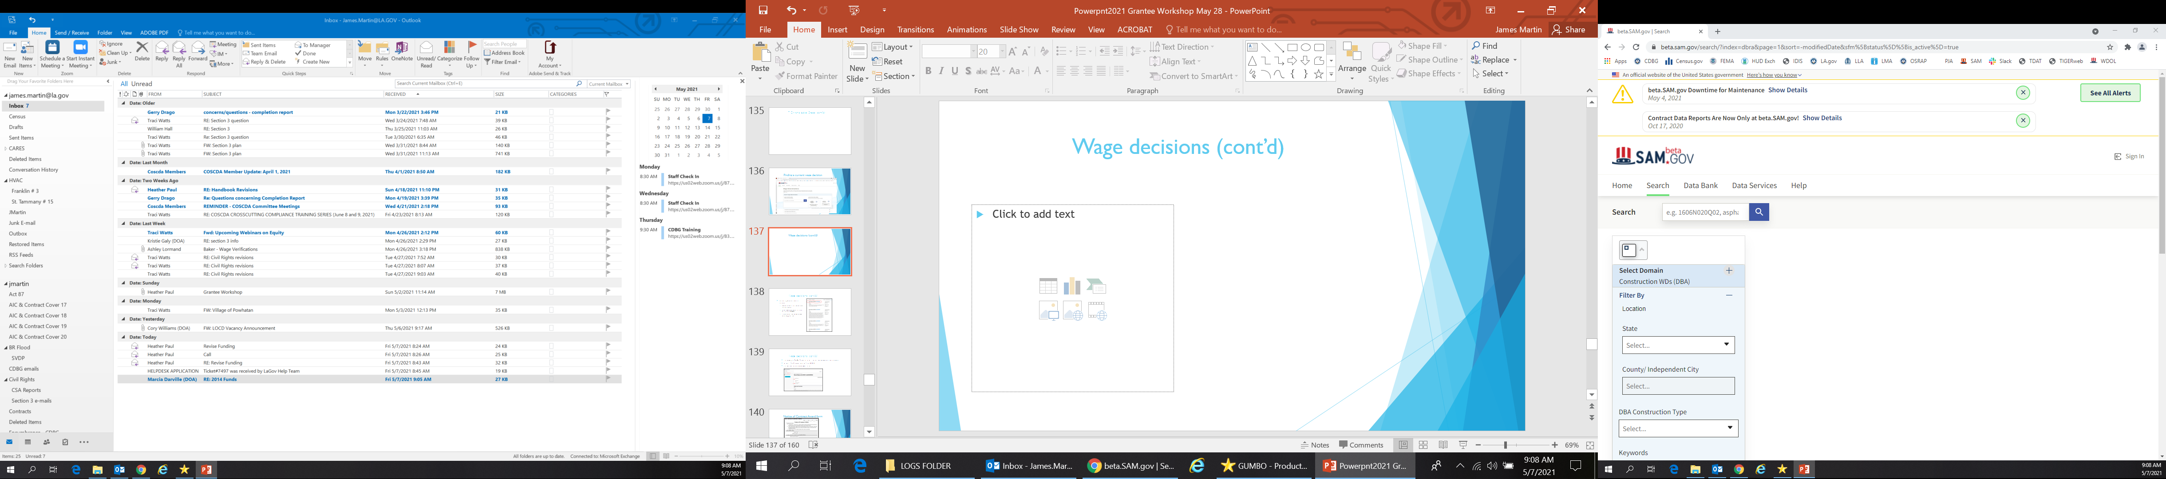
Wage Decisions (cont’d)

Slide 133
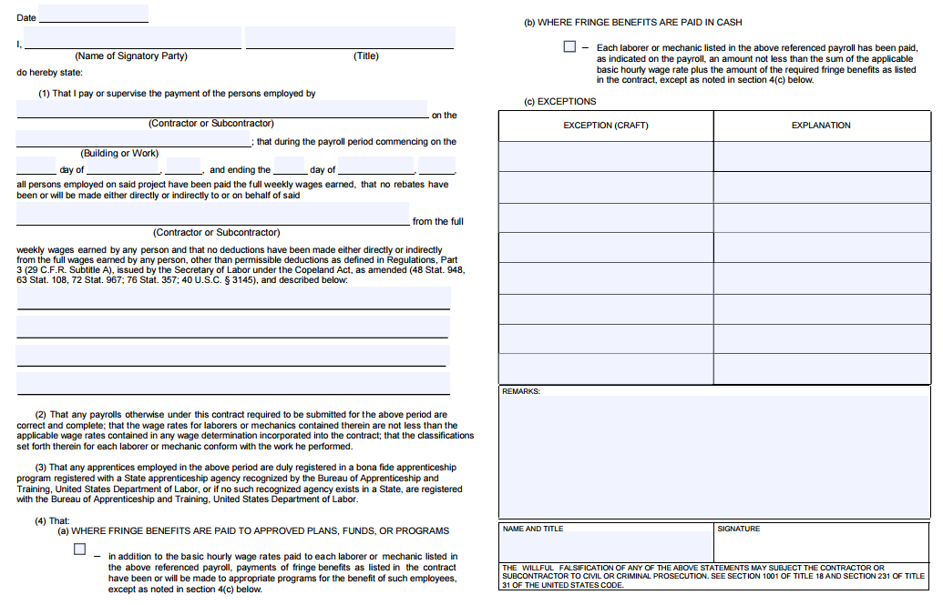
Fringe?
Signatory authority?

Slide 134
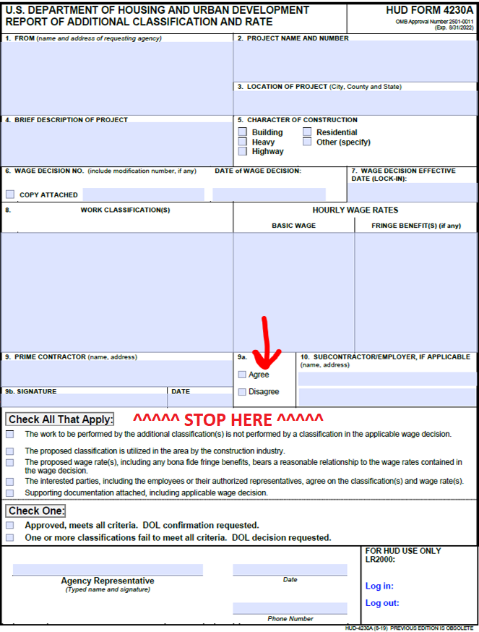
Report of Additional Classification

Slide 135
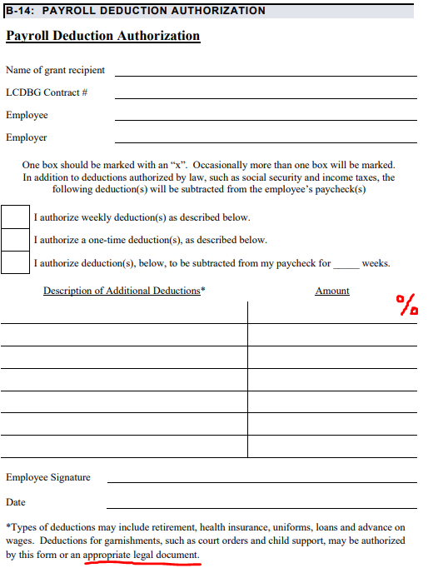
Payroll Deductions
If a percentage, check weekly.
NOTE: If the amount is different week to week, and not a percentage, you need a form for every amount (i.e. loan payback).

Slide 136
Laborers, Laborers, Laborers
read, “Excessive use of the ‘Laborer’ classification”
caution: excessive amount of laborers
  laborer usually lowest paid classification on WD
  payroll must reflect a reasonable distribution of laborers to mechanics
    inspection reports, site observations, employee interviews, general logic/knowledge
    Foremen/supervisors can’t do everything; don’t forget about the 20% rule for working foremen
  could result in massive restitution
Inspection Reports – use them & compare them to payrolls

Slide 137
Final Wage Compliance Report
submitted with closeout documents
  reports all restitution or absence of restitution under Davis-Bacon and CWHSSA
  we will remind you at monitoring to include restitution in the FWCR; as LCO you should ensure that it is there
must be approved by OCD before grant can be closed out
  any labor findings must be cleared
  if there are any outstanding labor issues, such as restitution, liquidated damages, unapproved additional classification requests, etc…those must be corrected

Slide 138
Monitoring/Closeout/ Program Amendments
Presented by:
Kristie Galy

Slide 139
Desktop Review
OCD staff will send a letter requesting documents when the grant is 25% expended.
Grantees will have 30 days to submit requested documents.
OCD staff will review documents and provide technical assistance to grantee if needed.
Review checklists are included as an exhibit in Section E of the LCDBG Grantee Handbook.
OCD is conducting this review in an effort to reduce findings through the provision of technical assistance.

Slide 140
Monitoring
Each grant will be monitored on site when 50% of the grant funds have been requested by the grantee.
OCD staff will review all compliance areas as well as view the project site.
Monitoring checklists are included as an exhibit in Section E of the LCDBG Grantee Handbook and will be updated online as new guidance is available.
OCD will send the grantee a monitoring report and the grantee will be required to respond to any findings of deficiency noted during the monitoring review.

Slide 141
Closeout
In order to receive a Conditional Closeout…
Improvements/construction undertaken with grant funds must be in full operation
Submit 1 copy of the Program Completion Report from the most recent grant year
Submit 3 copies of the Certificate of Completion (must be original signatures)
Submit Clear Lien Certificate
All findings of deficiency must be cleared

Slide 142
Closeout
In order to receive a Final Closeout
All conditions must be met in order to be approved for a Conditional Closeout.
All financial reports/audits covering the expenditure of all LCDBG funds have been received and accepted.

Slide 143
Program Amendments
Required when single or cumulative changes to the program budget greater than 10% of the grant award amount or changes that result in the deletion or addition of an activity or item.
Must be submitted by the grantee.
Funds remaining due to cost under-runs may be used with prior approval by OCD through a Request for Program Amendment.
Project must continue to be fundable based on the proposed changes to be approved and NOT require an amendment to the ERR.

Slide 144
Changes to approved projects
Some changes that become necessary for project implementation do not involve a change in scope of work or number of project beneficiaries and may not require a full program amendment.
These program changes generally must be requested in writing by the grantee.
The request should describe the intended change to the project and statements regarding whether the change will affect the intent/scope of the project, number of project beneficiates, and the Environmental Review Record.

Slide 145
Changes to approved projects
OCD must be contacted anytime a grantee seeks to make changes to an approved LCDBG project.
Amendments and/or project changes to the approved LCDBG project can neither be requested nor approved through the submittal of engineering change orders only.
Major reductions in the scope of proposed work could result in adverse state action — grant reduction, termination, or a finding of ineligibility for future funding.

Slide 146
PLEASE NOTE:
Any changes that are not necessary to complete the originally approved project and/or require an amendment to the originally approved ERR will NOT be considered.

Slide 147
Grant Performance Factors
A second contract or contract extension was required in order to complete and/or closeout the grant.
Penalties were assessed at any point during the grant due to failure to meet a required benchmark.
Finding of deficiency identified as “very serious” issued during the grant.

Slide 148
Contacts
Financial Management: Janelle Dickey Janelle.dickey@la.gov
Victoria Cavalier Victoria.cavalier@la.gov
Procurement: William Hall william.hall@la.gov
Kristie Galy Kristie.galy2@la.gov
Labor, Civil Rights: Jimmy Martin james.martin@la.gov
Civil Rights: Denease McGee denease.mcgee2@la.gov
Environmental: Fenishia Favorite Fenishia.favorite@la.gov
Layla Argrave Layla.Argrave@la.gov
Monitoring: Kristie Galy Kristie.galy2@la.gov
Jimmy Martin James.martin@la.gov
Engineering: Jeff Tessier Jefferson.Tessier@la.gov

Slide 149
The End

