Slide 1
Map Requirements for the Environmental Review Record

Slide 2
All Required Maps
This map is the same map that was approved at the end of the application process.
Project map
Floodplain map
Wetland Inventory map
Coastal Zone map
Coastal Zone Barrier map
Sole Source Aquifers map
Wild and Scenic Rivers map
Airport/Military Airfield maps
Environmental Justice map
NEPAssist Map

Slide 3
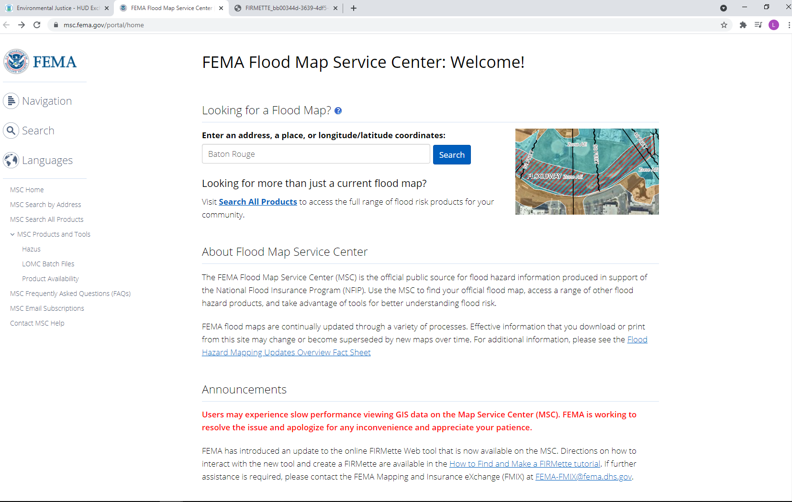
Floodplain Map
https://msc.fema.gov/portal/home
This map must be completed regardless of a Floodplain Analysis 8-step process being required
On this screen, search for the entity and click on Dynamic map for a printable version

Slide 4
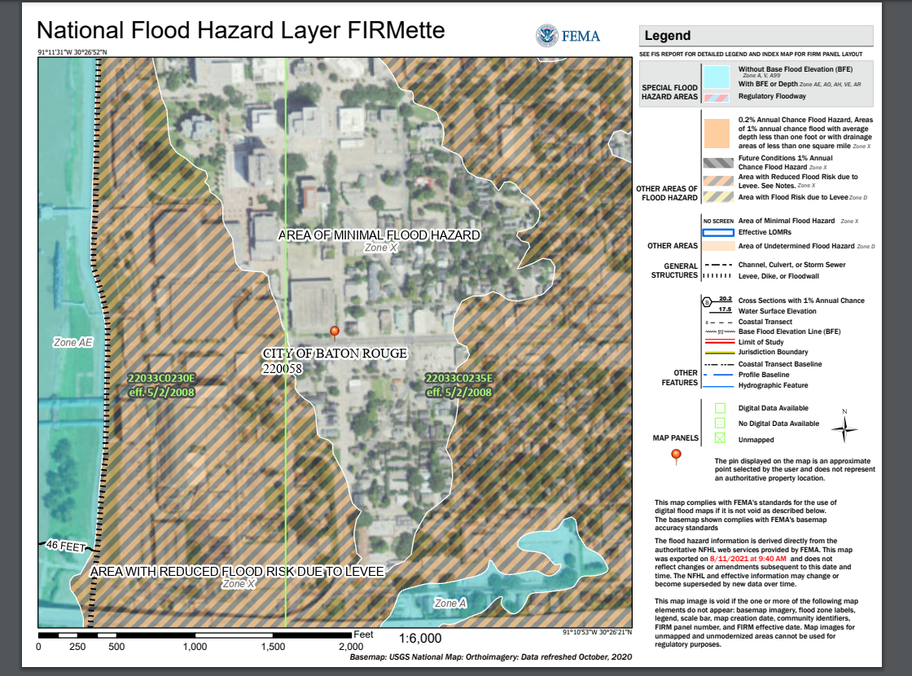
-These are the dates that need to be referenced on the Statutory Checklist, not the date exported
-the target area needs to be identified on the map (rectangle outline on current map)

Slide 5
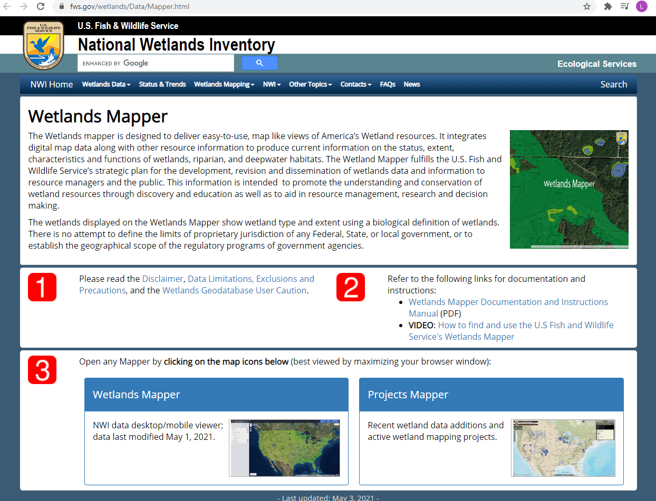
Wetland Inventory Map
https://www.fws.gov/wetlands/Data/Mapper.html
This map must be included regardless of a Wetland Analysis 8-step process being required.
Click on the Wetland Mapper icon.

Slide 6
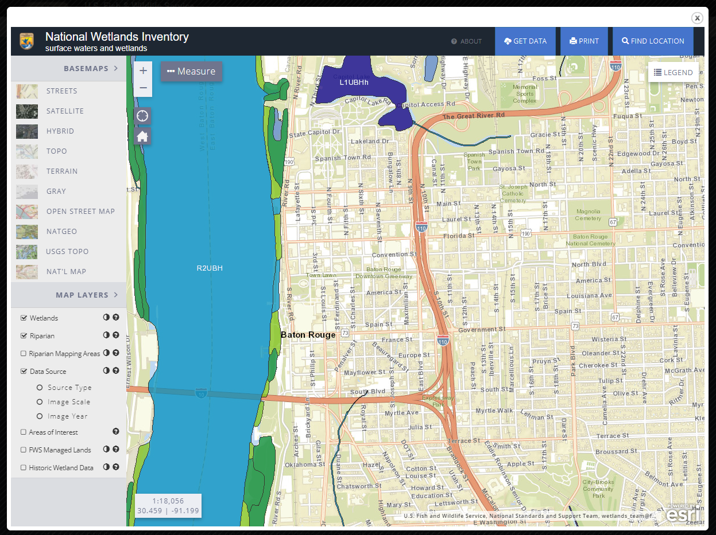
-Once you reach this screen, search the entity by clicking “Find Location”
-For easier access to street views, click “Basemaps” and “Streets”
-Make sure to include an outline of the project area on the map

Slide 7
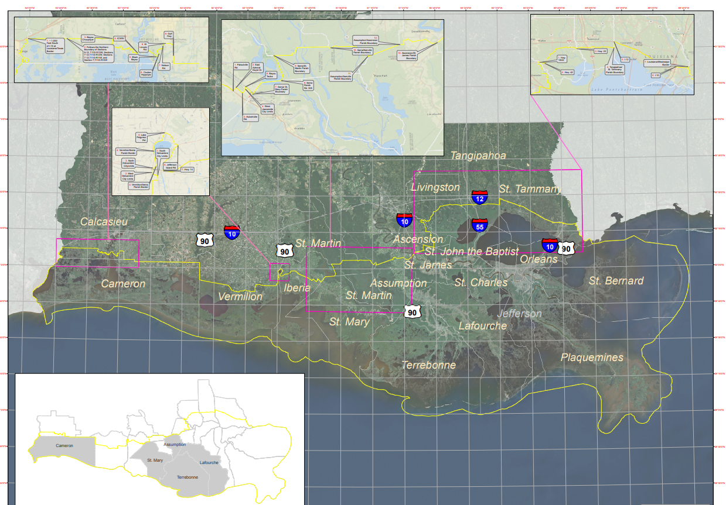
Coastal Zone Map
http://www.dnr.louisiana.gov/index.cfm?md=pagebuilder&tmp=home&pid=928
This link goes to the Coastal Zone Boundary main page on the Department of Natural Resources website
Scroll down to the Coastal Zone Boundary Map
The Parish that the project is being completed in must be referenced on the map
Project is located in East Baton Rouge Parish

Slide 8
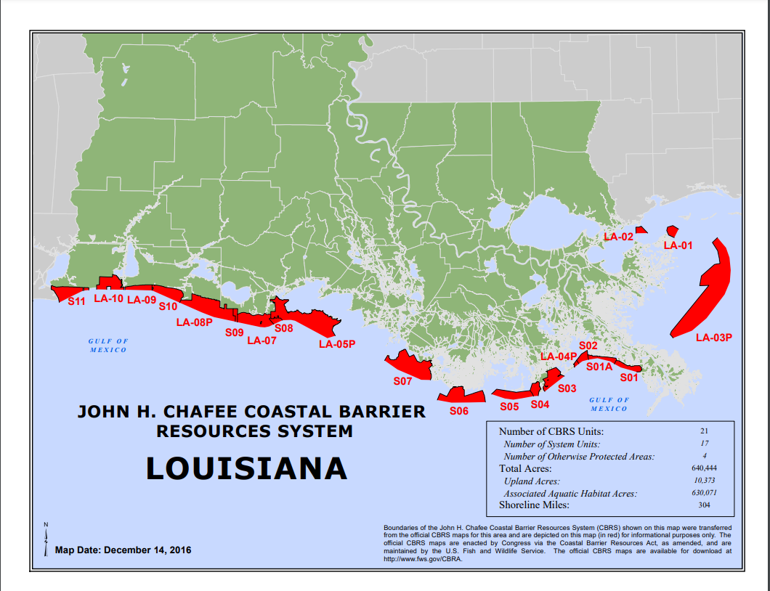
Coastal Zone Barrier Map
https://www.fws.gov/ecological-services/habitat-conservation/cbra/maps/a/LA.pdf
This link goes directly to the Coastal Zone Barrier Map
Project is located in East Baton Rouge Parish
To complete the requirements for this map, the parish in which the project is being done needs to be referenced on the map

Slide 9
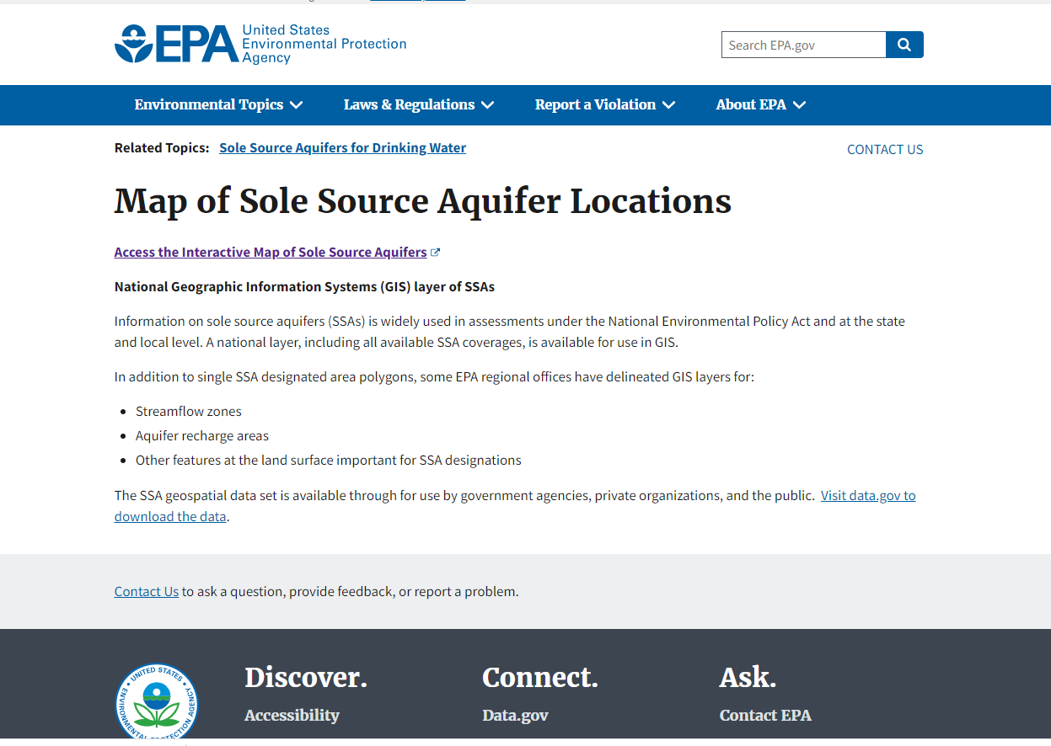
Sole Source Aquifers Map
https://www.epa.gov/dwssa/map-sole-source-aquifer-locations
Click on “Access the Interactive Map of Sole Source Aquifers”

Slide 10
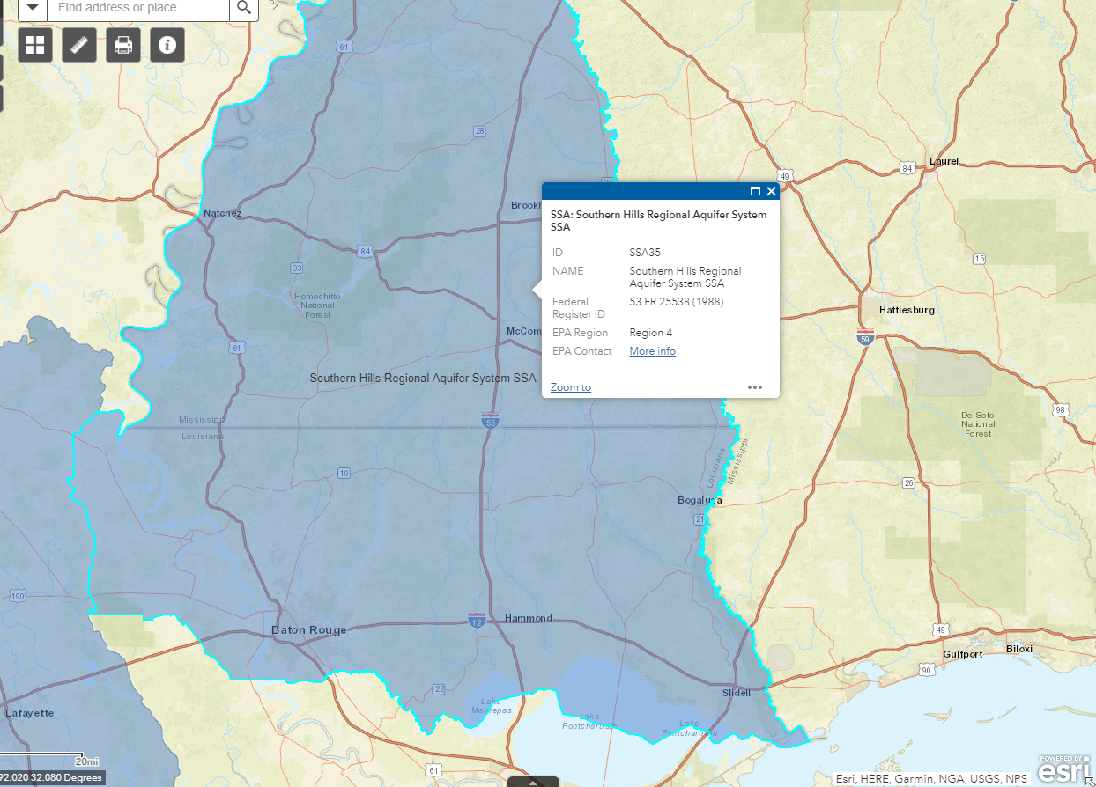
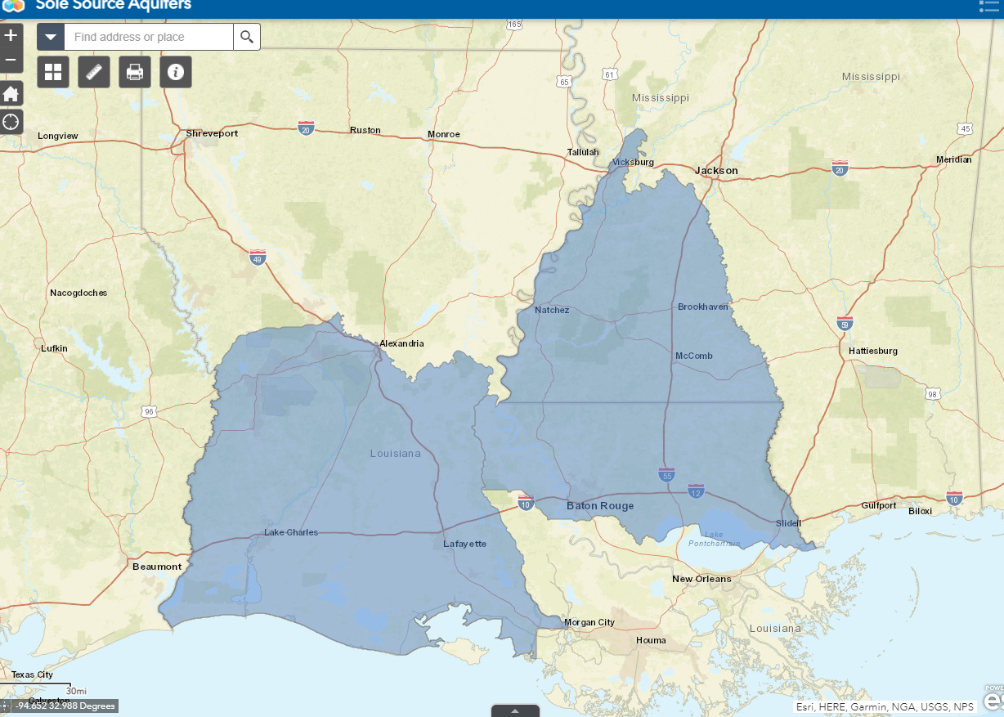
There are two Sole Source Aquifer regions in Louisiana (Region 6 and Region 4)
If the project area falls in one of these regions, zoom in to identify the general location on the map
If the project is not in a Sole Source Aquifer, mark the general location on a zoomed out map

Slide 11
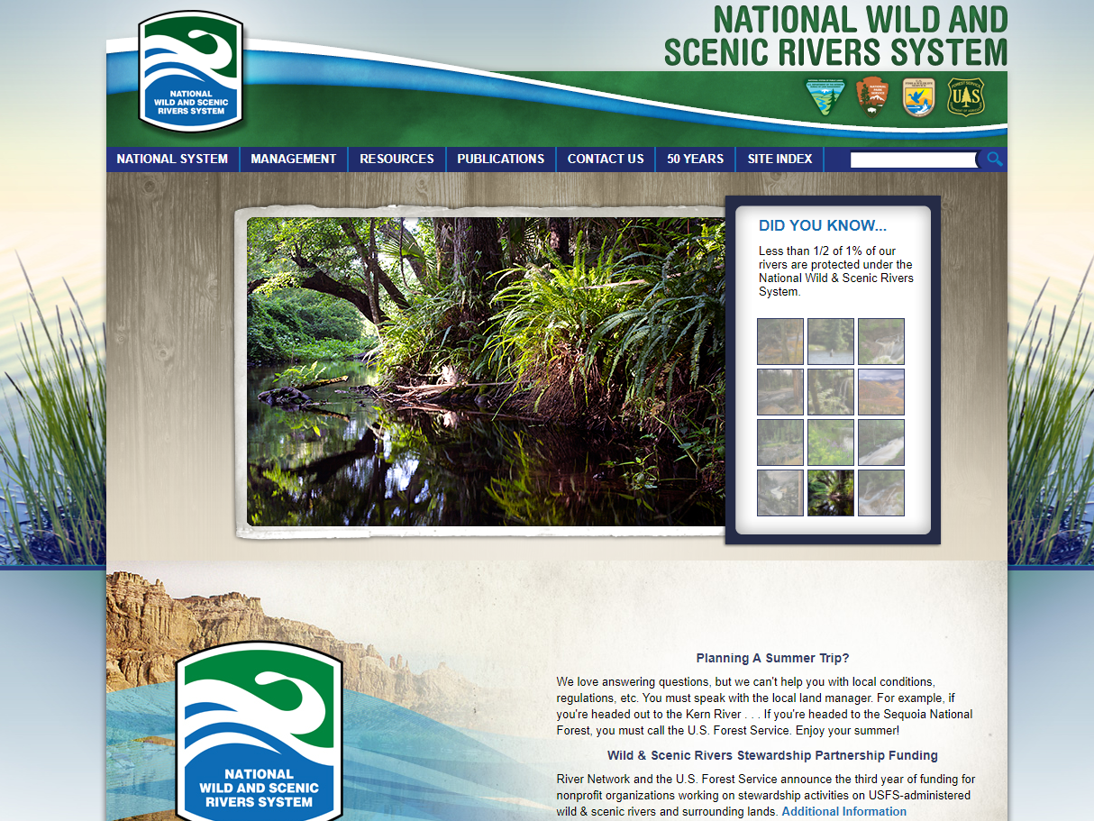
Wild and Scenic Rivers
https://www.rivers.gov/
Scroll down to “National Wild and Scenic Rivers Story Map” and click “View the Map”

Slide 12
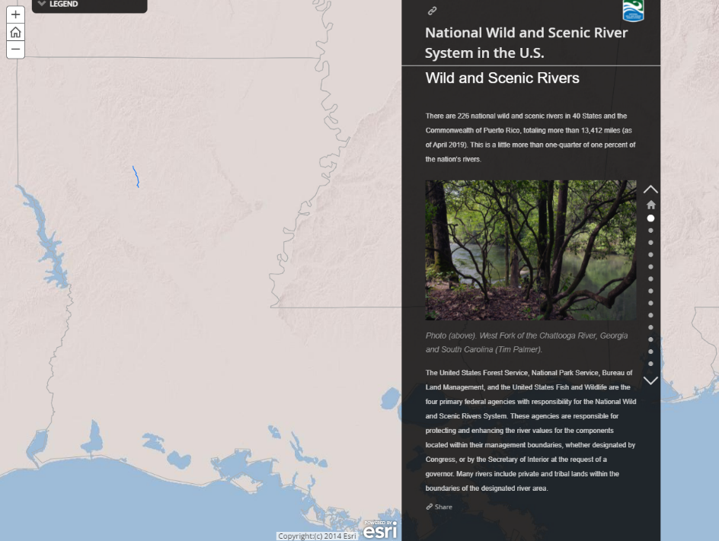
The only Wild and Scenic River in Louisiana is Saline Bayou
Mark where your location is in reference to Saline Bayou
We require that you list the rivers that are being studied as potential components of the Wild and Scenic River System. However, you do not have to provide a map for those.

Slide 13
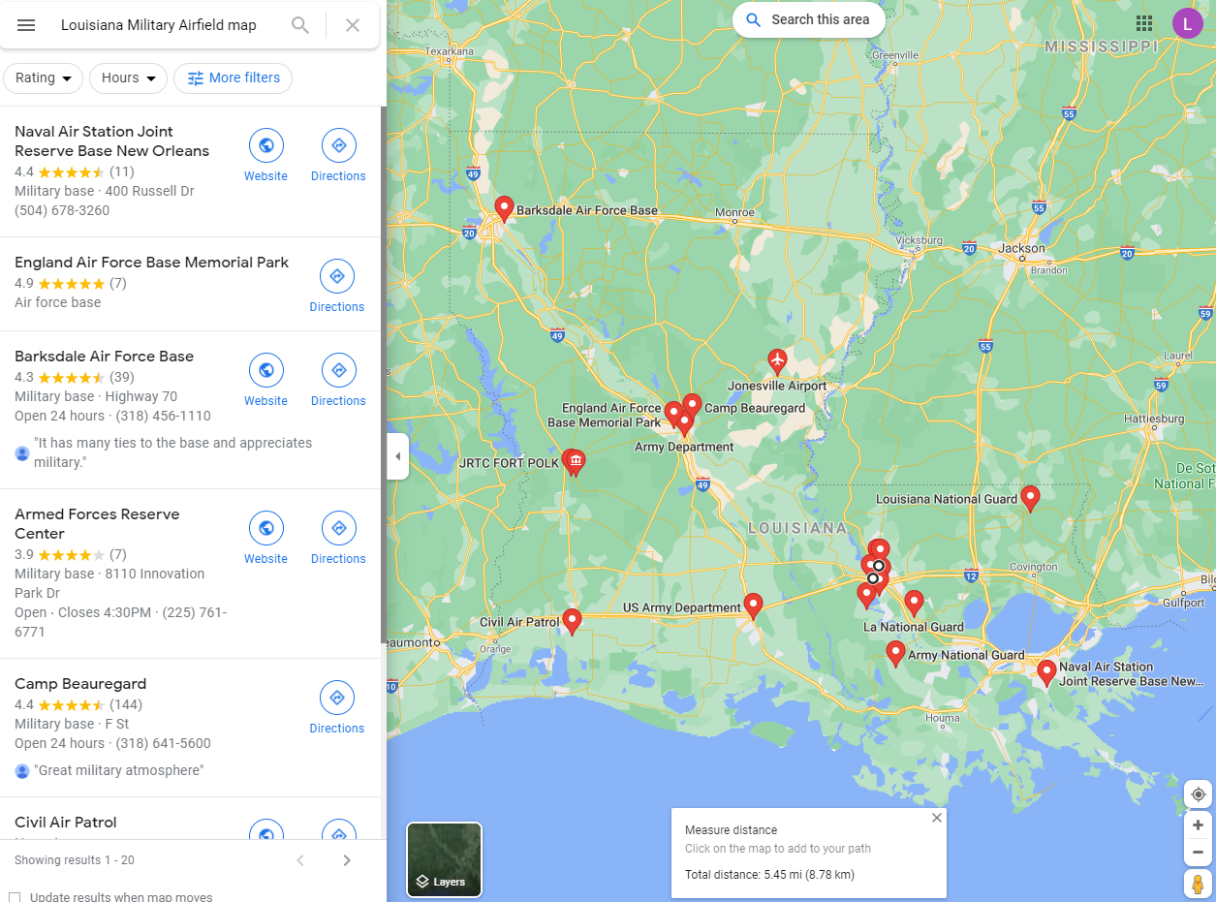
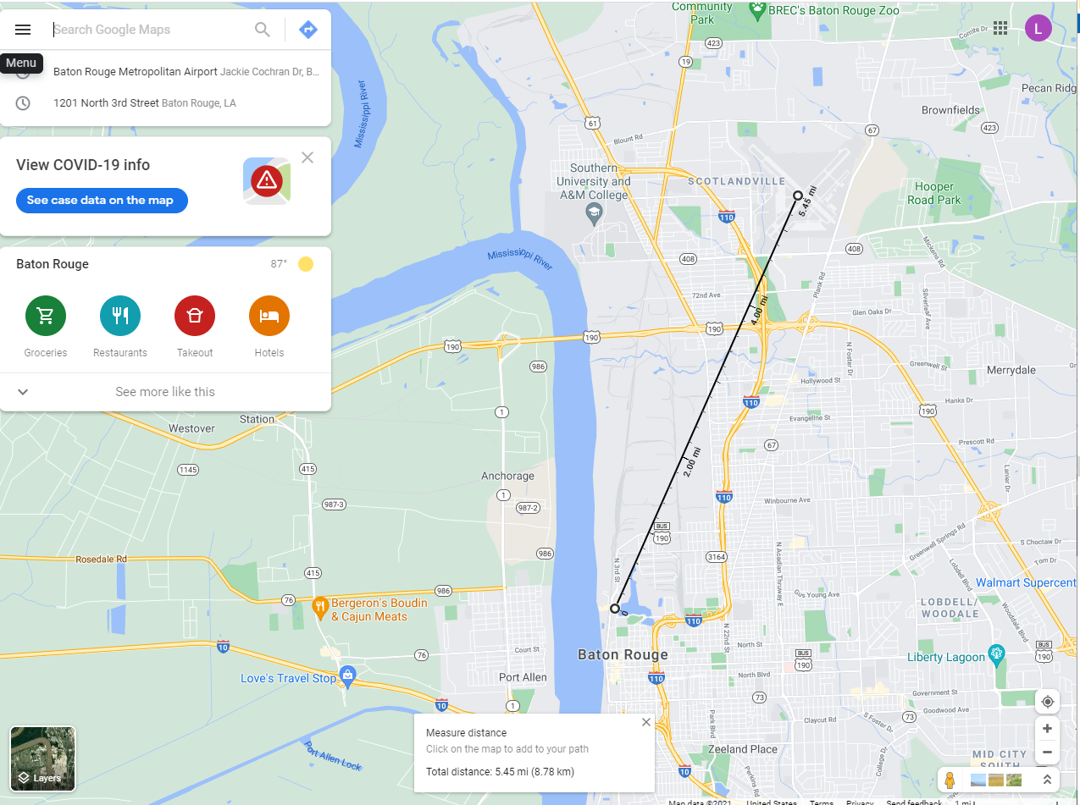
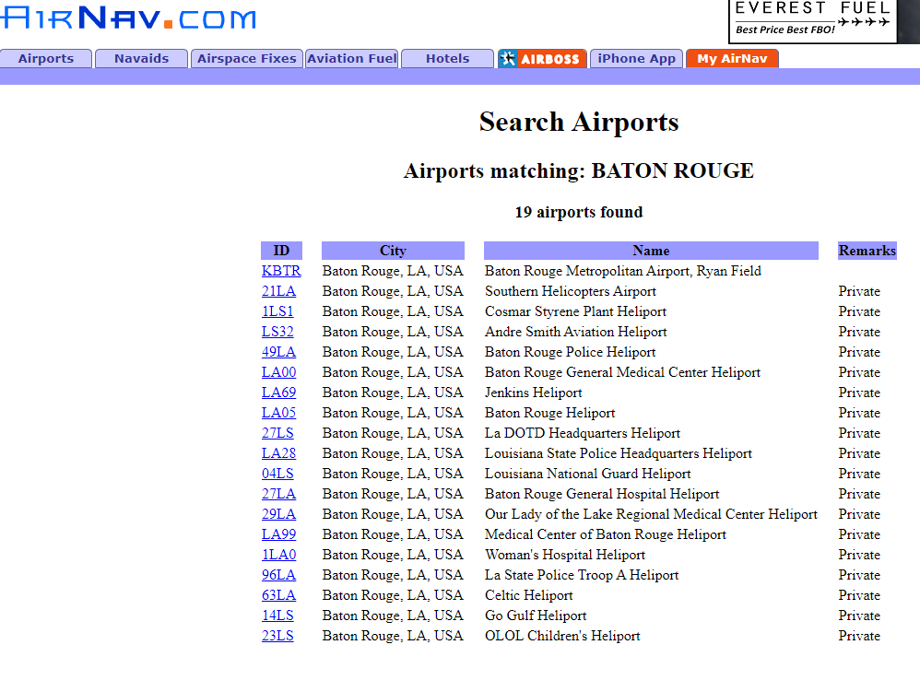
Airport/Military Airfields Map
To find airport maps, first go to www.airnav.com and search for the entity. It will provide a list of airports in the area
Then go to google maps and measure the distance between the project area and airport by right clicking on the target area and choosing “measure distance” and then clicking on the airport
Finally, provide a Military Airfield map by searching for “Louisiana Military Airfield Map” on google maps and identifying Barksdale Air Force Base, Polk Army Airfield, and Naval Air Station Join Reserve Base New Orleans

Slide 14
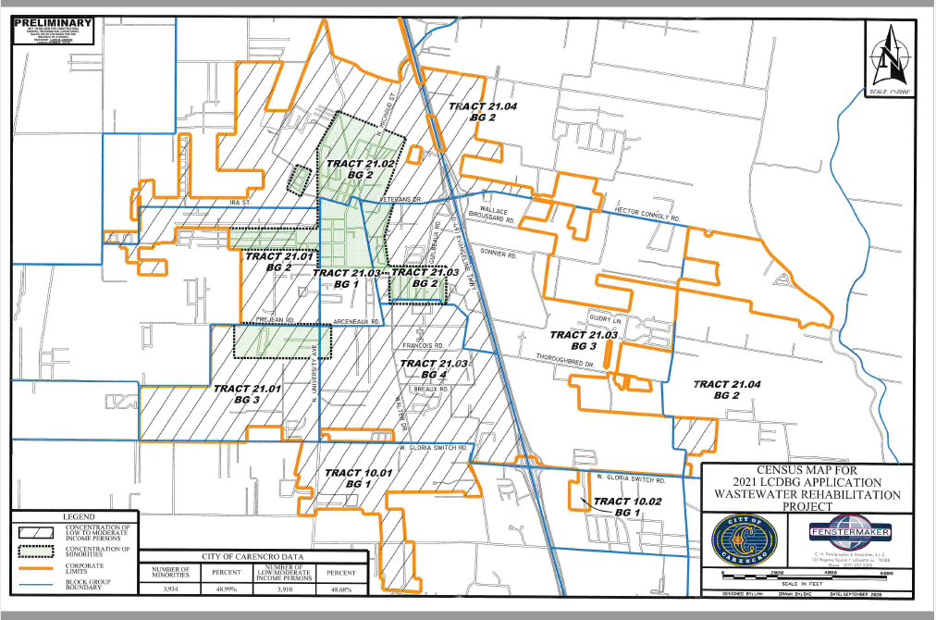
Environmental Justice Map
This map can mimic the outline of the Project Map. However, it needs to identify the concentrations of low/mod and minority persons, as well as include the percentages associated with these categories.

Slide 15
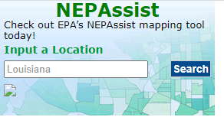
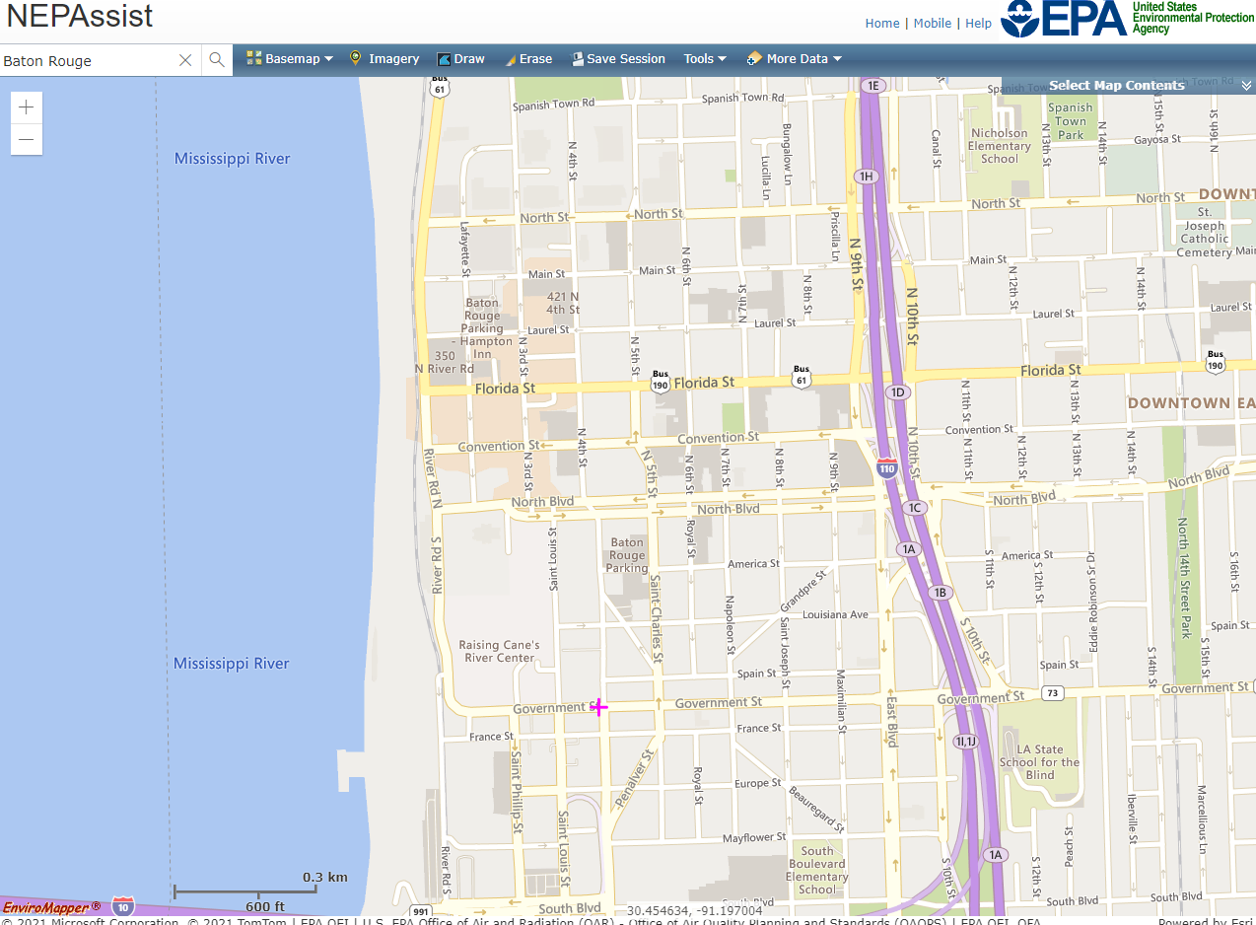
NEPAssist Map
https://nepassisttool.epa.gov/nepassist/entry.html enter the name of the entity in the search bar
Next, zoom in on the project area to show ongoing NEPAssist Reports in that area

Slide 16
Conclusion
https://www.hudexchange.info/programs/environmental-review/federal-related-laws-and-authorities/ is a great resource for extra information regarding the ERR, as well as the OCD-LGA website (https://www.doa.la.gov/doa/ocd-lga/lcdbg-programs/)
Reminder: Every map needs to be referenced on the Statutory Checklist, including dates for the Flood Insurance Rate Map

