Slide 1
Slip, Trip and Fall Prevention
for Broward County
© 2018 ARTHUR J. GALLAGHER & CO. | AJG.COM

Slide 2
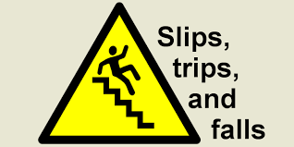
Data and Statistics
Slips and falls are a leading cause of workplace accidents, in terms of frequency
and severity. Falls are the primary cause of emergency room visits in the United
States, according to the Centers for Disease Control and Prevention.

Slide 3
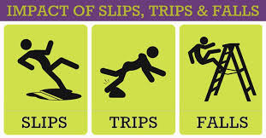
Data and Statistics
One of the most common and costly threats to a workplace safety program is a slip,
trip or fall accident. According to the National Safety Council, the average cost of a
slip, trip or fall related accident is almost $16,000. These injuries not only increase
operational costs, but also contribute to indirect costs such as higher insurance
rates, reassignment of personnel and loss of productivity.

Slide 4

Data and Statistics
The State of Louisiana had 15,993 Worker’s Compensation claims over the past five years and 20% of them were slips/trips/ and falls.

Slide 5

Direct Costs
Workers’ Compensation
Doctors’ Visits
Hospital Care/Treatment
Rehabilitation
Physical Therapy
Medicine

Slide 6

Indirect Costs
Time lost from work by injured employee(s)
Economic loss to injured worker’s family
Loss of efficiency due to break-up of crew
Cost of training a new worker
Administrative time
Potential legal issues
Lower morale

Slide 7

Slips, Trips, and Falls
The most common causes of office falls include:
Wet floors.
Reaching for something while sitting in an unstable chair.
Electrical cords.
Using the wrong equipment for the task.
Poor lighting/visibility.
Uneven flooring or torn carpeting.
Objects in walkways.
Poorly placed furniture.

Slide 8
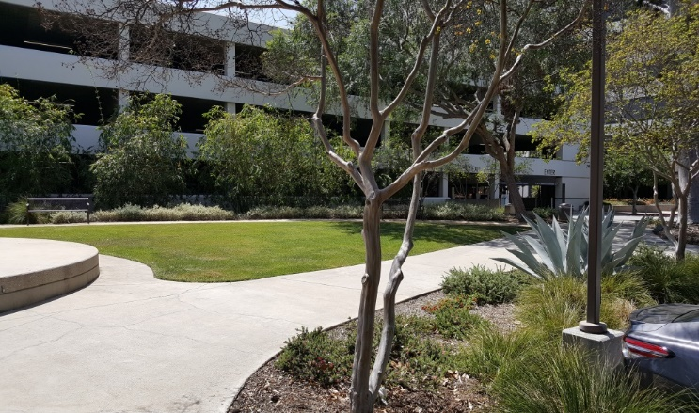
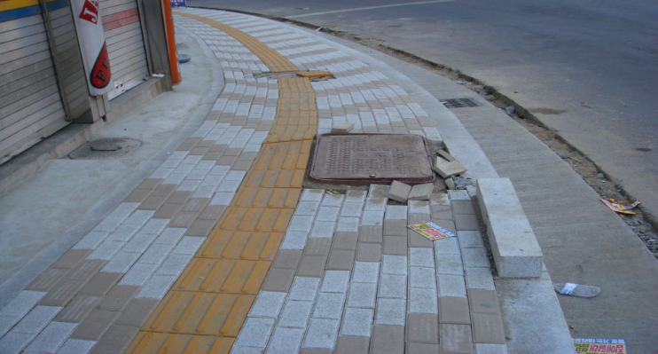
Be Aware
Be aware of:
Potholes and cracks.
Uneven surfaces, sidewalks, and changes in elevation.
Unmarked speed bumps and elevation bumpers.
Slip resistant strips.
  You will not notice these hazards if you are emailing, texting, or talking on your phone while walking.
  PAY ATTENTION!

Slide 9
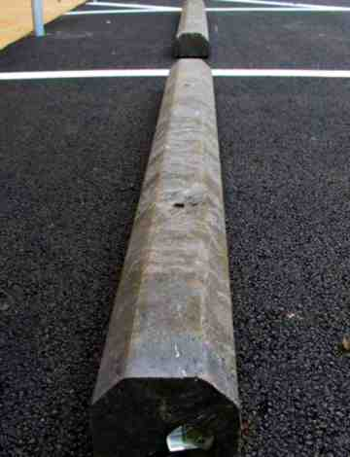
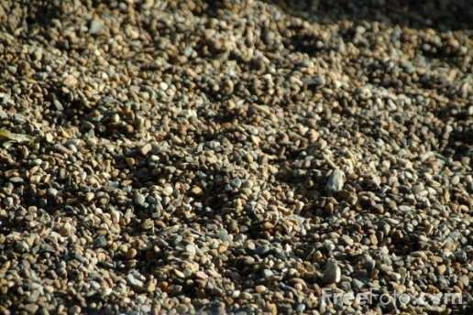
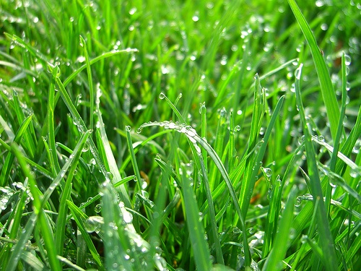
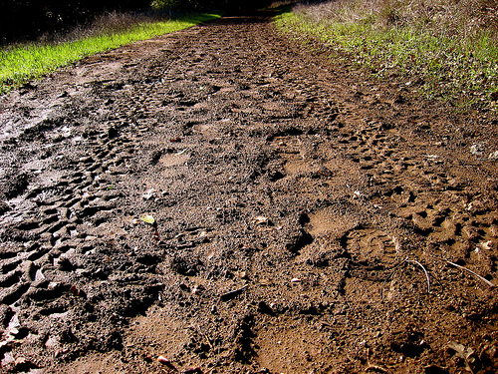
Other Common Outdoor Hazards
Loose gravel.
Uneven dirt/mud paths.
Wet grass.
Parking barriers.
Notes:
9

Slide 10


Proper Footwear
Besides paying attention to your surroundings, wearing the right footwear for your work environment will help prevent or reduce slips, trips, and falls.
Shoes should fit snugly and comfortably with a maximum heel height of 3 inches.
Sandals must have back strap.
Keep your footwear clean and in good condition at all times.
Inspect regularly for any damage; repair or replace worn or defective footwear.
Replace shoes or replace soles before they become worn smooth.
Notes:
10

Slide 11
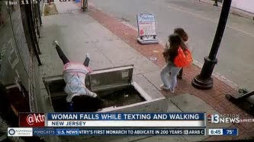
Distracted Walking
Distracted walking also is a major cause of slips, trips, and falls across all organizations.
According to the National Safety Council, talking on the phone was the most prevalent activity at the time of injury, while texting accounted for 12 percent.

Slide 12
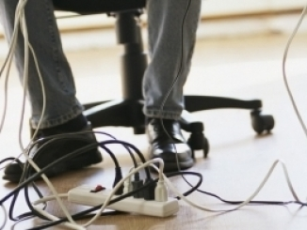
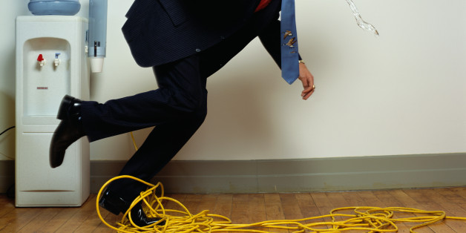
Cord Management
Keep cords out of walkways and away from under your desk.
Secure cables and cords with tape or cord covers.
Notes:
12

Slide 13
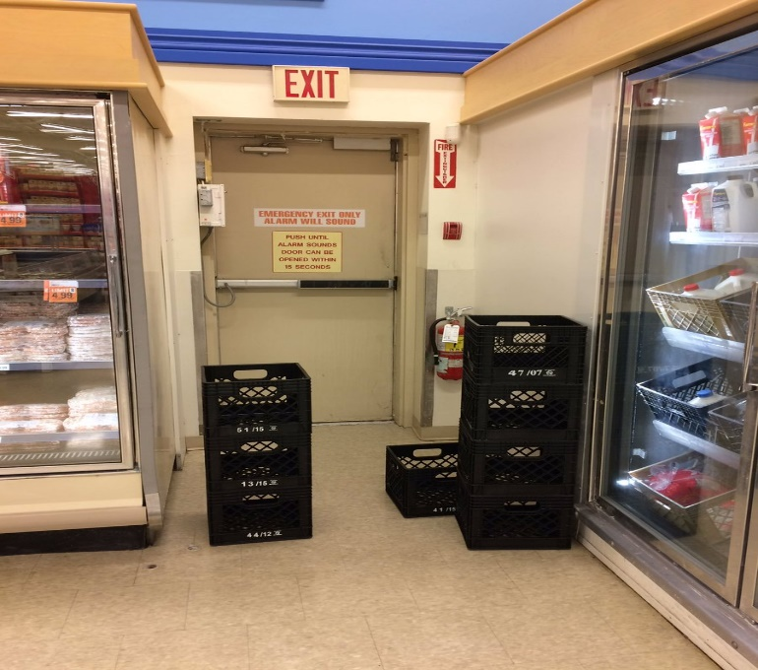
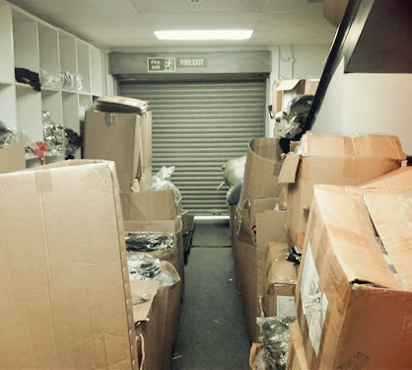
Emergency Exit Doors
Keep items out of the way of emergency exits.
The path needs to remain clear so that everyone can get out safely in an emergency.
Notes:
13

Slide 14
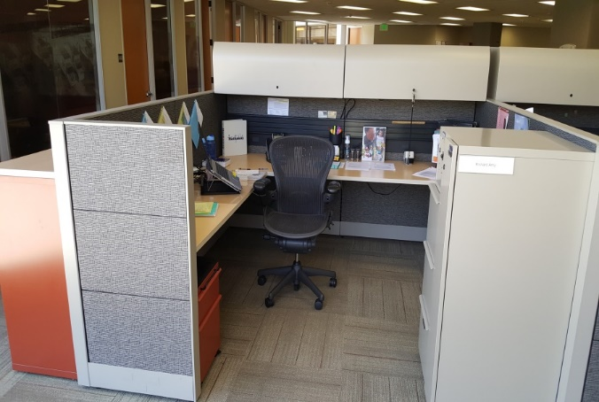
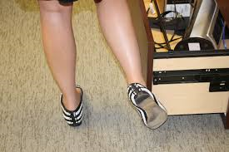
Other Office Hazards
Close your desk drawers, cabinets, and file drawers and doors immediately after each use.
Keep the floor around your workspace free of boxes, cords, cables, materials, and other objects.
Notes:
14

Slide 15
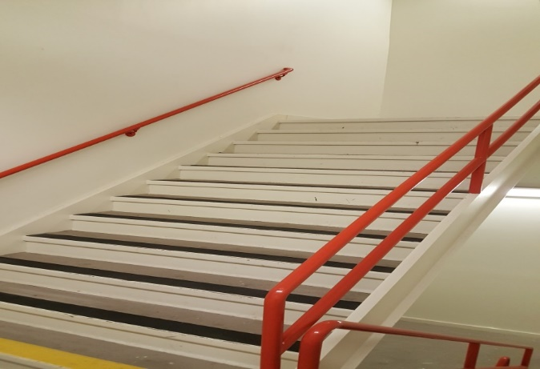
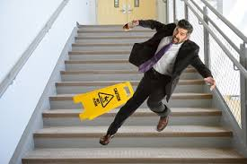
Common Stairway Hazards
Always use the handrails when climbing or descending the stairs.
Do not carry anything that will compromise your ability to hold onto the handrail.
Do not rush and skip steps.
Notes:
15

Slide 16

Hazard Recognition
You’ve got problems, we’ve got answers.

Slide 17
Hazard Recognition
Objects Blocking Walking Path
Problem: Box is causing a trip hazard.
Solution: Remove objects to
make a clear walking path.

Slide 18
Hazard Recognition
Housekeeping
Problem: Poor housekeeping.
Solution: Improve housekeeping and
create a designated walking area.
Notes:
Problem: Cluttered work areas and debris left on walking surfaces can lead to slip or trip incidents.
Solution:

Slide 19
Hazard Recognition
Electrical Cords
Problem: Electrical cords present
a trip hazard.
Solution: Use cord covers.
Notes:
Problem: Power cords
are routed across walkways,
creating a trip hazard.
Solution: Additional wall outlets
may need to be installed to eliminate
the need to run cords along the
floor. Otherwise, high-visibility cord
covers should be used. Cords that
dangle should be tied up to prevent
feet entanglement.

Slide 20
Hazard Recognition
Wet Walking Surface
Problem: Water discharge on
walking surface.
Solution: Redirect the
flow of water.
Notes:
Problem: The downspout
discharge directed across
walking surfaces, contributing to
wet and/or icy conditions.
Solution: Channel the runoff
underneath a walkway.

Slide 21
Hazard Recognition
Slippery Walking Surface
Problem: Can become slippery when
wet.
Solution: Slip resistant floor.
Notes:
Problem: Wooden or aluminum ramps can be slippery when wet or
snowy.
Solution: Install traction strips on the walking surfaces of ramps or apply
another slip-resistant treatment, such as lacquer and sand. Slip-resistant
resin ramps should be considered when planning new ramp construction.

Slide 22
Hazard Recognition
Umbrellas
Problem: Wet surface due to
umbrellas.
Solution: Umbrella bags.
Notes:
Problem: People often shake umbrellas after coming into a
building out of the rain. Water from the umbrellas may pool,
causing a slip hazard.
Solution: To help reduce water puddles inside into the building,
provide umbrella bags for employees and visitors.

Slide 23
Hazard Recognition
Handrails
Problem: Lack of handrails.
Solution: Provide handrails.
Notes:
Problem: Stairs that have no handrails or insufficient handrails can increase the risk of a trip or fall.
Solution: Approved handrails should be installed on at least one side of steps with four or more
stairs. Handrail construction should be rounded to enable a firm grip, which helps prevent falls.
Handrails should be mounted so there is at least a three-inch clearance between the handrail and wall.

Slide 24
Hazard Recognition
Staircases
Problem: Non-contrasting staircase
Solution: Anti-slip tape.
Notes:
Problem: Stair steps with non-contrasting stair tread can cause trips and falls.
Solution: Stair steps should have visibly contrasting edge treatments, especially at the last step on a flight of stairs. Nonslip nosing inserts or friction strips enhance visibility of steps.

Slide 25
Hazard Recognition
Damaged Stairs
Problem: Chipped or deteriorated stairs create a trip or fall hazard.
Solution: Slip-resistant inserts.
Notes:
Problem: Chipped or deteriorated stairs create a trip or fall hazard.
Solution: Deteriorated stairs should be repaired or replaced. Damaged stair treads should be
replaced with slip-resistant inserts. Makeshift stairs should be avoided and replaced with stable stairways.

Slide 26
Hazard Recognition
Changes in Elevation
Problem: Changes in elevation.
Solution: Rework concrete
Notes:
Problem: Sidewalk sections that have changes in elevation greater than 1/2 inch create a
tripping hazard, but even a 1/4 inch elevation can cause trips, especially among the elderly.
Solution: If possible, rework concrete to provide a smooth transition between sections. If
reworking the concrete is not an option, provide warning markings or cones, especially when
dealing with seasonal concrete heaving.

Slide 27
Hazard Recognition
Gravel Potholes
Problem: Inadequate gravel depth.
Solution: Apply additional gravel.
Notes:
Problem: Gravel parking lots with inadequate gravel thickness can lead to pooling water. During winter months, standing water can freeze and create a slip hazard.
Solution: Apply additional gravel to high-traffic areas and areas with thin gravel layers.

Slide 28
Hazard Recognition
Curbs
Problem: Unpainted curbs
Solution: Painted curbs.
Notes:
Problem: Unpainted curbs or curb ramps along high-traffic sidewalks and other high traffic
areas may be difficult to see, creating a trip hazard.
Solution: Paint curbs and curb ramps with nonslip yellow paint. In addition, consider reworking
curb areas by installing a curb ramp with flared sides and contrasting color.

Slide 29
Hazard Recognition
Concrete Expansion Joints
Problem: Sidewalk gaps.
Solution: Concrete joint filler.
Notes:
Problem: Gaps between sidewalk sections can catch heels, creating a tripping hazard. In addition, large gaps collect water, which can aggravate frost heaving.
Solution: Large cracks should be cleaned and filled with the appropriate filling material. In some cases, rope caulking may be necessary to use as a base to keep the filler material in place.

Slide 30
Hazard Recognition
Walk-off Mats
Problem: Overlapping mats.
Solution: Smooth level mats.
Notes:
Problem: Entrance mats that overlap create a raised hump that could cause a person to trip.
This is especially a concern for the elderly, who may have more difficulty seeing the hump.
Solution: Mats should be placed in a way that creates a smooth, level walking surface.

Slide 31
Hazard Recognition
Walk-off Mats
Problem: Water accumulation
Solution: Water absorbent mats
Notes:
Problem: Areas around drinking fountains and sinks do not always have the correct types of
mats to prevent water pooling increasing the chance of a slip or fall.
Solution: Set up slip-resistant or water-absorbing mats in these areas.

Slide 32
Hazard Recognition
Walk-off Mats
Solution: Water absorbent mats

Slide 33
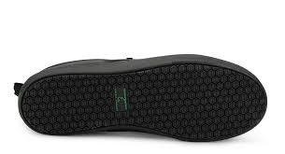
Hazard Recognition
Footwear
Problem: Improper footwear
Solution: Anti-Slip Footwear
Notes:
Problem: People often wear inadequate footwear for the task being performed.
Solution: Employees should be trained to wear slip-resistant footwear specifically designed for the work environment. Open heels, spiked heels and flip flops should not be allowed. Since most people walk heel first, the heel area is usually the first area to wear out and should be inspected regularly.
Employees assigned to work in routinely wet slippery areas (e.g., kitchens) should wear slip-resistant, rubber-soled footwear.

Slide 34

Hazard Recognition
Wet Floor Signs
Problem: Improper footwear
Solution: Anti-Slip Footwear
Notes:
Problem: People often wear inadequate footwear for the task being performed.
Solution: Employees should be trained to wear slip-resistant footwear specifically designed for the work environment. Open heels, spiked heels and flip flops should not be allowed. Since most people walk heel first, the heel area is usually the first area to wear out and should be inspected regularly.
Employees assigned to work in routinely wet slippery areas (e.g., kitchens) should wear slip-resistant, rubber-soled footwear.

Slide 35
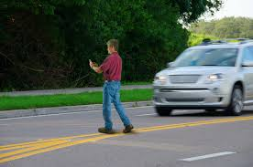
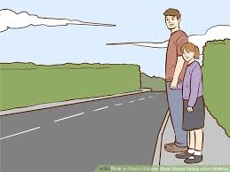
Hazard Recognition
Distracted Walking
Problem: Distracted walking
Solution: Remain vigilant
Notes:
Problem: People often wear inadequate footwear for the task being performed.
Solution: Employees should be trained to wear slip-resistant footwear specifically designed for the work environment. Open heels, spiked heels and flip flops should not be allowed. Since most people walk heel first, the heel area is usually the first area to wear out and should be inspected regularly.
Employees assigned to work in routinely wet slippery areas (e.g., kitchens) should wear slip-resistant, rubber-soled footwear.

Slide 36
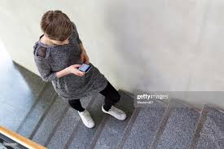
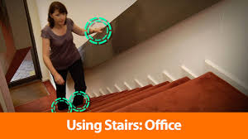
Hazard Recognition
Distracted Walking
Problem: Distracted walking
Solution: Remain vigilant
Notes:
Problem: People often wear inadequate footwear for the task being performed.
Solution: Employees should be trained to wear slip-resistant footwear specifically designed for the work environment. Open heels, spiked heels and flip flops should not be allowed. Since most people walk heel first, the heel area is usually the first area to wear out and should be inspected regularly.
Employees assigned to work in routinely wet slippery areas (e.g., kitchens) should wear slip-resistant, rubber-soled footwear.

Slide 37
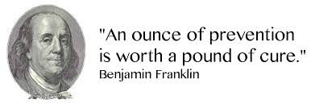
Prevention

Slide 38

We have identified a problem. Now we need a solution.

Slide 39


Teamwork
The State of Louisiana’s Office of Risk Management has set a goal of decreasing its slip/trip/fall injuries. With your help we can keep one another safe! We need everyone on board! Together we can do this.

Slide 40
Questions?
Notes:
I know that we have covered a lot of different material today with a lot of different topics. Please ask your questions.

Slide 41


Thank You!
Tommy Normand
225-955-0794
tommy_normand@ajg.com
235 Highlandia Drive
Baton Rouge, LA 70810
© 2018 ARTHUR J. GALLAGHER & CO. | AJG.COM

