Slide 1
CDBG Environmental Review
Workshop
Louisiana Housing Corporation
October 16 & October 17
9:00 am

Slide 2
Staff Introduction
Fenishia Favorite – Environmental Review Compliance Officer
Staff that review ERRs
Denease McGee – CDBG Program Manager
Kristi Kron – Community Development Specialist
Sarah Underwood– Community Development Specialist

Slide 3
Agenda
Day 1
Introductions
Overview of Environmental Process
First Project Review
Day 2
Ice Breaker
Second Project Review
Publications
Letters
Common Errors

Slide 4
What is the Environmental Review Record (ERR)?
Analysis of a proposed project’s potential impacts on the surrounding environment and the project site’s suitability for the proposed use
  Ensures that HUD-funded projects provide decent, safe, and sanitary projects
  Documents compliance with 17 federal environmental laws and authorities
A transparent public document that encourages community participation

Slide 5
Federal Requirements
24 CFR Part 58
Each LCDBG (Louisiana Community Development Block Grant) Program participant must implement their program in compliance with the National Environmental Policy Act of 1969 (NEPA) and other applicable federal environmental laws.
For all projects, especially economic development projects, particular attention must be given to 24 CFR Part 58.32 – Project Aggregation.

Slide 6
Project Aggregation
  RE must group together and evaluate as a single project all individual activities that are related either on a geographical or functional basis, or are logical parts of a composite of contemplated actions
  Must include both HUD and non-HUD funds
  HUD’s aggregation principles require aggregating all related known and reasonably foreseeable activities regardless of funding sources, in one environmental review (ER).
  A reasonably foreseeable activity or project phase is one for which there are funding or contractual commitments in place or existing plans for reuse go beyond the preliminary or schematic plan phases.
Example:
  A proposal for street improvements in different neighborhoods throughout a jurisdiction. Must consider aggregating all locations if the improvements are the same for all sites and environmental conditions at all locations can be adequately addressed in one ER.

Slide 7
Question & Answer
A town has hired a consultant and engineer, to complete a project that involves acquisition of new land and construction of a water well on the acquired land. How many different ERR related forms should be included?
A.) 2
B.) 1
C.) 4

Slide 8
The Answer is……
B The Town should include 1 copy of each form that addresses the entire project.

Slide 9
Choice Limiting Actions
HUD defines a choice limiting action as one that may have an adverse impact on the environment or limit the choice of reasonable alternatives.
A choice limiting action may include, but is not limited to, signing a lease agreement, real property acquisition, rehabilitation, repair, demolition, disposition, or new construction. REMEMBER: Projects are based on the aggregation of all activities that are included in the scope of the environmental review.

Slide 10
Program Requirements
All contract conditions must be cleared within five months of the date of the Authorization to Incur Costs letter.
The Environmental Review Record (ERR) should be received by the State within four months of this date to ensure sufficient time for review.
The grantee’s Chief Elected Official (CEO) will assume overall responsibility for the environmental review process. Others may assist but local government CANNOT DELEGATE this responsibility to another entity or consultant.
The CEO must sign all certifications and findings.
The ERR must be submitted to this office with original signatures (NOT e-mailed)
If grant funds are used to prepare the ERR no correspondence should be dated before the Authorization to Incur Cost letter.

Slide 11
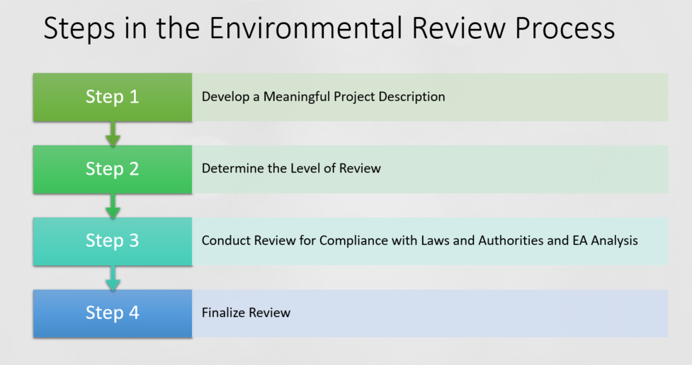

Slide 12
Project Description & Map
This should be the first step of the review process.
The description should be detailed and include all activities that will take place in the project.
Map should show the exact location(s) of the project
The Project Description and Map will be sent with all correspondences
Project Description will also help Grantee determine the level of review.

Slide 13
Purpose of the proposed project
Location
Size of the parcel and buildings
Trends-economic and demographic
Benefits of and impact to the community
What is currently or what was on the site
Will there be demolition, rehabilitation and or new construction?
A small project will still have details that need to be identified
Project Description = Defining the Project

Slide 14
Exercise #1
Project Description Review

Slide 15
Environmental Review Clearance Levels
Exempt
  Environmental studies, project planning, and administrative costs
Categorically Excluded Not Subject to 58.5 – 58.35 (b)
  Operating costs and equipment
Categorically Excluded Activities Subject to 58.5 – 58.35 (a)
  Acquisition, repair, and improvements (less than 20%)
Activities Requiring an Environmental Assessment 58.36
  New construction and substantial improvements (more than 20%)
Environmental Impact Statement – 58.37
  Significant impact on environment
See Handout -HUD SUMMARY OF LEVELS OF ENVIRONMENTAL REVIEW & DOCUMENTATION REQUIRED IN ERR

Slide 16
Exercise # 2
ERR CLEARANCE LEVEL REVIEW

Slide 17
Project Review # 1

Slide 18
DAY 2

Slide 19
Ice Breaker:
15- Minute Networking Period
Meet SOMEONE NEW and Exchange Contact Information!

Slide 20
Project Review # 2

Slide 21
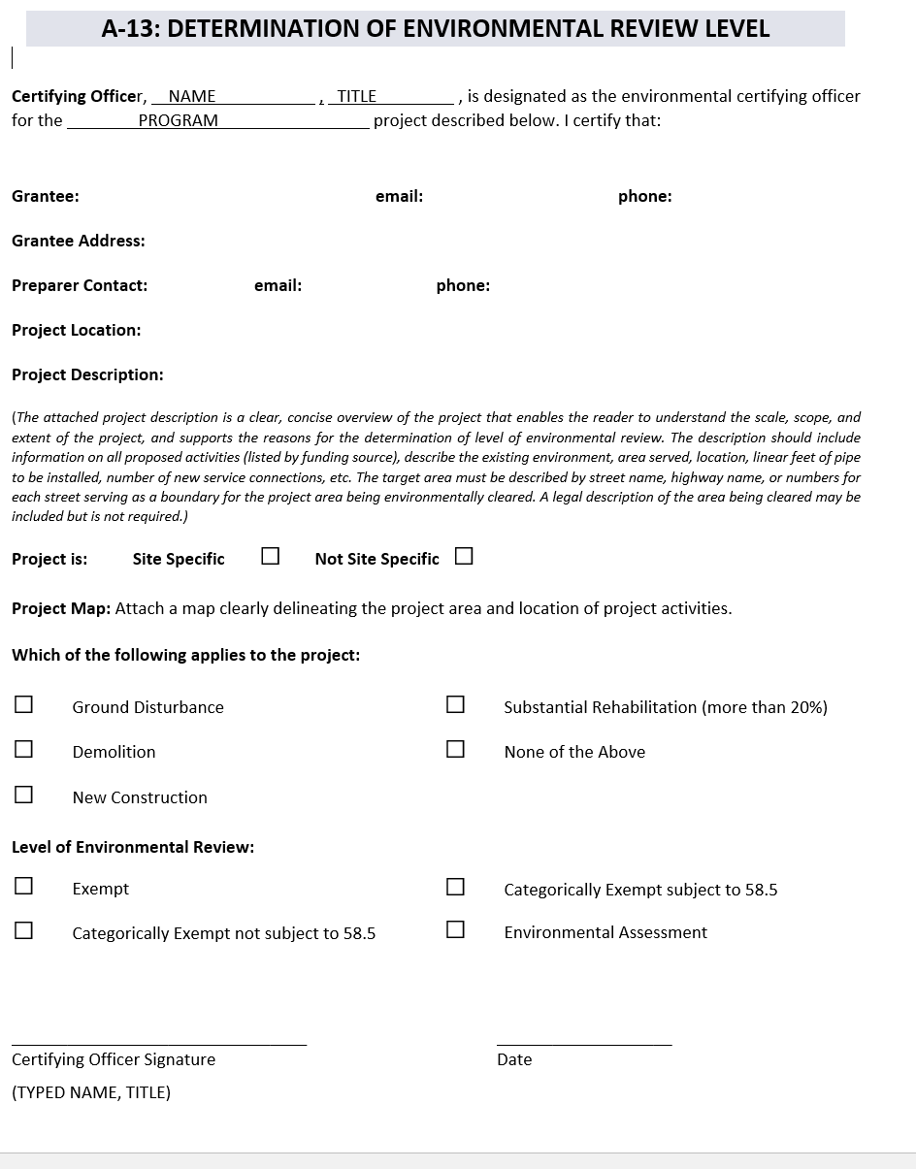
Determination of Environmental Review Level
Must be included for all projects.
Signed by RE, dated, project description and project map should be attached, Read selections and make sure they match the project

Slide 22
HUD Form based on the level of Review
The ERR Handbook includes links to all needed Forms based on the Review level and Worksheets. Forms may also be found on Environmental Review - HUD Exchange
The Compliance Determination section should state what was included in the response from the agencies; documentation of both copies of the letters and dates that match the letter; if a map is referenced the date on the map and map number should be included.
The HUD worksheet it will let you know depending on responses if box yes or no should be answered to “Are formal compliance steps or mitigation required?”

Slide 23
Worksheets for Compliance Areas
Worksheet must be completed and submitted with all supporting documentation because the worksheet directs the Grantee to know what should be put on the Form.
If the compliance area is listed on the HUD form for that level of review a worksheet should be completed and all supporting documentation should be attached.
Link to all partner worksheets : Environmental Review Record Related Federal Laws and Authorities Worksheets - HUD Exchange
Partner Worksheets should not be used!!
THE ERR IS NOT COMPLETE WITHOUT THE WORKSHEETS AND SUPPORTING DOCUMENTATION.

Slide 24
Statutory Checklist and Worksheet
Worksheet must be completed because the worksheet directs the Grantee to know what should be put on the checklist.
The Compliance Finding section should state what was included in the response from the agencies. The Source Documentation column should include both copies of the letters and dates that match the letter. If a map is referenced the date on the map and map number should be included.

Slide 25
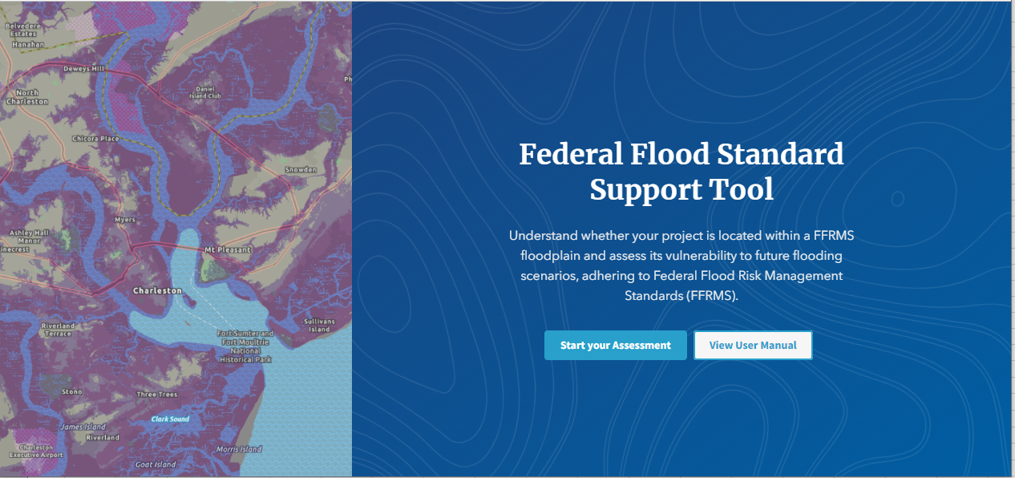
Floodplain Map
Beginning July 1, 2024 HUD’s final rule changed the highly recommended map to Federal Flood Standard Support Tool (climate.gov)
This map must be completed regardless of a Floodplain Analysis 8-step process being required
On this screen, click launch tool and start your assessment

Slide 26
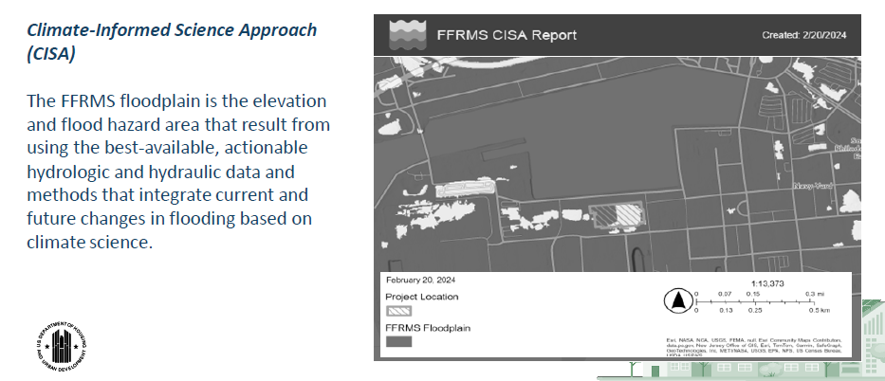
Climate Informed Science Approach CISA Map

Slide 27
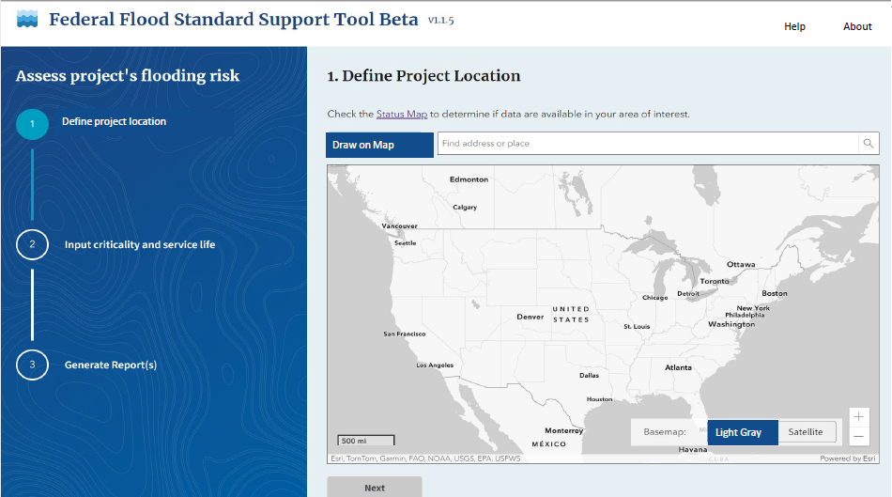

Slide 30
8- Step Process
General overview:
Step 1: Reviewed the site and ensured the project is needed
Step 2: Early Publication notice w/ 15-day comment period
Step 3: Can the project be avoided? List reasons why it can not be avoided.
Step 4: Permanent adverse impacts?
Step 5: Require minimization of project impacts
Step 6: Re-evaluation of alternatives
Step 7: Final notice Publication w/ 7-day comment period
Step 8: Proceed to implement project after comment period
If the 8-step is needed for both Wetlands and Floodplains the Grantee can include both findings in one 8-step review, but all findings must be mentioned. Also, make sure that the findings of the 8-step are included in the compliance finding column and 8-step process is mentioned in the source documentation column of the checklist.

Slide 31
Publication of 8-Step !!!!!
As of the final rule issued by HUD on April 23, 2024, public notices required for environmental reviews to be published online on appropriate government websites.

Slide 32
8-Step Process Example –
Exercise #1

Slide 33
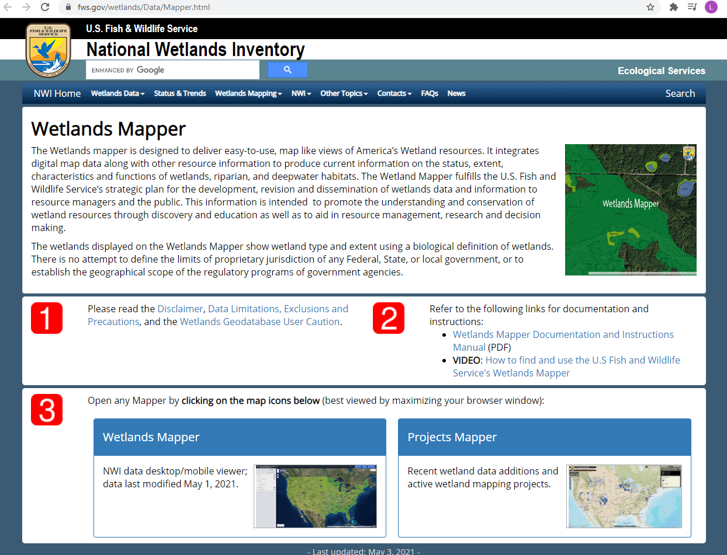
Wetland Inventory Map
https://www.fws.gov/wetlands/Data/Mapper.html
This map must be included regardless of a Wetland Analysis 8-step process being required.
Click on the Wetland Mapper icon.

Slide 34
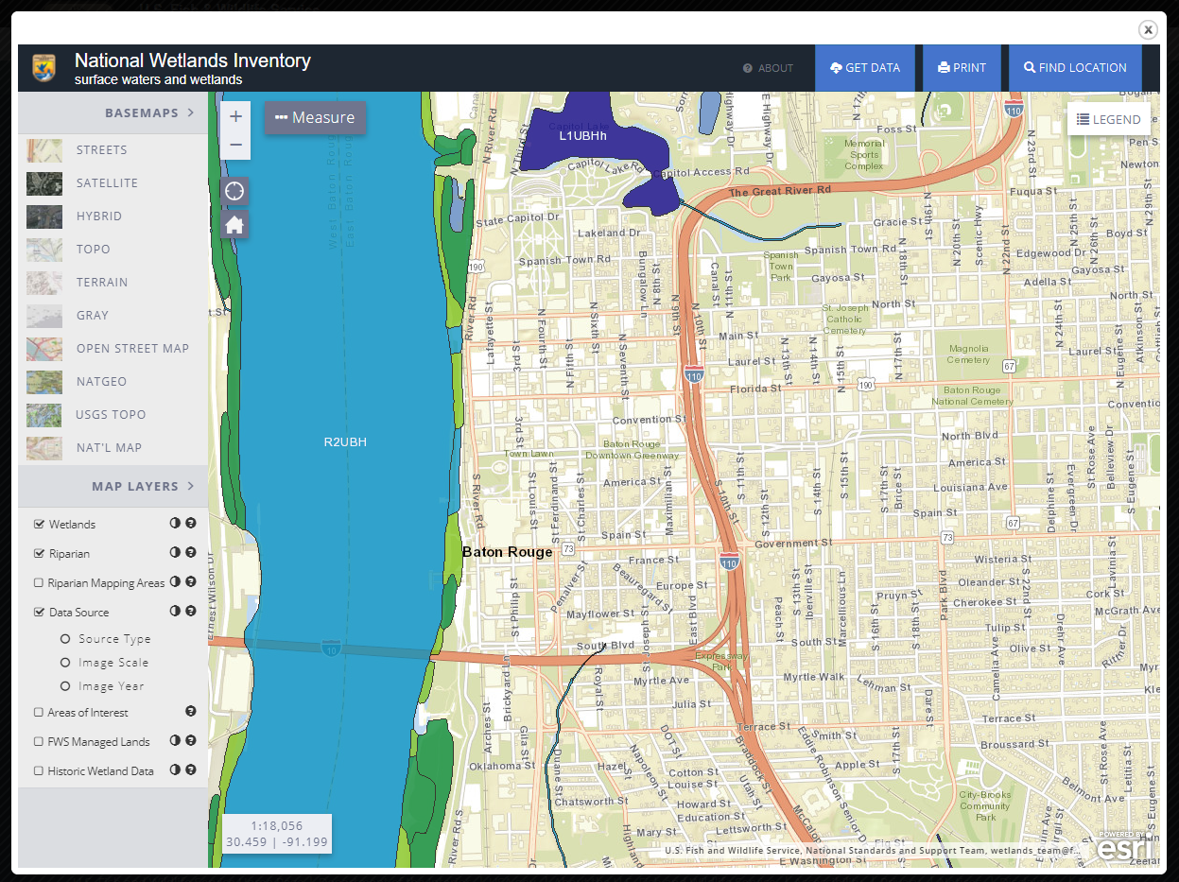
-Once you reach this screen, search the entity by clicking “Find Location”
-For easier access to street views, click “Basemaps” and “Streets”
-Make sure to include an outline of the project area on the map

Slide 35
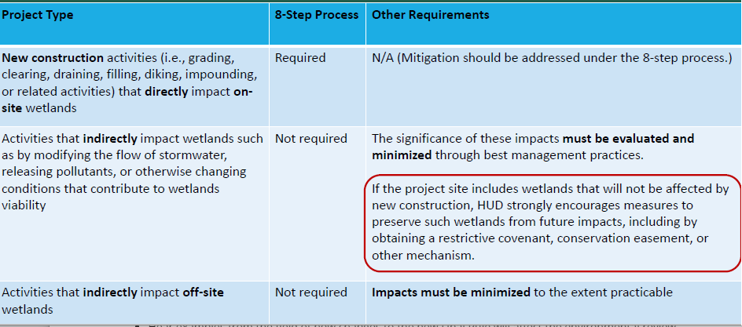
Defining the need for an 8- Step related to Wetlands

Slide 36
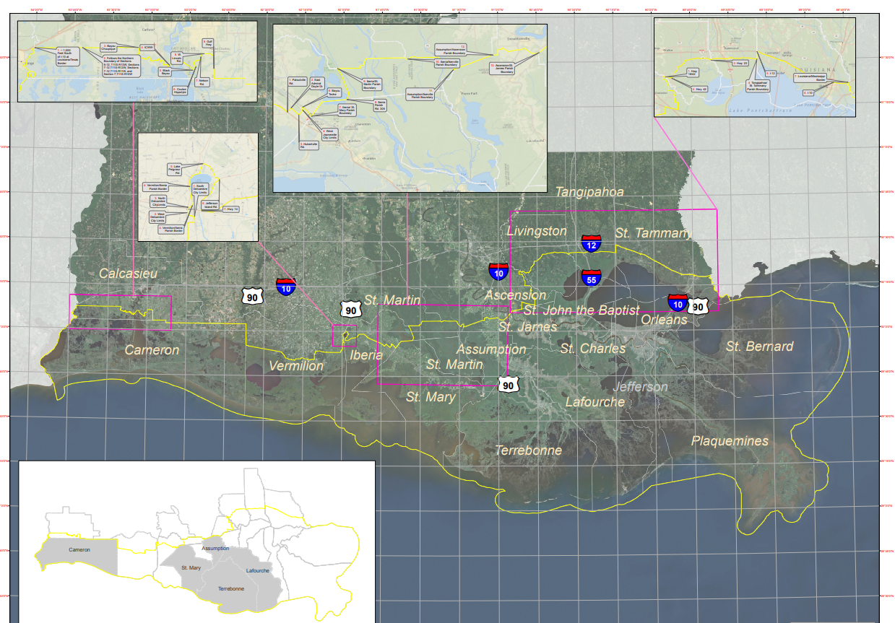
Coastal Zone Map
http://www.dnr.louisiana.gov/index.cfm?md=pagebuilder&tmp=home&pid=928
This link goes to the Coastal Zone Boundary main page on the Department of Natural Resources website
Scroll down to the Coastal Zone Boundary Map
The Parish that the project is being completed in must be referenced on the map
Project is located in East Baton Rouge Parish

Slide 37
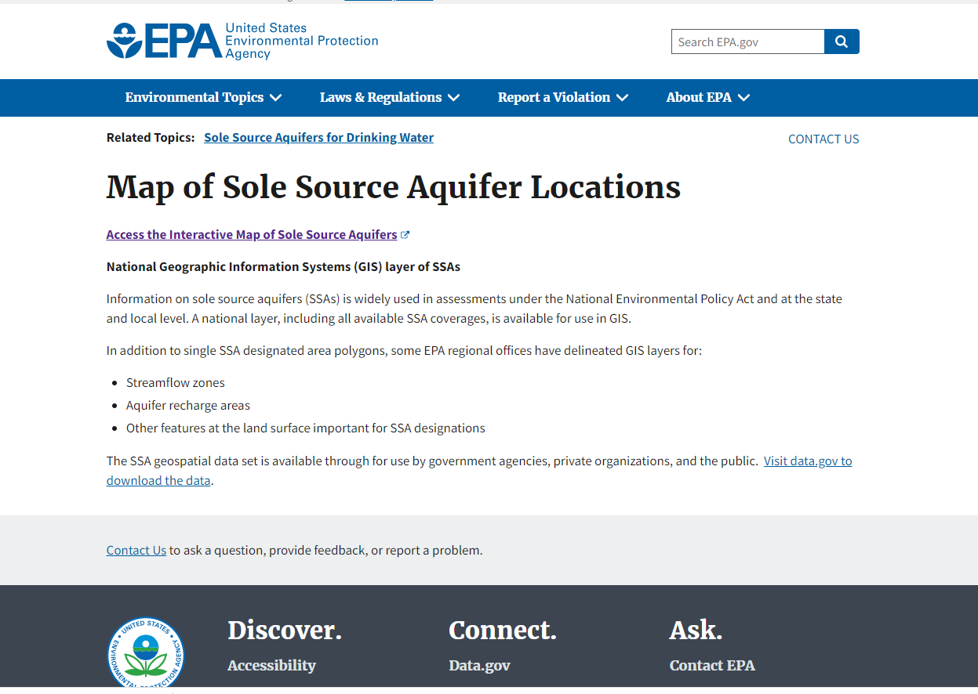
Sole Source Aquifers Map
https://www.epa.gov/dwssa/map-sole-source-aquifer-locations
Click on “Access the Interactive Map of Sole Source Aquifers”

Slide 38
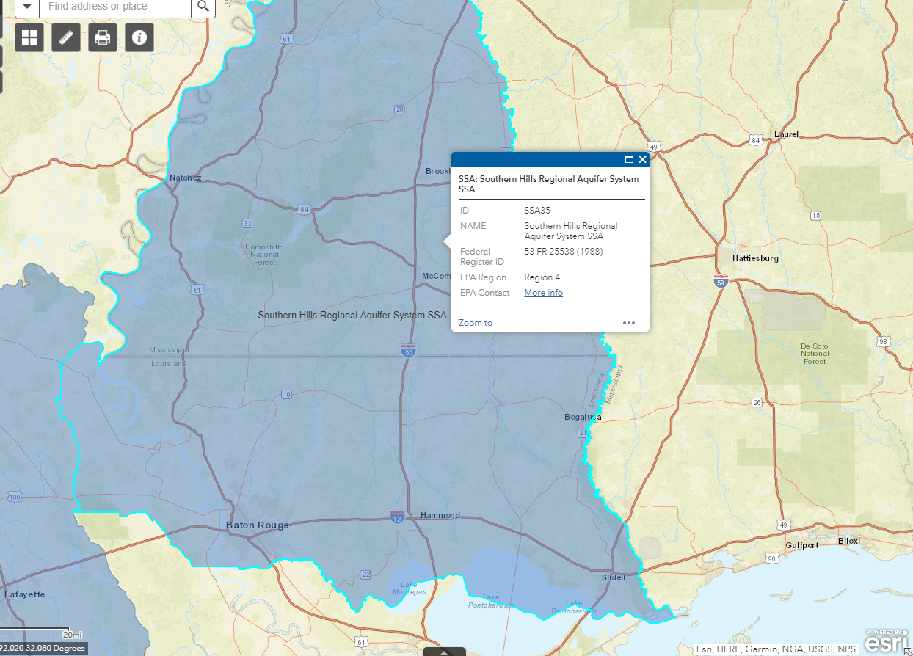
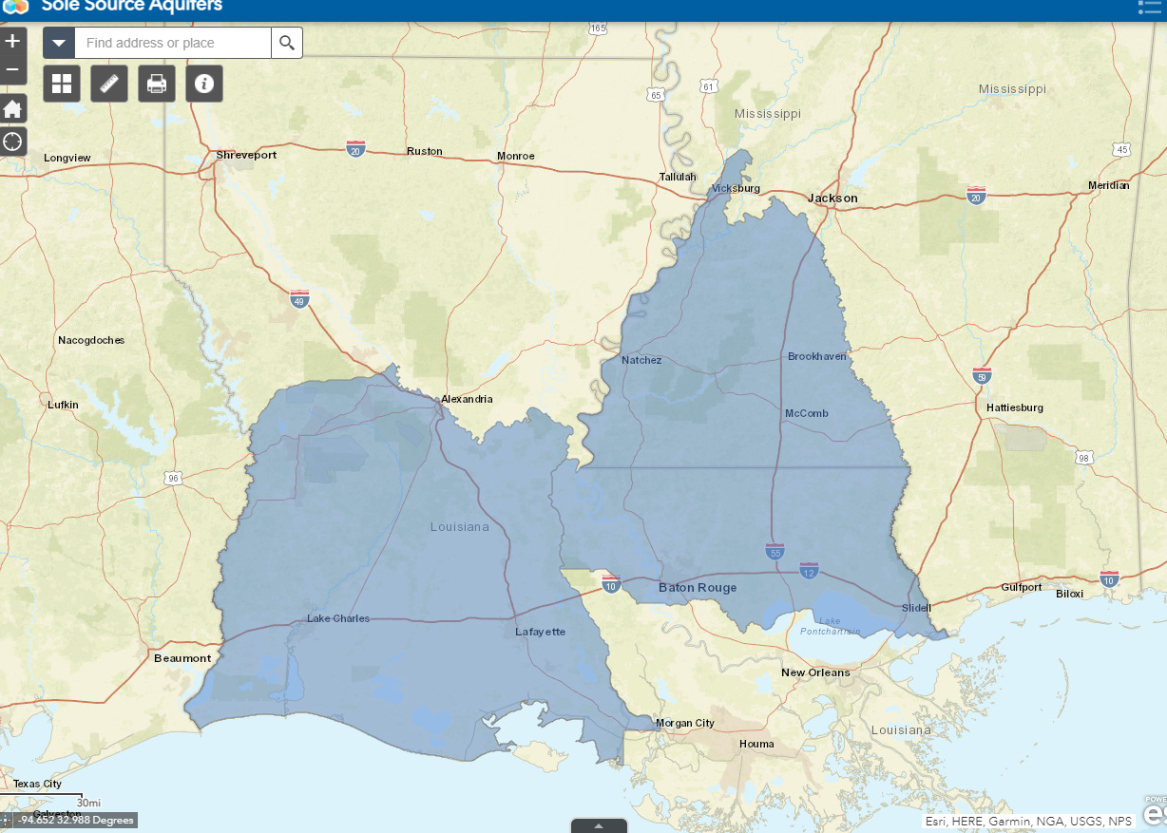
There are two Sole Source Aquifer regions in Louisiana (Region 6 and Region 4)
If the project area falls in one of these regions, zoom in to identify the general location on the map
If the project is not in a Sole Source Aquifer, mark the general location on a zoomed out map

Slide 39
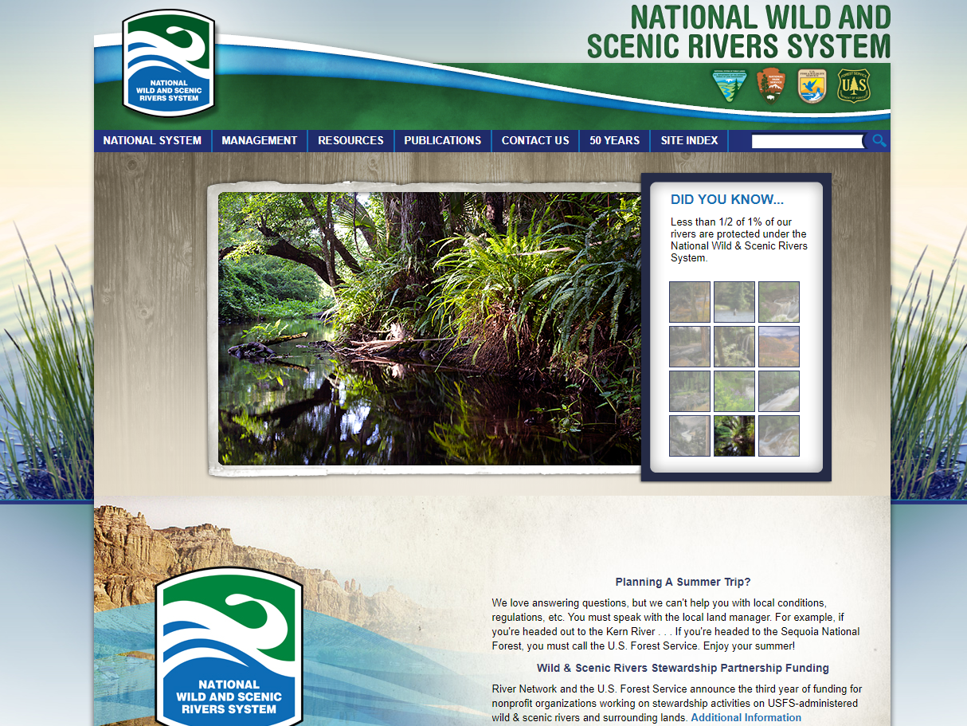
Wild and Scenic Rivers
https://www.nps.gov/subjects/rivers/nationwide-rivers-inventory.htm & https://www.nps.gov/subjects/rivers/louisiana.htm
Scroll down to “National Wild and Scenic Rivers Story Map” and click “View the Map”

Slide 40
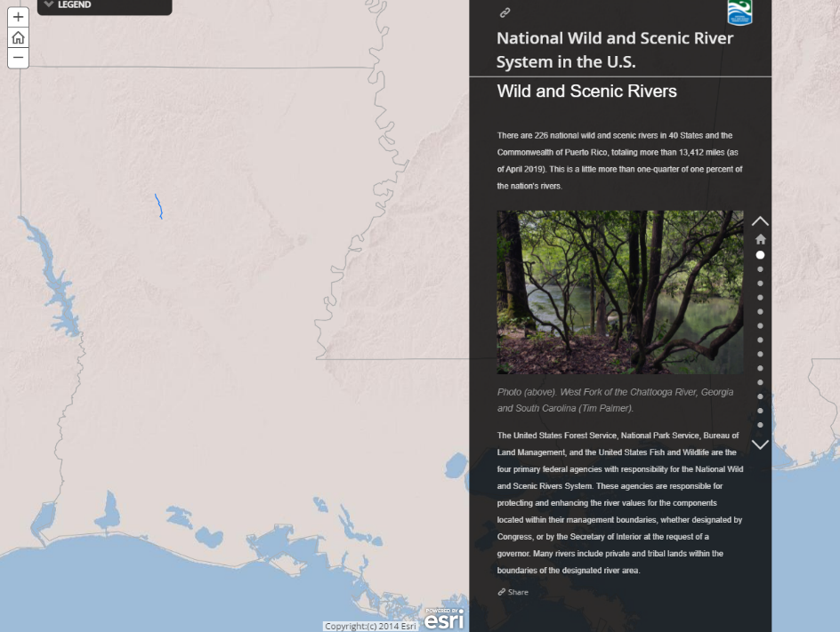
The only Wild and Scenic River in Louisiana is Saline Bayou
Mark where your location is in reference to Saline Bayou
We require that you list the rivers that are being studied as potential components of the Wild and Scenic River System. However, you do not have to provide a map for those.

Slide 41
Farmland Protection
Should include one of the following for documentation:
A determination that the project does not include any activities, including new construction, acquisition of undeveloped land, or conversion, that could potentially convert one land use to another
Evidence that the exemption applies, including all applicable maps
Evidence supporting the determination that “Important Farmland,” including prime farmland, unique farmland, or farmland of statewide or local importance regulated under the FPPA does not occur on the project site
Documentation of all correspondence with NRCS, including the completed AD-1006 and a description of the consideration of alternatives and means to avoid impacts to Important Farmland

Slide 42
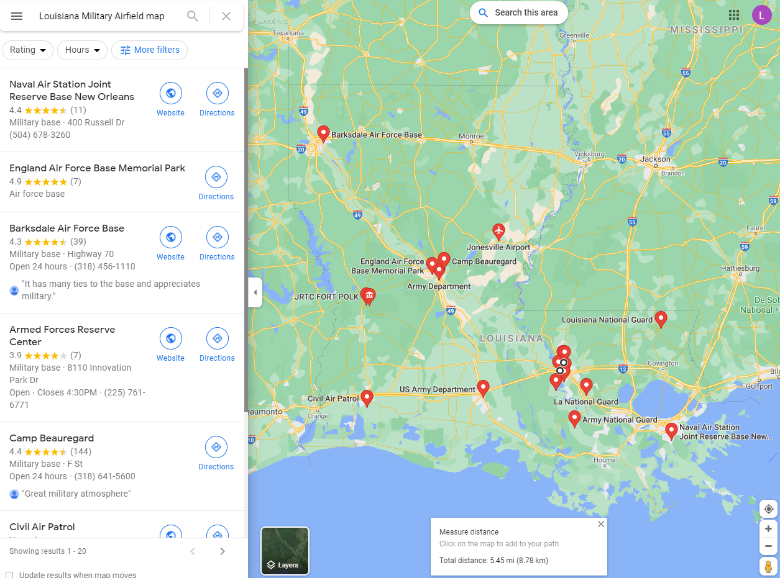
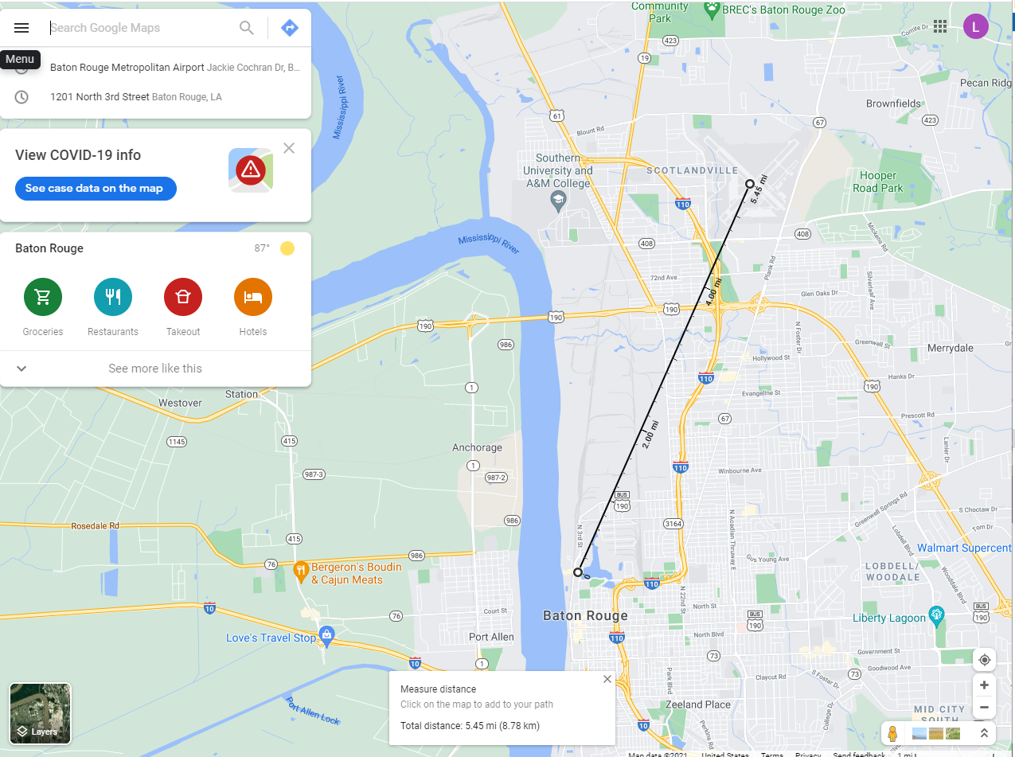
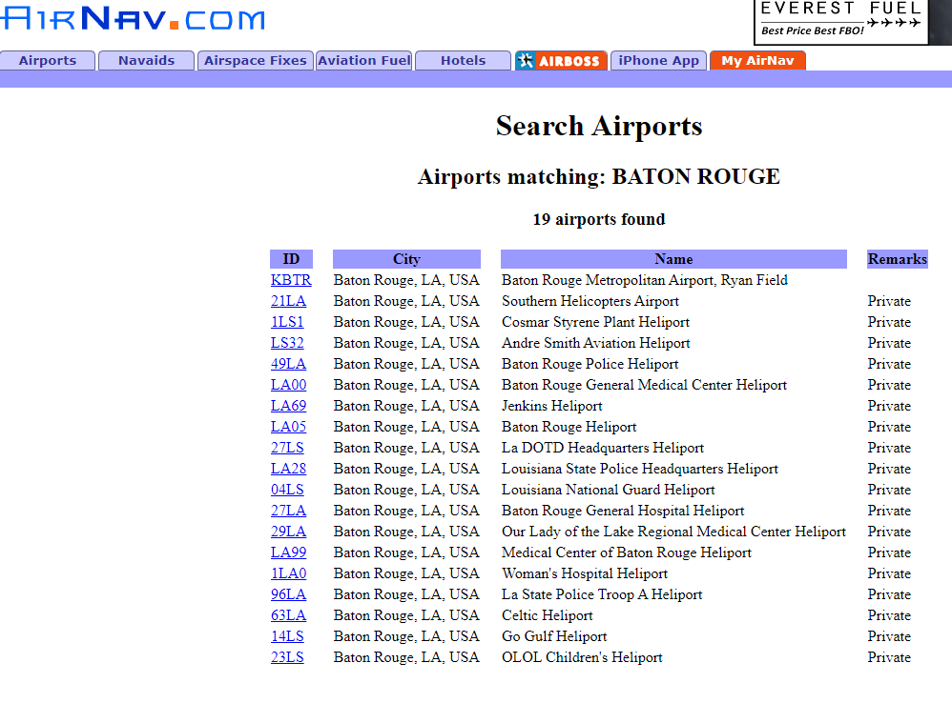
Airport/Military Airfields Map
To find airport maps, first go to www.airnav.com and search for the entity. It will provide a list of airports in the area
Then go to google maps and measure the distance between the project area and airport by right clicking on the target area and choosing “measure distance” and then clicking on the airport
Finally, provide a Military Airfield map by searching for “Louisiana Military Airfield Map” on google maps and identifying Barksdale Air Force Base, Polk Army Airfield, and Naval Air Station Join Reserve Base New Orleans

Slide 43
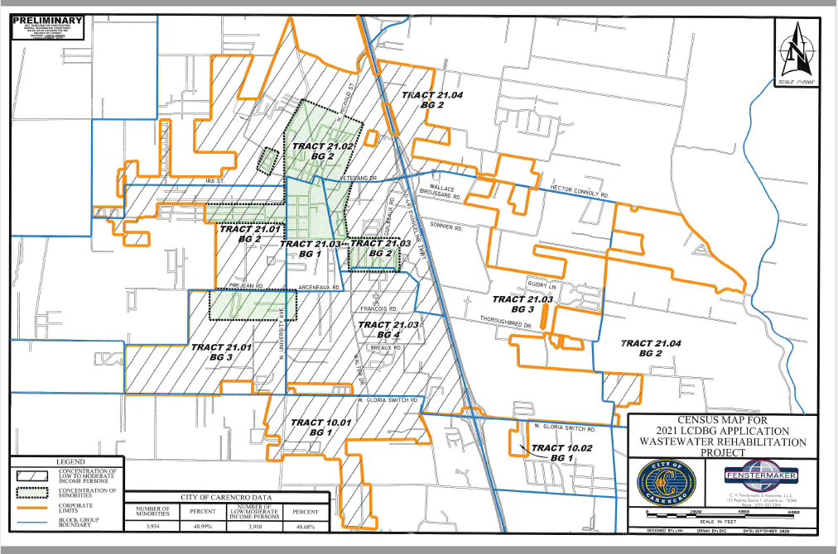
Environmental Justice Map
This map can mimic the outline of the Project Map. However, it needs to identify the concentrations of low/mod and minority persons, as well as include the percentages associated with these categories.

Slide 44
Environmental Assessment
Checklist should be completed (all questions) and signed by the Responsible Entity.
Make sure the person that answered the questions has knowledge in that area. Example: The school board director should not be answering questions about the soil in the Parish.
Also, look closely at questionnaires if provided and make sure they match the answers on the assessment.

Slide 45
Revisions
After the initial review – If revisions are needed the reviewer will send out a letter requesting revisions. The Grantee should respond in a timely manner to avoid delays and penalties. Subsequent revision letters may be sent.
Once the ERR is complete and no other revisions are needed the reviewer will send a letter giving permission to publish or clearance depending on the level of review.

Slide 46
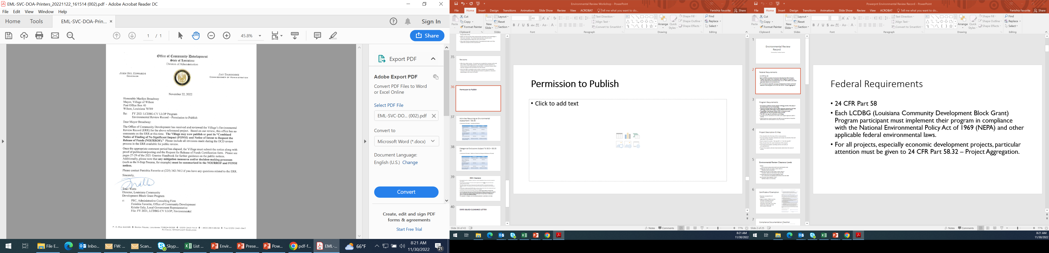
Permission to Publish

Slide 47
Activities Requiring an Environmental Assessment – 58.36
Comment Periods - Combined Notice
 | Publication | Posted
“Combined Notice” Date | 06/04/xx (15 days) | 06/04/xx (18 days)
Date of “Request for Release of Funds and Certification” | 06/20/xx | 06/23/xx
Date ERR and request for funds mailed to State | 06/20/xx | 06/23/xx
ERR received by State | 06/22/xx | 06/25/xx
State’s 15-day Public Comment Period | 06/23/xx to 07/07/xx | 06/26/xx to 07/10/xx

Slide 48
Categorical Exclusions Subject To 58.5 – 58.35 (a)
Comment Periods - Notice of Intent to Request Release of Funds
 | Publication | Posted
Notice of Intent Date | 06/04/XX (7 days) | 06/04/xx (10 days)
Date of “Request for Release of Funds and Certification” | 06/12/xx | 06/15/xx
Date ERR and request for funds mailed to State | 06/12/xx | 06/15/xx
ERR received by State | 06/14/xx | 06/17/xx
State’s 15-day Public Comment Period | 06/15/xx to 06/29/xx | 06/18/xx to 07/02/xx

Slide 49
ERR Clearance
All required permits, mitigation measures, and the Eight-Step Process must be included in the notices.
The Request for Release of Funds must be signed by the CEO after the end of the local public comment period.
The ERR reviewer will count 15 days from the date the RROF is received for the state comment period. The day after the 15th day the reviewer will prepare the ERR clearance letter.
If the entity is determined EXEMPT after a review of documents then the reviewer will issue a clearance and the Permission to Publish is not needed.
All activities must be environmentally cleared including those funded by private funds.
Until the State has approved the recipient’s Request for Release of Funds, neither a grantee nor any participant, including public or private non-profit or for-profit entities or any of their contractors, may commit LCDBG/HUD funds or private funds or undertake an activity or project. (24 CFR Part 58.22)
This regulation is triggered when the grantee’s application is submitted to the State.

Slide 50
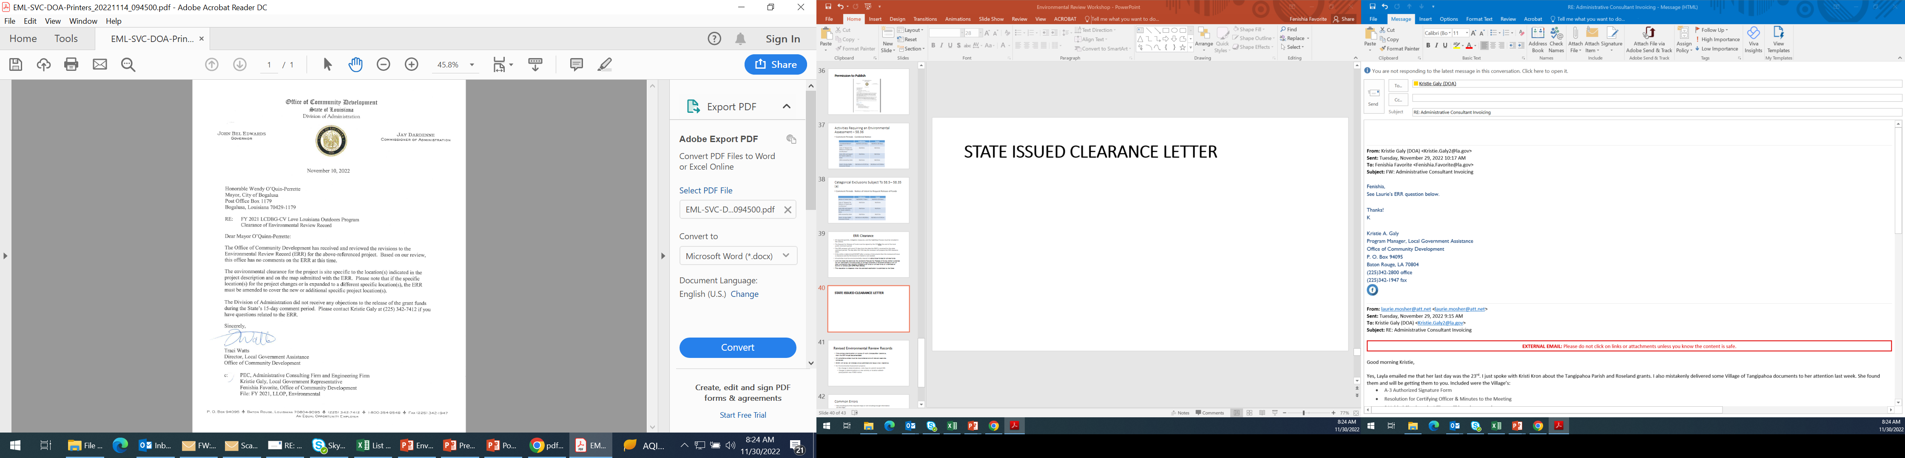
STATE ISSUED CLEARANCE LETTER

Slide 51
Revised Environmental Review Records
If the project site/location or scope of work changes after clearance, then the ERR must be amended. FORM A-20 MUST BE COMPLETED
All compliance areas must be reconsidered and all relevant agencies contacted.
OCD will review all changes once submitted and issue a new clearance.
For Environmental Assessment projects:
  No change in determinations - only have to submit revised ERR.
  Change in determinations or new activity or location added – post/publish new FONSI notice.

Slide 52
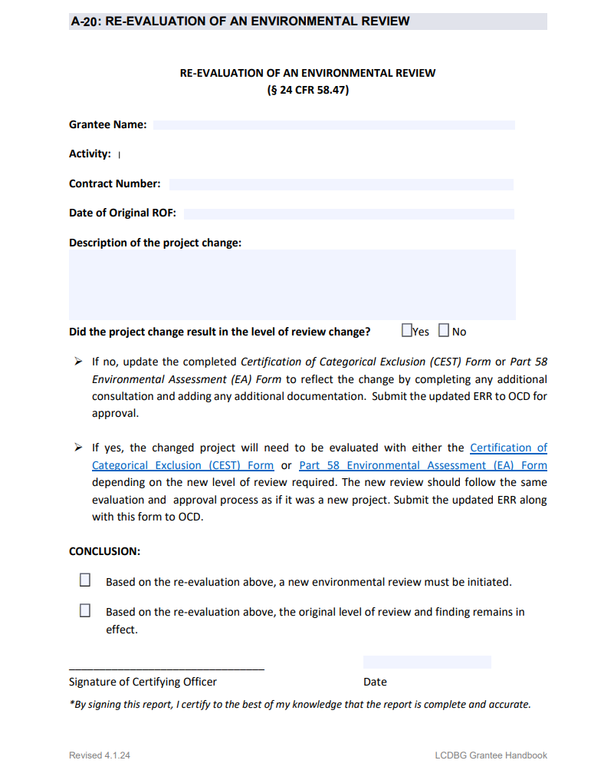

Slide 53
Common Errors
  Not including all of the required maps or not including enough information on the maps.
  Not including whether or not the project is site specific or not listing all proposed activities in the Project Description.
  Not following requests from tribes.
  Not signing and dating forms that require signatures.
  Not discussing alternatives in the Eight-Step Process.
  Request for Release of Funds not one page.
  Missing documentation to support determinations.
  Not making sure that the Statutory Worksheet and Checklist match (e.g., dates, names, etc.) and that all relevant information is included in the Statutory Checklist.
  Make sure you review the entire ERR before turning it in! This will minimize errors.

Slide 54
Questions??
Please contact Fenishia Favorite
  Fenishia.favorite@la.gov
225-342-5884
Staff that Review Environmental Review Records:
  Kristi Kron, Denease McGee & Sarah Underwood

