Slide 1
Today’s Agenda
In today’s session, we’ll be discussing:
  Types of ladders
  General ladder safety
  Step ladder safety
  Straight ladder safety

Slide 2
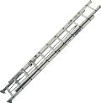

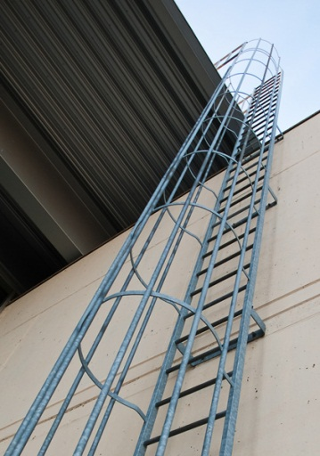
Types of Ladders
        Straight ladders are non-self-supporting ladders that include single section and extension ladders
Step ladders are hinged ladders that must be used in the open, or “A” frame, position
Fixed ladders are permanently mounted to a structure

Slide 3
General Ladder Safety
Inspect the ladder before each use. Check for:
  General condition of the side rails and rungs
  Grease, oil, and other slippery substances
  Missing parts
  Safety feet on straight and extension ladders
  Evidence of corrosion, heat, or chemical damage
Ladders are heavy: Get help carrying them or use carts whenever possible
NEVER USE A DAMAGED OR DEFECTIVE LADDER: TAG IT “DANGER - DO NOT USE” AND TAKE IT OUT OF SERVICE

Slide 4
General Ladder Safety
NEVER USE A METAL OR WET WOOD LADDER WHEN SERVICING ELECTRICAL EQUIPMENT OR WHEN WORKING WITHIN 10 FEET OF POWER LINES
Read and follow all label information on the ladder
Ladders must be set-up on stable, even surfaces
If foot or vehicle traffic could upset the ladder, take precautions to block the area
The area under and to the sides of the ladder should be blocked off to protect others from dropped objects

Slide 5
General Ladder Safety
Only one person is allowed on a ladder at one time unless the ladder is specially designed for multiple climbers
Always face ladders while climbing
Maintain three point contact (two feet and one hand) with the ladder while climbing
As a general rule, grasp the rungs while climbing rather than the side rails: your grip will be stronger

Slide 6
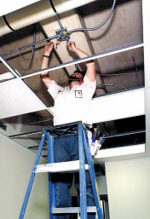
General Ladder Safety
Objects that are large and bulky should be hoisted up with a rope: do not carry objects that could change your center of balance or cause you to fall
Never over-reach (generally past an arm length from the center point of a ladder)

Slide 7
General Ladder Safety
Ladders should be returned to storage after use
Ladders should be stored flat, on edge, or secured with a chain if stored vertically
When in storage, ladders must be adequately supported to avoid distorting the supporting parts

Slide 8
Step Ladder Safety
Step ladders must be fully opened and locked when in use
Never lean a step ladder against a wall or other stationary object: the step ladder could slide out from under you
Never stand on the top step of the step ladder. Better yet, do not stand on the top two steps of a step ladder.

Slide 9
Straight Ladder Safety
The ladder must be placed against a secure point that supports both side rails
When accessing a roof or platform, the ladder must extend a minimum of three rungs above the elevation
To achieve the proper work angle, set the ladder base 1/4th the distance of the working height back from the vertical support

Slide 10
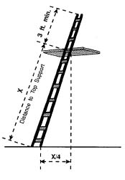
Straight Ladder Work Angle
The proper angle is achieved by keeping the ladder base 1/4th the working height distance away from the vertical support

Slide 11
Straight Ladder Safety
Be sure that the ladder locks engage and hold the extension section(s) in place
Never use straight ladders as stages, braces, or work platforms
Tie off the ladder at the top and bottom (using the side rails as anchors) if you will be using power tools or using significant physical force. A co-worker can also hold the ladder steady at the base.

Slide 12

Fixed Ladder Safety
Inspect anchorage to the structure as you climb: exit the ladder and report if any potential problems are observed
Follow the general ladder safety rules during use
[review any fixed ladder safety devices in your facility and insert here]

Slide 13
Conclusion
Ladders must be inspected before use: Never use damaged or defective ladders
Safety rules must be followed while using ladders to prevent serious accidents
The safety of the ladder user and others in the area of use must always be considered
After use, store ladders properly

