Slide 1

SAFETY SPOTLIGHT
Hazard Communication
Presented by:
State of Louisiana Office of Risk Management and Gallagher National Risk Control

Slide 2


Slide 3
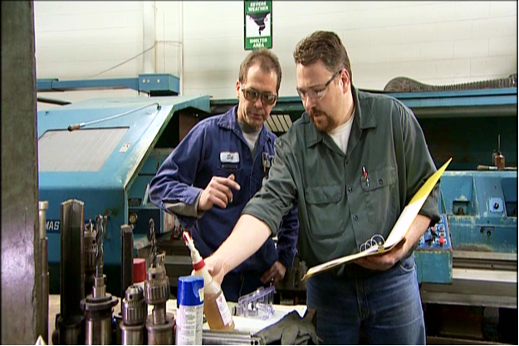
The HazCom Standard
Gives you the right to know about:
  Chemicals that are used in your workplace
  Possible dangers you could be exposed to
  How to protect yourself and
  others

Slide 4
Hazardous Chemical
A hazardous chemical is any chemical which is classified as a:
  Physical hazard
  Health hazard
  Simple asphyxiant
  Combustible dust
  Pyrophoric (“instantly igniting”) gas
  Hazard not otherwise classified

Slide 5





Physical Hazards
Physical hazards are chemicals that can cause:
  Fire
  Explosion
  Violent reaction

Slide 6



Health Hazards
Health hazards are chemicals that are harmful to your health and can
cause:
  Short-term (acute)
  health problems
  Long term (chronic)
  health problems

Slide 7
Health Hazards, continued…
OSHA considers a health hazard to be any chemical which:
  Is toxic
  Is corrosive to the skin or eyes
  Is a respiratory sensitizer
  May cause cancer, birth defects, or reproductive issues
  Attacks specific organs
  Is harmful or deadly when inhaled

Slide 8
Five Employer Requirements
1. Create a hazardous chemical inventory
2. Ensure each chemical has a GHS-style safety data sheet
3. Ensure each chemical container is properly labeled
4. Create and implement an employee training program
5. Develop a written HazCom program

Slide 9
The HazCom Chain
HazCom starts at the chemical manufacturing plant:
Chemists classify and categorize the chemical
Safety data sheets and labels are created
Safety data sheets and labels are passed along to each company and person who handles the chemical

Slide 10
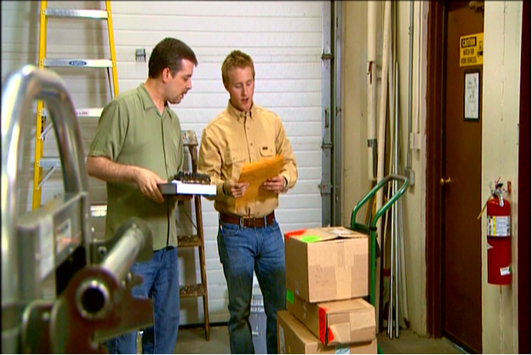
1. Chemical Inventory
When a chemical arrives at your company, hazard information is passed along with it.
This information is added to your company’s chemical inventory.
OSHA requires that each
company keep an inventory
on all its hazardous chemicals.

Slide 11
2. Safety Data Sheets (SDS)
Explain what you need to know to safely work
with a chemical
Must have the GHS-specified 16 section format
Must include certain types of information in each section, employees should focus on section 4-8
Help ensure that employers and employees understand the chemical
Must be readily accessible to employees in the
work area during each work shift

Slide 12
What are the features of a SDS?
Chemical manufacturers and importers must obtain or develop a safety data sheet for each hazardous chemical they produce or import. Employers must have a safety data sheet in the workplace for each hazardous chemical which they use.
(a) Section 1, Identification;
(b) Section 2, Hazard(s)
identification;
(c) Section 3, Composition/
information on
ingredients;
(d) Section 4, First-aid
measures;

Slide 13
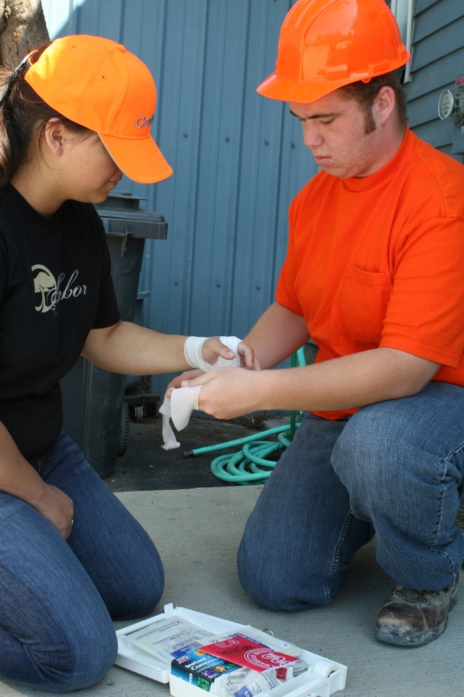
(e) Section 5, Firefighting
measures;
(f) Section 6, Accidental
release measures;
(g) Section 7, Handling
and storage;
(h) Section 8, Exposure
controls/personal
protection;
(i) Section 9, Physical
and chemical
properties;
(j) Section 10, Stability
and reactivity;
(k) Section 11,
Toxicological
information;

Slide 14

(12-15 Non-mandatory)
(l) Section 12, Ecological
information;
(m) Section 13, Disposal
considerations;
(n) Section 14, Transport
information;
(o) Section 15, Regulatory
information; and
(p) Section 16, Other
information, including
date of preparation or
last revision.

Slide 15
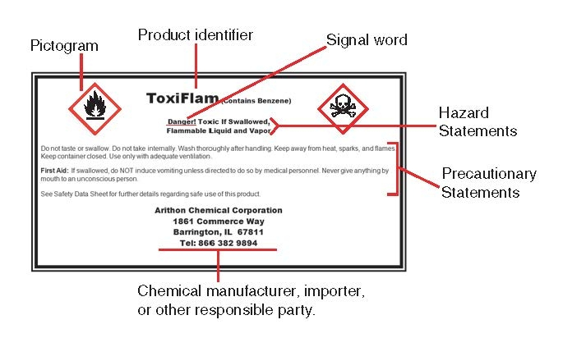
3. Labels

Slide 16
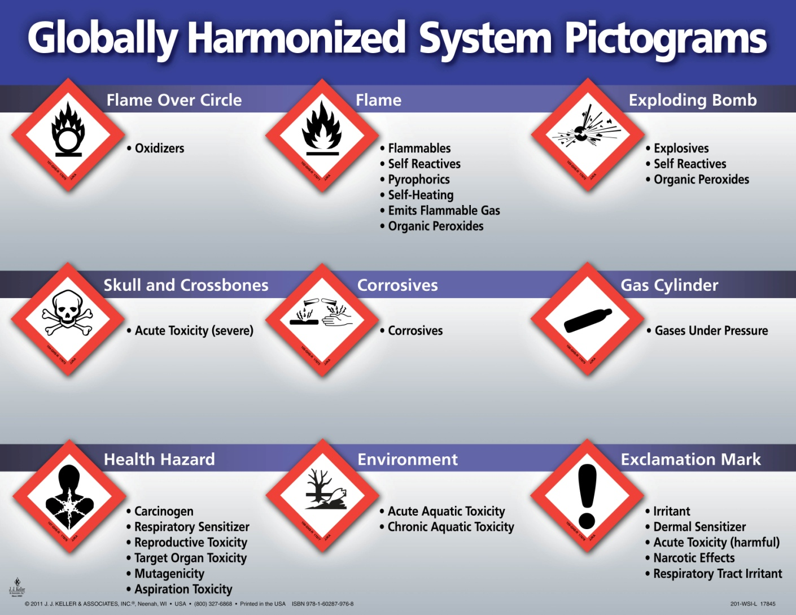
Pictograms

Slide 17
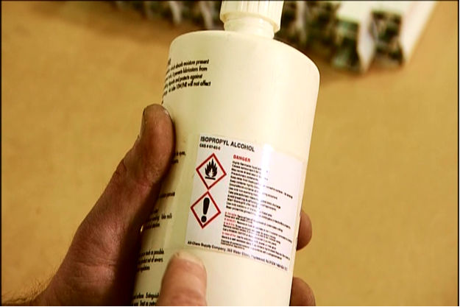
Re-Labeling
Re-labeling can take place when:
  Your employer chooses to use an OSHA-approved label in your workplace.
  A large quantity of a chemical is broken
  down into smaller ones to use
  in different areas.

Slide 18
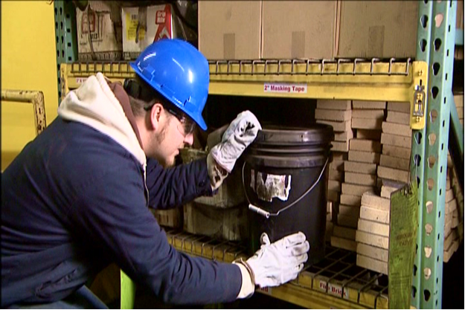
Re-Labeling, continued…
If you ever find a container with no label, or an illegible label, contact your supervisor.
Never use a chemical from an unlabeled container.

Slide 19
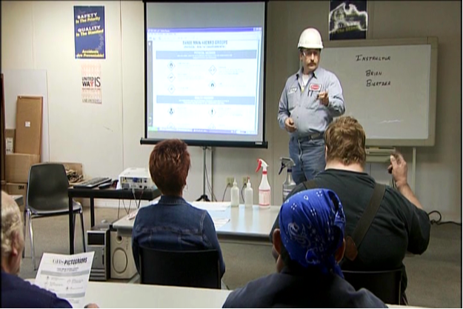
4. Training & Information
Employees must receive training on:
  HazCom Standard requirements
  Hazard chemical locations
  Chemical inventory
  Safety data sheets
  Labels
  Written HazCom program
  Specialized chemicals

Slide 20
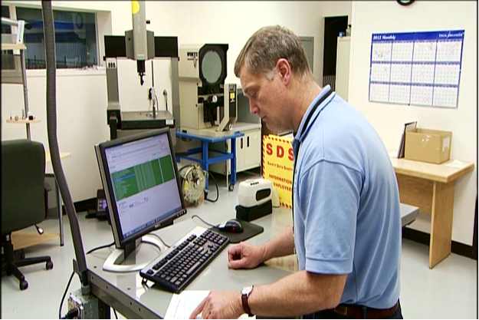
5. Written HazCom Program
Documents, in detail, your employer’s plans for communicating chemical hazards
You have a right to review the written HazCom program whenever you want.

