Slide 1

Procurement Workshop
Office of Community Development- Local Government Assistance

Slide 2

Contact Information
Kristie Galy, Program Manager
  Kristie.galy2@la.gov
  (225) 342-2800
Denease McGee, LCDBG Grant Representative
  Denease.mcgee2@la.gov
  (225) 342-7530
William Hall, CDBG Financial Analyst
  William.hall@la.gov
  (225) 219-3613

Slide 3

Agenda
Procurement General Principles/Policies
Federal Procurement Procedures and Records
Procurement Planning
  Process
  Evaluation
Format of Competitive Proposals
Final Notes

Slide 4
Purpose
To acquaint potential applicants of federally assisted programs with the federal grant procurement requirements; with an emphasis on utilizing competitive proposals for procurement of professional services
* Title 2 of the Code of Federal Regulations; Part 200; Subpart D, Sections 200.317 to 200.326

Slide 5
Procurement Policies

Slide 6
General Procurement Principles
All procurement transactions, regardless of dollar amount, must be conducted to provide “full and open competition” [2 CFR 200.319]. Some of the situations considered to be restrictive of competition include, but are not limited to:
  Placing unreasonable requirements on firms in order for them to qualify to do business. Requiring unnecessary experience and excessive bonding.
  Noncompetitive pricing practices between firms or between affiliated companies. Noncompetitive awards to consultants that are on retainer contracts.
  Organizational conflicts of interest. Specifying only a “brand name” product instead of allowing an “equal” product to be offered and describing the performance of other relevant requirements of the procurement.
  Any arbitrary action in the procurement process.
  Methods of procurement to be followed when purchasing materials and supplies or contracting for services must be included [2 CFR 200.320].
Notes:
Each local government needs to create and adopt a procurement policy.

Slide 7
General Procurement Principles
A code of conduct that prohibits elected officials, staff, or agents from personally benefiting from LCDBG procurement must be included. The policy should prohibit the solicitation or acceptance of favors or gratuities from contractors or potential contractors. Sanctions or penalties for violations of the code of conduct by either grantee officials, staff or agents, or by contractors or their agents must be identified [2 CFR 200.318 (c)(1)].
Proposed procurements must be reviewed by staff to avoid unnecessary and duplicative purchases. Also, consideration should be given to consolidating or breaking out procurements to obtain a more economical purchase. [2 CFR 200.318 (d)].
Affirmative efforts must be undertaken to hire women’s business enterprises, minority firms and labor surplus firms, both by the grantee and the project’s prime contractor [2 CFR 200.321].

Slide 8
General Procurement Principles
The method of contracting outlined in the policy should be acceptable (fixed price, cost plus fixed fee, purchase orders, etc.). Cost plus a percentage of cost contracts must be specifically prohibited if LCDBG funds are involved [2 CFR 200.323].
Procedures to handle and resolve disputes relating to procurement actions of the grantee must be included [2 CFR 200.318 (k)].
Methods of procurement to be followed when purchasing materials and supplies or contracting for services must be included [2 CFR 200.320].

Slide 9
General Procurement Principles
Conflicts of interest in the award and/or administration of contracts must be avoided. “No employee, officer, or agent must participate in the selection, award, or administration of a contract supported by a Federal award if he or she has a real or apparent conflict of interest.
Such a conflict of interest would arise when the employee, officer, or agent, any member of his or her immediate family, his or her partner, or an organization which employs or is about to employ any of the parties indicated herein, has a financial or other interest in or a tangible personal benefit from a firm considered for a contract.” (2 CFR 200.318 (c)(1)) Other federal regulations with which the grantee must comply are the conflict of interest requirements in 24 CFR 570.611.
Conflicts of interest may be governed also by state law (State’s “Code of Governmental Ethics”) or local law or ordinance. Policy and records. The federal procurement regulations require that the grantee document rationale for the method of procurement, selection of contract type, contractor selection or rejection, and the basis for the contract price for all procurement transactions in adherence to its procurement policy

Slide 10
Contract Types, Price, & methods

Slide 11
Procurement Records: Methods of procurement
Methods for fixed price purchases:
Micro purchase
  up to $10,000; competitive solicitation not required
Small purchase
  up to $30,000; quotations or other competitive solicitation required
Sealed Bids
  formal advertising; bids opened publicly; selection by price; fixed price contract awarded
Competitive Proposals
  cost and qualitative factors are considered; typically used for professional services; Request for Proposals [RFPs] and Request for Qualifications [RFQs]
* Pages 2 and 3 of LCDBG Procurement Procedures *

Slide 12
Methods of Procurement
Micro-purchase, Small Purchase &
Sealed Bid
Price Determination
Adherence to established process for different purchases
Competitive Proposals
Qualitative Factors and Cost
  select the proposal that represents the best value.
Results of the solicitation
Planning and Approach are required for different purchases

Slide 13
Procurement Records: Federal Contract Types
Fixed Price
  Certainty of performance, specific accomplishments and deliverables
Cost Reimbursement
  Performance uncertainties; efforts as well as accomplishments and deliverables
Time and Materials
  No performance certainty, efforts
* Pages 4 and 5 of LCDBG Procurement Procedures *

Slide 14
Procurement Records: Types of Prices
Lump Sum Price
  For a definable work product or deliverable; all contractor costs are contained in a single price
Unit Price
  For iterations of lump sum work products or deliverables
Billable Hours
  For applied work efforts with other costs included as overhead charges
Reimbursable Costs
  For work efforts and other significant itemized costs
* Pages 5 and 6 of LCDBG Procurement Procedures *

Slide 15
Competitive Proposals

Slide 16
Format of RFP and RFQ
Selection Criteria
  How the entity is selecting the offeror
  Threshold items for competition eligibility
  Competitive Evaluation Factors
Administrative
  Contract and Payment
  Person to contact
  Submission requirements
  Deadline for submittal

Slide 17
Format of Competitive Proposals
Objective
  Purpose of the RFP/RFQ
Project Description
  Entity has described the project in some detail for the proposers to estimate the work effort and time needed
Scope of Services
  What services are the municipalities seeking
  Contract and Payment
Request for Qualifications
  Statement of Qualifications
    General
    Introduction
    Background and Experience
    Specialized Knowledge if needed
    Personnel/Professional Qualifications

Slide 18
Procurement Planning: Competitive Proposal Process
Considerations
Requirements are: | Repeat/Familiar or | New/Unfamiliar
Project Goals/Objectives are: | Well defined or | General
Contract Tasks are: | Specified or | Proposed/Negotiated
Performance Approach is: | Less important or | More Important
Particular vendor selections are: | Less important or | More Important
Price/Cost vs. Qualitative factors -: | Price/Cost | Qualitative factors
Evaluation of Offerors are: | Minimal to Routine or | Extensive

Slide 19
Procurement planning: Competitive Proposal Process
Considerations
Requirements are: | Repeat/Familiar or | New/Unfamiliar
Project Goals/Objectives are: | Well defined or | General
Contract Tasks are: | Specified or | Proposed/Negotiated
Performance Approach is: | Less important or | More Important
Particular vendor selections are: | Less important or | More Important
Price/Cost vs. Qualitative factors -: | Price/Cost | Qualitative factors
Evaluation of Offerors are: | Minimal to Routine or | Extensive
Single Step Process
Issue Solicitation
Receive/Review Proposals
Select Contractor

Slide 20
Procurement Planning: Competitive Proposal Process
Considerations
Two Step Process:
Issue Solicitation
Receive/Review Proposals
Determine Qualified
Determine most advantageous
RE-evaluate listed offers
Choose best approach
Requirements are: | Repeat/Familiar or | New/Unfamiliar
Project Goals/Objectives are: | Well defined or | General
Contract Tasks are: | Specified or | Proposed/Negotiated
Performance Approach is: | Less important or | More Important
Particular vendor selections are: | Less important or | More Important
Price/Cost vs. Qualitative factors -: | Price/Cost | Qualitative factors
Evaluation of Offerors are: | Minimal to Routine or | Extensive

Slide 21
Procurement planning: Competitive Proposal Process
One Step Events:
Two Step Events:
Issue RFP/RFQ
Conduct pre proposal conference
Receive Proposals
Review all proposals
Initially evaluate all proposals
Determine qualified
Determine most advantageous
Interview [or reevaluate] most adv
Re –score or rank
Select/Offer BAFO Best and Final Offer
Negotiate final terms
Award
Debrief Unsuccessful
Issue RFP/RFQ
Receive Proposals
Review
Compare/Evaluate
Score
Rank
Select
Document Selection
Award
Debrief Unsuccessful

Slide 22
Evaluation Factors

Slide 23
Evaluation Factors
Select the source or sources whose proposal is the best value to the Government; the best value may not be the lowest price if other evaluation factors can establish a better value
Evaluation factors must
  Represent the key areas of importance and emphasis to be considered in the source selection decision; and
  Support meaningful comparison and discrimination between and among competing proposals.

Slide 24
Evaluation Factor Components
Evaluation Factor
  Subject Area; measurement indicator
Rating Criteria
  What specific information or data will be evaluated
Rating Factor Rationale
  How will this evaluation factor relate to contractor performance
Submission Requirements
  What information does the solicitation require proposers to submit to conduct the evaluation
Evaluation Basis
  How will the proposers information be compared and scored to determine contractor selection

Slide 25
Example
Evaluation Factor
  Proposer’s Capabilities: Size of Staff
Rating Criteria
  Proposer’s personnel by job specialty and number
Rating Factor Rationale
  Assumes larger workforce available will be more responsive and timely in contract performance
Submission Requirements
  Proposers will submit the job specialties required for the project and the number of those employed by the firm
Evaluation Basis
  Points awarded by number of positions and weighted by skill level

Slide 26
Evaluation Factors
* Do not have to use all four categories
Can use more than factor in the same category *
Qualifications
  What licenses, certifications, academic credentials do proposers have? - What licenses, certifications, academic credentials do proposers have?
Experience
  What have proposers done relevant to the procurement [types of/ comparable projects]?
  What have proposers done?
Capabilities
  What can proposers do? [size of staff; technical abilities]
  What can proposers do?
Past Performance
  How well have proposers done it?
Price/Cost
  For RFPs Price/Cost must be evaluated
  How well have proposers done it?
“The quality of the product or service shall be addressed in every source selection through consideration of one or more non-cost evaluation factors”
Notes:
QUALIFICATIONS – Typically does not provide “meaningful comparison and discrimination” among proposers
EXPERIENCE – Easy to evaluate but limited usefulness in establishing value *
CAPABILITIES – Very meaningful in establishing value; more time consuming to evaluate
PAST PERFORMANCE – Provides the most “meaningful comparison and discrimination” among proposers; usually is the most valuable bit is also the most difficult to evaluate

Slide 27
Evaluation Factors
Qualifications
  Lesser evaluation weight or threshold
Experience
  Lesser evaluation weight or threshold
Capabilities
  Medium weight
Past Performance
  Heavy weight

Slide 28
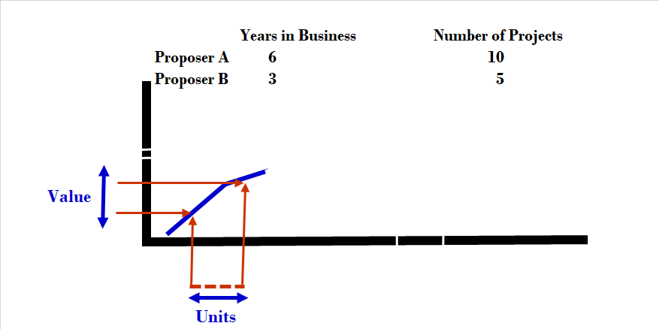
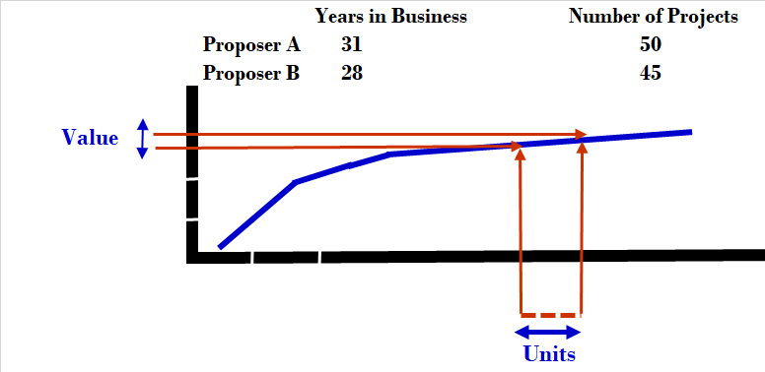
Experience
Experience – easy to evaluate but limited usefulness in establishing value

Slide 29
Evaluation Factor components
2 CFR 200.320(b)(2)
“The non-Federal entity must have a written method for conducting technical evaluations of the proposals received and making selections;”

Slide 30
Ratings/evaluation methods
Comparative Point Scale
Grouping Point Scale
Ordinal Ranking
Weighted Pointed System
Adjectival Rating Systems
* Evaluation Factor- Experience: Number of Projects in the last 5 years *

Slide 31
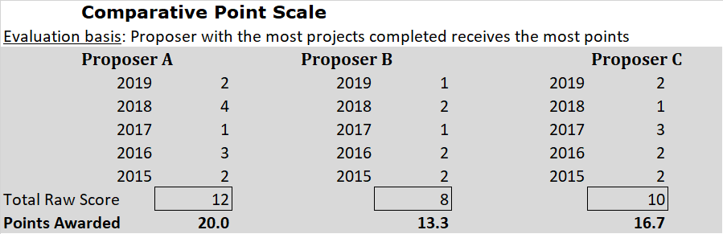
Ratings/evaluation method
Evaluation Factor- Experience: Number of Projects in the last 5 years

Slide 32
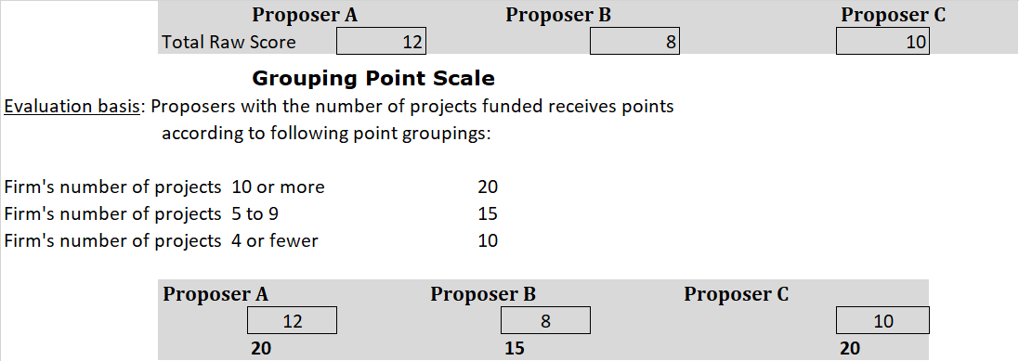
ratings/evaluation method

Slide 33
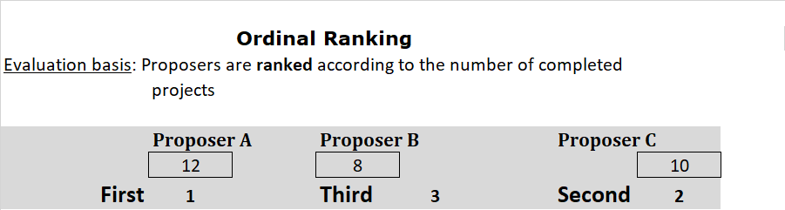
Ratings/evaluation method

Slide 34
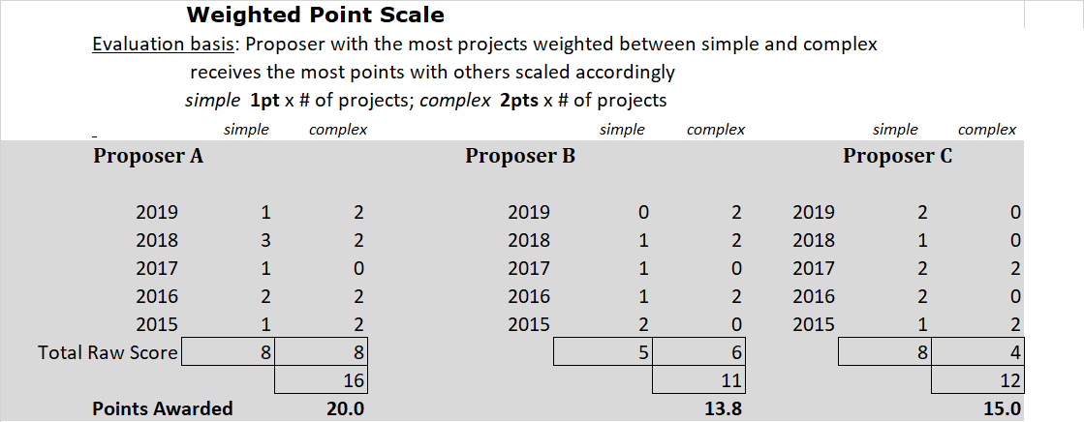
Ratings/evaluation method

Slide 35
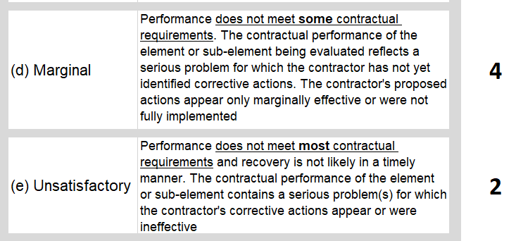
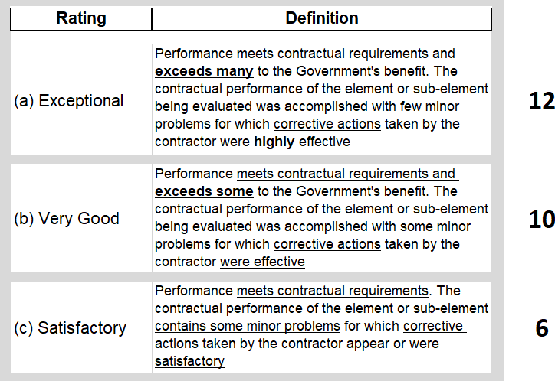
Ratings/evaluation method
Adjectival Rating Must have definitions!
Adjectival Rating typically used for “Past Performance”
* OCD-LGA will go into more depth regarding ratings and evaluations when we work with each municipality. *

Slide 36
Helpful Information

Slide 37
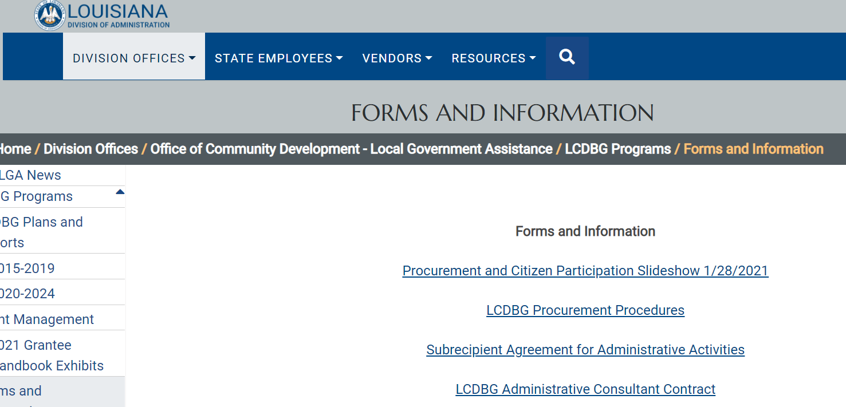
Federal grant administrative Requirements
Office of Community Development is federally funded by the U.S. Department of Housing and Urban Development
Department’s Procurement guidance is provided by HUD Handbook 7460.8
OCD’s Procurement guidance is provided on our website
  Forms and Information - Louisiana Division of Administration (la.gov)

Slide 38
Helpful Information
2 CFR § 200.101 Applicability.
  “The requirements established in this part apply to Federal agencies that make Federal awards to non-Federal entities. These requirements are applicable to all costs related to Federal awards.”
  “Administrative requirements. Subparts B through D of this part [Procurement] set forth the uniform administrative requirements for grant and cooperative agreements…”
§ 200.1 Definitions.
  “Non-Federal entity (NFE) means a State, local government, Indian tribe, Institution of Higher Education (IHE), or nonprofit organization that carries out a Federal award as a recipient or subrecipient..”
§ 200.318 General procurement standards.
  “The non-Federal entity must have and use documented procurement procedures, consistent with State, local, and tribal laws and regulations and the standards of this section, for the acquisition of property or services required under a Federal award or subaward.”

Slide 39
Helpful Information
2 CFR § 200.319
  “All procurement transactions must be conducted in a manner providing full and open competition consistent with the standards of this section. In order to ensure objective contractor performance and eliminate unfair competitive advantage, …
  Competition …contractors that develop or draft specifications, requirements, statements of work, or invitations for bids or requests for proposals must be excluded from competing for such procurements
Records 2 CFR § 200.317(h)
  “The non-Federal entity must maintain records sufficient to detail the history of procurement. These records will include, but are not necessarily limited to the following: rationale for the method of procurement, selection of contract type, contractor selection or rejection, and the basis for the contract price.”

Slide 40
Helpful Information
OCD-LGA is here to offer technical assistance throughout the procurement process
The RFQ/RFP cannot be solicited without OCD-LGA approval
If the municipality is paying for administration and engineering fees with local funds, OCD-LGA does not need to approve the solicitation.

Slide 41
Contact Information
Kristie Galy, Program Manager
  Kristie.galy2@la.gov
  (225) 342-2800
Denease McGee, LCDBG Grant Representative
  Denease.mcgee2@la.gov
  (225) 342-7530
William Hall, CDBG Financial Analyst
  William.hall@la.gov
  (225) 219-3613

Slide 42

Thank you

