Slide 1


Staying Cool
In The
Heat
Notes:
Thank you for including me…
My background – over 25 years of commercial Property and Casualty insurance experience, specializing in marketing, product development, and the utilization of client-facing technologies.
Began career with Willis, then was with Sedgwick which became Marsh, then spent the last 15 years with WGA and came into Gallagher as a merger partner in 2015.
Beyond all my marketing years, I was a producer while at Marsh and when I started at WGA, making me uniquely qualified to know what it takes for all of you to get the kind of opportunities I want to work on with you.

Slide 2

Types of Heat Stress
Symptoms and Treatment

Slide 3
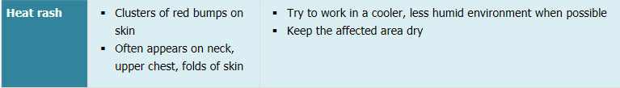
Heat Rash Symptoms/First Aid

Slide 4
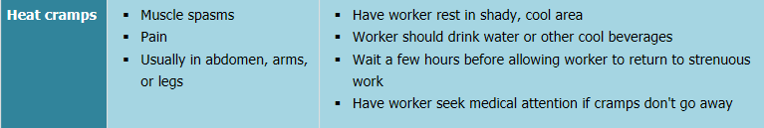
Heat Cramps Symptoms/First Aid

Slide 5
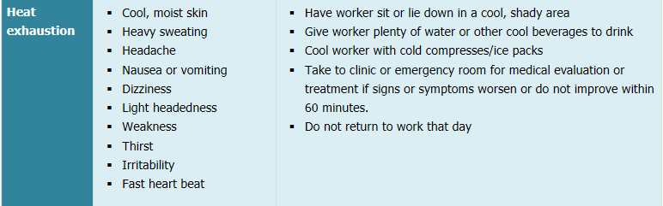
Heat Exhaustion Symptoms/First Aid

Slide 6
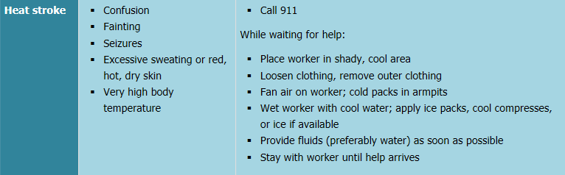
Heat Stroke Symptoms/First Aid

Slide 7
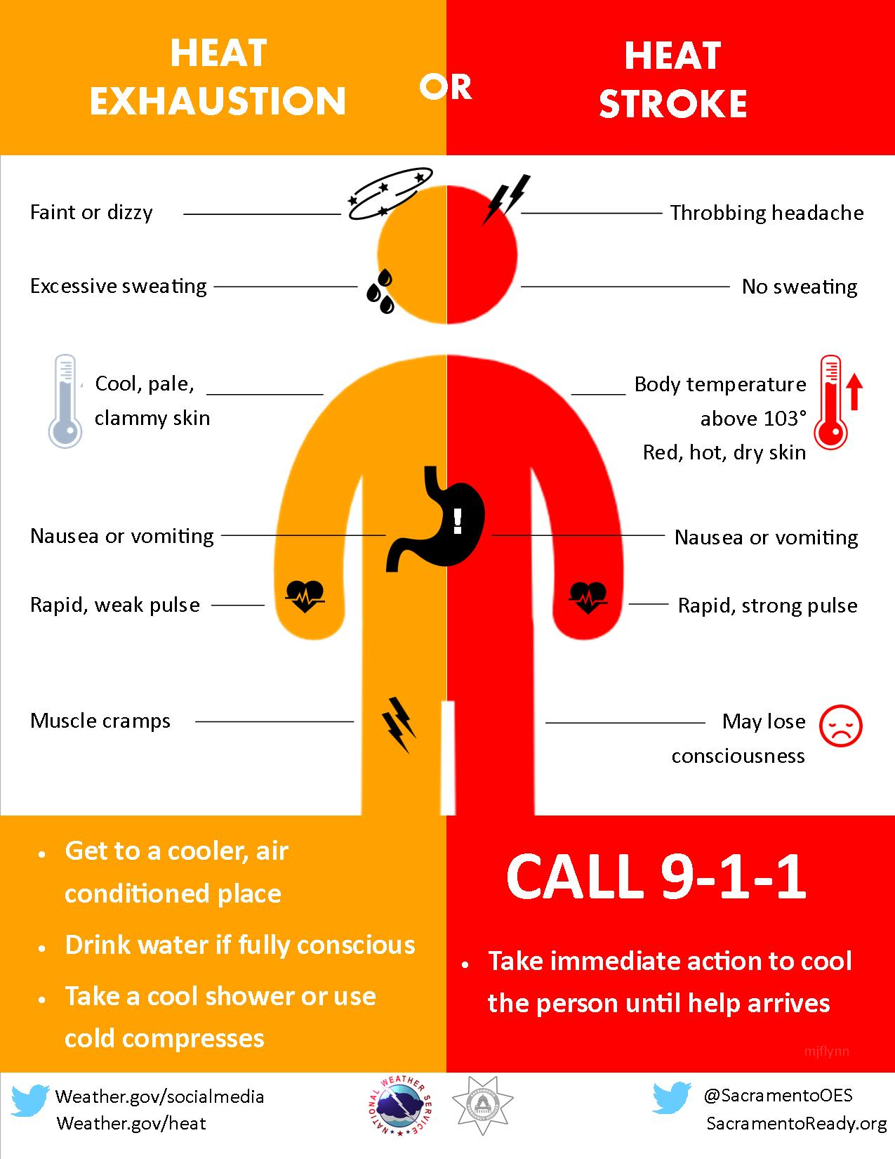

Slide 8
How to Prevent Heat Illness

Slide 9
Acclimation
Gradually increase workers’ time in hot conditions over 7 to 14 days.
For new workers:
  The schedule should be no more than 20% of the usual duration of work in the heat on day 1 and no more than 20% increase on each additional day.
For workers with previous experience:
  The schedule should be no more than 50% of the usual duration of work in the heat on day 1, 60% on day 2, 80% on day 3, and 100% on day 4.
Closely supervise new employees for the first 14 days or until they are fully acclimatized.
Non-physically fit workers require more time to fully acclimatize.
Acclimatization can be maintained for a few days of non-heat exposure.
Taking breaks in air conditioning will not affect acclimatization.

Slide 10
Hydration
If in the heat <2 hours and involved in moderate work activities, drink 1 cup (8 oz.) of water every 15–20 minutes.
During prolonged sweating lasting several hours, drink sports drinks containing balanced electrolytes.
Avoid alcohol and drinks with high caffeine or sugar.
Generally, fluid intake should not exceed 6 cups per hour.

Slide 11
Rest Breaks
Encourage co-workers to take appropriate rest breaks in order to cool down and hydrate.
Permit rest and water breaks when a worker feels heat discomfort.
Modify work/rest periods to give the body a chance to get rid of excess heat.
Assign new and unacclimatized workers lighter work and longer, more frequent rest periods.
Shorten work periods and increase rest periods:
  As temperature, humidity, and sunshine increase.
  When there is no air movement.
  If protective clothing or equipment is worn.
  For heavier work.

