Slide 1


Safe Vehicle
Backing
Notes:
Thank you for including me…
My background – over 25 years of commercial Property and Casualty insurance experience, specializing in marketing, product development, and the utilization of client-facing technologies.
Began career with Willis, then was with Sedgwick which became Marsh, then spent the last 15 years with WGA and came into Gallagher as a merger partner in 2015.
Beyond all my marketing years, I was a producer while at Marsh and when I started at WGA, making me uniquely qualified to know what it takes for all of you to get the kind of opportunities I want to work on with you.

Slide 2
Safe Vehicle Backing

Slide 3
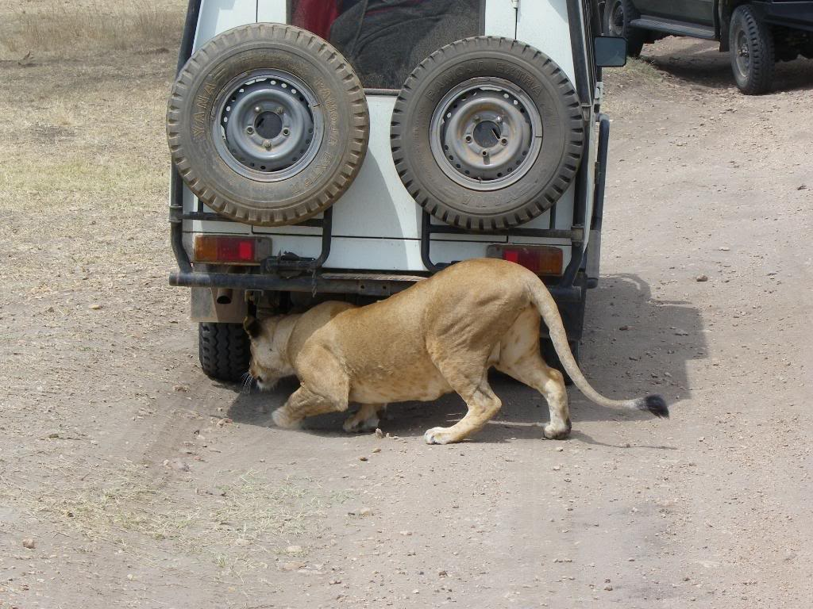
What’s behind you?

Slide 4
Introduction
Backing up isn’t easy:
  The driver’s seat faces forward, making it tough to turn to look and see behind the vehicle;
  Many cargo-carrying vehicles create giant blind areas where you can’t see; and
  Mirrors (and even TV camera systems) while helpful, can distort views and don’t cover every area unless positioned properly.

Slide 5
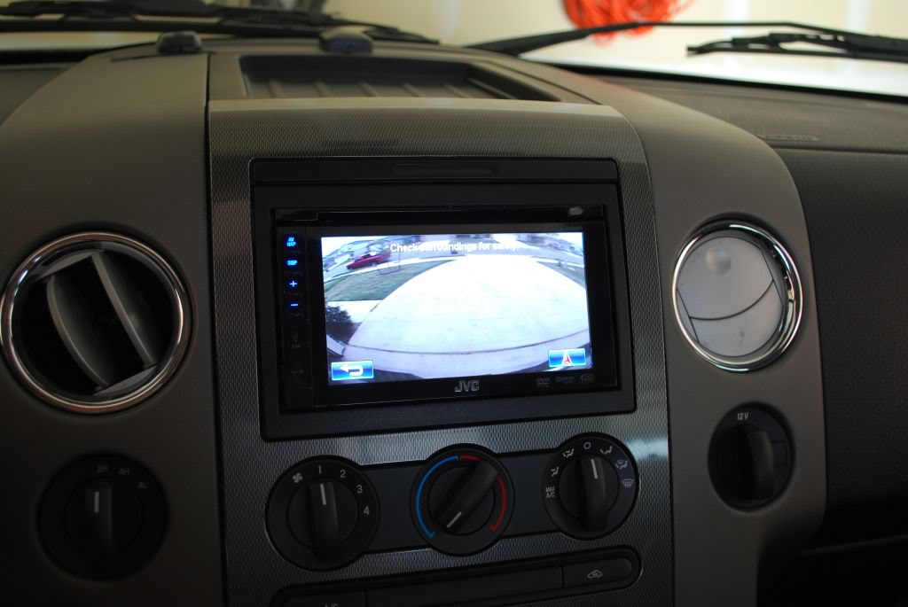
Introduction
Although there are new “aids” or “tools,” such as camera systems and sonar systems, the only certain way for any driver to know that there is enough room to maneuver is to get out and look.

Slide 6
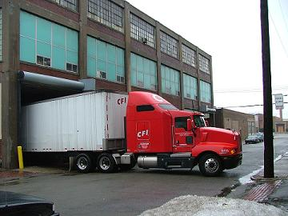
Introduction
Only by looking at exact clearances on either side of (and behind!) the vehicle can a driver spot what maneuvers will be needed to safely back into a parking or loading area.

Slide 7
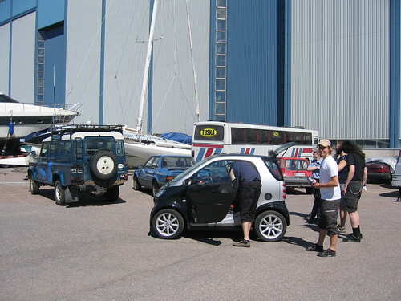
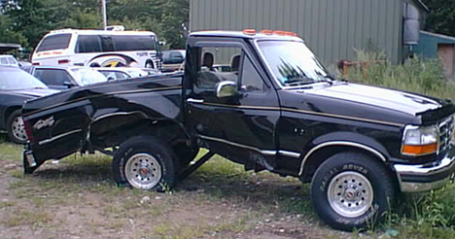
Vehicle Backing Safety
Think In Advance
Use a Spotter
Do a Walk-Around
Know Clearances
Backing out of a driveway

Slide 8

Think in Advance
Try to position vehicle so that you don’t have to back up.
Choose easy exit parking spots that don’t crowd neighboring vehicles.
Back into the space if possible when parking.
Back to the left if possible so you can see objects on the driver’s side.

Slide 9
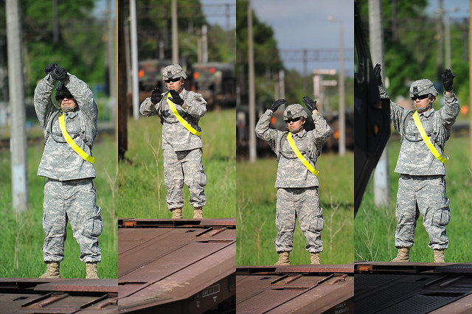
Use a Spotter
Use another person to help when backing.
Turn off radio and roll down window to hear what spotter is telling you.
Make sure driver and spotter clearly understand hand signals.
Don’t have spotter walking backwards while giving instructions.

Slide 10
Do a Walk-Around
Conduct a “circle of safety” walk-around to look for hazards.
Get back into vehicle ASAP.
Look over shoulders & check both mirrors.
Give two horn blasts before backing up.

Slide 11
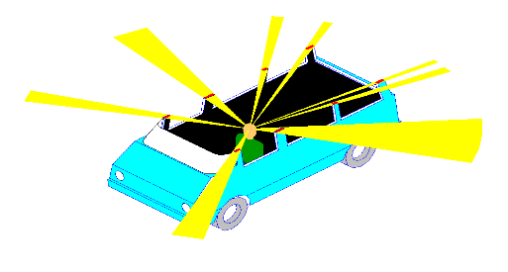
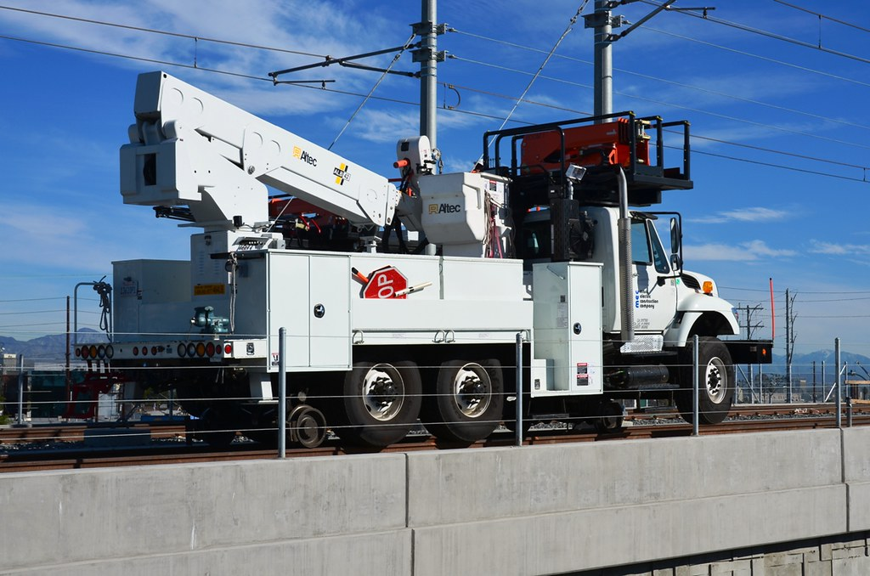
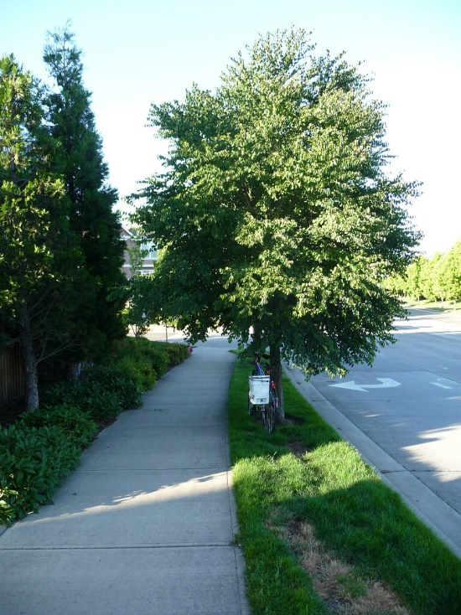
Know Clearances
6 Dimensions of Vehicle: front, back, left, right, above, and below.
Walk-around will identify obstructions, low hanging branches, or clearance-related problems.
Be vigilant of vehicle’s blind spots.

Slide 12
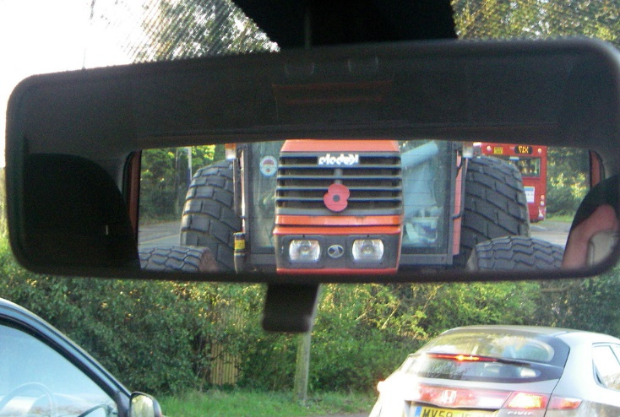
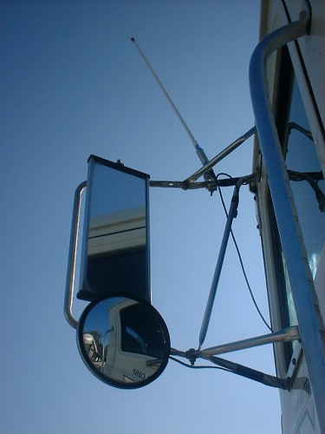
Backing Collisions
Other conditions or situations that may contribute to backing accidents include:
  Moving backwards without first looking to be sure that the area behind the vehicle is clear – no one can assume that it’s safe to back up
  Lack of, or inadequately designed, mirrors (size, shape, configuration)
  Improperly positioned mirrors (mounting locations)

Slide 13
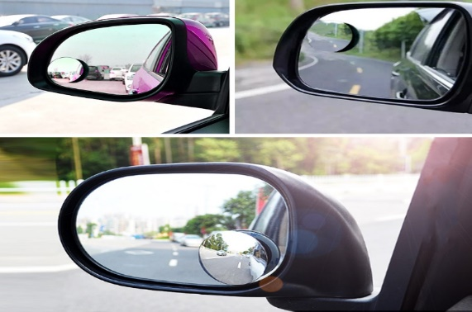
Backing collisions (cont..)
Other conditions or situations that may contribute to backing accidents include:
  Improperly adjusted mirrors (line of sight, minimize blind spots)
  Blind spots that cannot be easily corrected with mirrors (the area located immediately behind large vehicles)
  View blocks (signs, shrubs)
  Turning while backing (body of vehicle or trailer obscures target area)

Slide 14
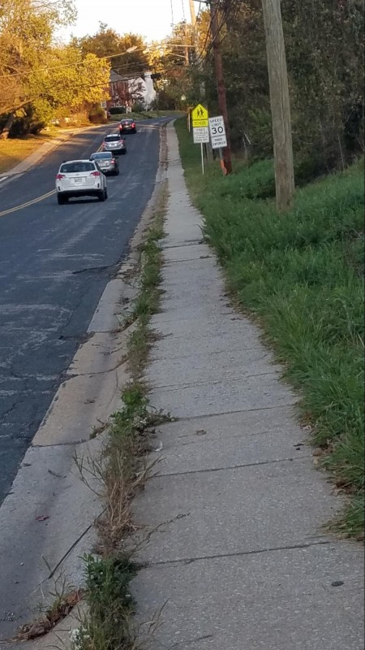
Backing collisions (cont.)
  Distractions caused by bystanders, traffic, improper signaling of helper, etc.
  Low visibility conditions (weather, night, enclosed docks, dimly lit garages)
  Hard to see physical barriers behind the vehicle (posts, cargo, pallets, etc.)
  Physical barriers which move behind the vehicle prior to, or during, the backing maneuver

Slide 15
Prevention Tips
  If your vehicle (sedan, SUV, pickup, van, etc.) has a rear window, use defoggers (if available) to melt snow/ice and keep the window clear.
  Take time to walk around your vehicle and look for people, vehicles, or other objects that may obstruct your start-up/back-up path.
  Don’t forget to look overhead to ensure a safe clearance.

Slide 16
Prevention Tips (cont..)
  Minimize distractions (turn off music or talk radio so that you can hear what’s happening around your vehicle)
  After the walk-around check, have no delay in moving vehicle. Don’t enable another hazard to approach your vehicle while you are getting ready to move.
  Avoid “blind side” backing (backing and turning simultaneously when the vehicle blocks the driver’s view).

Slide 17
Prevention Tips (cont..)
  Check your mirrors – are they both clean and adjusted to minimize any “blind areas”?
  Start up slowly at first to allow other vehicles and pedestrians, who may have unexpectedly approached, to safely move away.
  Tap horn in congested areas or recruit a spotter (if permitted by your agency’s policies) and practice hand signals to avoid confusion.

Slide 18
Prevention Tips (cont..)
  Turn off personal radios and lower window during back up moves to hear any verbal alerts/warnings.
  Stop before loading dock contact - get out and check the final distance to dock. (Serious injuries can occur when bystanders are pinched between vehicles and docks.)
  Make back-up moves slowly in order to stop quickly.

