Slide 1
E-Verify
Employment Eligibility Verification

Slide 2
ACT 402 of 2011
PROVIDES THAT AN EMPLOYER SHALL NOT BE SUBJECT TO PENALTIES IF:
Verify each employee in E-Verify, or
Each employee has provided picture ID and one of the following:
U.S. Birth Certificate or certified birth card
Naturalization Certificate
Certificate of Citizenship
Alien Registration Receipt Card
U.S. Immigration form I-94 (with employment authorized stamp)

Slide 3
What is E-Verify?
A no cost internet based system that electronically verifies the employment eligibility of newly hired employees
Partnership between the U.S. Department of Homeland Security and the Social Security Administration

Slide 4
What is E-Verify?
An extension of the I-9 process
Information from the I-9 must be entered into E-Verify no later than the 3rd business day after the employees’ start date
Fast, free and user-friendly
Offers automatic results for employers
Returns over 98% of employees as “work authorized”

Slide 5
LaGov HCM Paid Agencies Are Required to Participate in E-Verify no later than 01/01/2012

Slide 6
Enrolling in E-Verify
All LaGov HCM Paid Agencies will use the same tax id
72-1447520

Slide 7
Enrolling in E-Verify
Agencies will enroll as an Employer and set up a program administrator for program oversight
Each employer will be assigned a unique E-verify number.
E-Verify requires each account to have at least one program administrator user.
All program administrators for that employer can view all user information under that number.

Slide 8
Website to Enroll
https://e-verify.uscis.gov/enroll/
The enrollment process must be completed in a single web session.
Enrollment time = 15-30 minutes

Slide 9
User types and roles
Program Administrators
(2 or more recommended)
Register new users
Create E-Verify cases
View reports
Reset passwords
Update own profile
General Users (Optional)
Create E-Verify cases
View reports
Update own profile

Slide 10
Setting up Program Administrators and Users
E-Verify structure should be based on your agency’s organization
Questions to ask:
Centralized or decentralized?
How many users?
Internal procedures to develop?

Slide 11
E-Verify MOU
Memorandum of Understanding (MOU) is a legal agreement between DHS, SSA & your agency.
Each E-Verify account requires an MOU.
HR Director or someone at an equal or higher level must electronically sign MOU.

Slide 12
ENROLLMENT PROCESS OVERVIEW

Slide 13
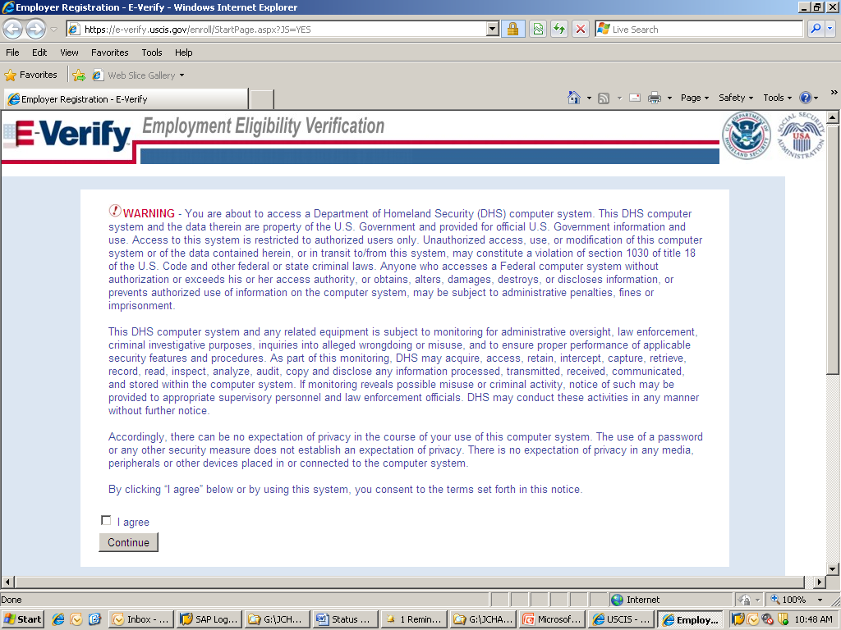

Slide 15
Before you enroll, you must decide:
Who will electronically sign the E-Verify memorandum of understanding (MOU) on behalf of your agency?
Which hiring sites will participate in E-Verify?
Which agency location(s) will access E-Verify?
Who in your agency will have access to E-Verify?
Who in your agency should be program administrators?

Slide 16
To enroll, you will need to know:
Contact information for your agency’s E-Verify memorandum of understanding (MOU) signatory (name, phone number, fax number and e-mail address)
Agency’s name
The physical address of the location from which your agency will access E-Verify
Agency’s mailing address (if different from the physical address)
Employer identification number (72-1447520) For LaGov HCM Paid Agencies Only
Total number of employees for all of your agency’s hiring sites that will participate in E-Verify (you’ll choose from a range of numbers)
The first three digits of your agency’s primary North American Industry Classification System (NAICS) code
The number of hiring sites that will participate in E-Verify
Notes:
.

Slide 17
All registering users must provide:
Name
Phone Number
Fax Number (optional)
E-mail Address

Slide 18
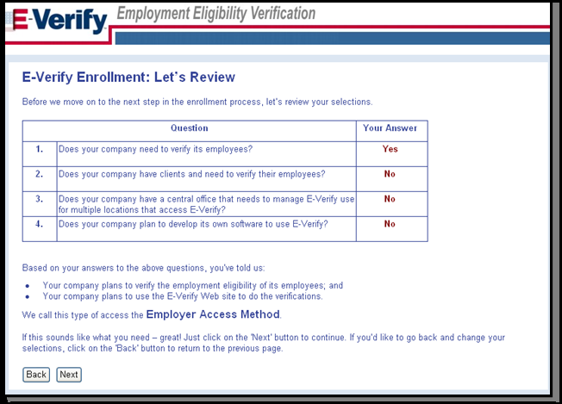
REVIEW AND CONFIRM ACCESS METHOD

Slide 19
SELECT YOUR ORGANIZATION DESIGNATION

Slide 20
REVIEW AND AGREE TO THE MOU

Slide 21
ENTER MOU SIGNATORY INFORMATION

Slide 22
ENTER COMPANY (AGENCY ) PROFILE

Slide 23
ENTER OR SELECT NORTH AMERICAN INDUSTRY CLASSIFICATION SYSTEM (NAICS) CODE

Slide 24
PROVIDE HIRING SITE INFORMATION

Slide 25
REGISTER E-VERIFY PROGRAM ADMINISTRATORS

Slide 26
REVIEW AND CERTIFY INFORMATION

Slide 27
After Enrollment
Must verify all newly hired employees
E-Verify cannot be used as pre-screening tool for applicants
Must display 2 required posters
Each user will receive an email confirmation
Username
Temporary password
E-Verify User Manual
Tutorial

Slide 28
After Enrollment
OSUP will issue a policy memo
Required documentation to send to OSUP:
OSUP E-Verify Enrollment Form
Signature page of MOU
E-Verify print out of agency’s profile information

Slide 29
E-VERIFY RESOURCES AND CONTACT INFORMATION
General information about E-Verify
Program information and statistics
Frequently asked questions
E-Verify user manuals & reference guides
Educational videos plus free webinars
Information about employee rights and employer obligations

Slide 30
E-Verify Customer Support
888-464-4218
877-875-6028 (TTY)
E-Verify@dhs.gov

Slide 31
OSUP Contact Information
Benefits & Financial Administration Unit
phone: (225) 342-0713
fax: (225) 219-4432
_doa-osup-bfa@la.gov

Slide 32
QUESTIONS

